Slide 1
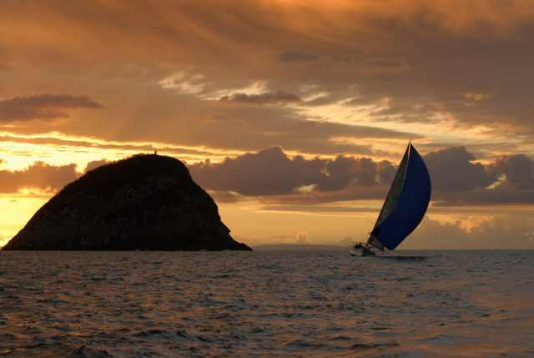
Academic Listening and Speaking
John Morris
KRIS, KMITL
previously
Engineering, Mahasarakham University
Electrical and Computer Engineering, The University of Auckland
Iolanthe II leaves the Hauraki Gulf under full sail –
Auckland-Tauranga Race, 2007

Slide 2
INtroduction
Academic Listening and Speaking

Slide 3
Aims
Focus on academic and technical
Listening and speaking
Preparation for
Technical meetings as engineers
Clients
Technical experts
Conferences
Technology updates
Presenting your research to other engineers
Technical reports and papers
New projects
Research

Slide 4
Assumptions
Basic English
You can
Introduce yourself
Ask simple questions in English
Explain simple things in English
You understand
Basic English grammar
Sentence structure
Tenses – past, present, future
Basic vocabulary
Maybe 400 words?

Slide 5
Assumptions
Fluent?
Generally, you can conduct intelligent conversations with 1000-3000 words (in any language)
At about 400 words, you should be able to travel reasonably easy in an English speaking country
get off the plane in Sydney
get to your hotel by train
find something that you can eat
MacDonalds does not count .. And is a health hazard!
find how to go to the Zoo (highly recommended in Sydney ☺ )

Slide 6
Assumptions
If you can pass the test on the previous slide
You are in ‘good shape’
IF you stay awake in classes
You will add 1000+ words before you graduate
Including 300+ technical terms
Approaching the conversational fluency level
Practice and be confident
On the ‘Introduce yourself’ sheet, estimate your fluency
Your benchmark is:
If I got off the plane in Sydney, would I manage
easily | OK | with difficulty

Slide 7
Your English is weak?
Do not panic!!
Practice and be confident
We can also arrange some additional sessions to help
One possibility …
Practice your English to teach ภาษาไทย
Several อาจารย์ฝรั่ง need your help!!

Slide 8
Background
Academic Listening and Speaking

Slide 9
English
Now language for
science and engineering,
trade,
travel,
diplomacy,
….
Used as official language in … ?
Can you name countries where English is the main language?
Official and majority language
One of the official languages
Commonly understood

Slide 10
Geography or Politics Test
English is
the official language in
an official language in
commonly used and understood in …

Slide 11
Geography or Politics Test
English is
the official language in
an official language in
commonly used and understood in …

Slide 12
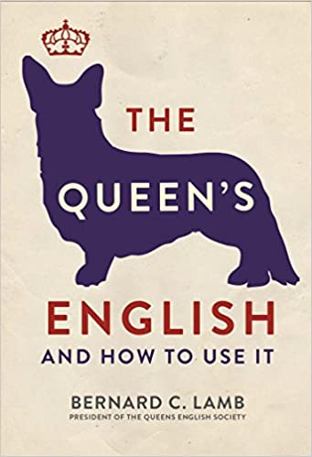
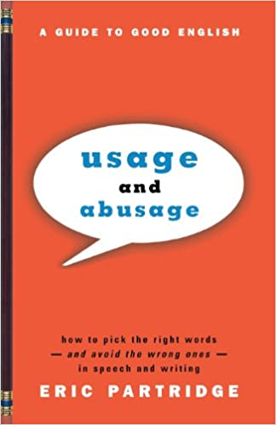
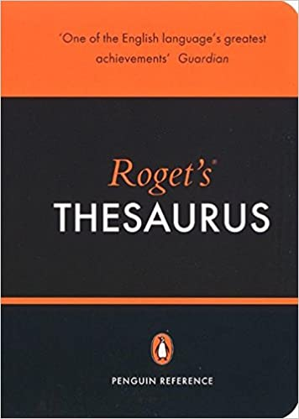
A Standard Language?
Written English
Basically well defined
Many textbooks available
The Queen’s English, B.C. Lamb, 2016
Usage and Abusage: A Guide to Good English, E Partridge, 2006
Roget’s Thesaurus, E. Davidson, 2004
several thousand more …
Generally they agree on the written language
Spelling however …

Slide 13
or A Living Language?
Written English has evolved
Basically well defined
Many textbooks available
The Queen’s English, B.C. Lamb, 2016
Usage and Abusage: A Guide to Good English, E Partridge, 2006
Roget’s Thesaurus, E. Davidson, 2004
several thousand more …
Generally they agree on the written language
Spelling however …

Slide 14
A Living Language
Written English has evolved though
Geoffrey Chaucer, 1342 – 1400, London
Author of “The Canterbury Tales”
Written in 1387-1392
Considered to be one of the greatest poetic works in English
Describes pilgrims on a journey to Canterbury

Slide 15
Chaucer, Canterbury Tales: 1387-1392 Prologue
Whan that Aprill with his shoures soote When April with its sweet-smelling showers The droghte of March hath perced to the roote, Has pierced the drought of March to the root, And bathed every veyne in swich licour And bathed every vein (of the plants) in such liquid Of which vertu engendred is the flour; By which power the flower is created; Whan Zephirus eek with his sweete breeth When the West Wind also with its sweet breath, Inspired hath in every holt and heeth In every wood and field has breathed life into The tendre croppes, and the yonge sonne The tender new leaves, and the young sun Hath in the Ram his half cours yronne, Has run half its course in Aries,

Slide 16
Canterbury Tales
Spelling – very different from modern use
shoures = showers
soote = sweet
Acceptable grammar has changed also
Your English teacher will fail you if you write
Whan that Aprill …
instead of
When April …
If you are worried that this course is for English specialists ..
Do not worry .. This is just some background history
Chaucer will not appear in the exam!

Slide 17
Evolution of English
By about 1600, the language had (almost) stabilized
With a little difficulty, you can read texts from this time on
A version of the Bible, the King James Version published in 1611
It is still in common use, if you go to a Christian church nearby,
It will probably be there

Slide 18
Bible, King James Version: 1611 Genesis
Words in modern English,
but with slightly different use
¹⁶And God made two great lights; the greater light to rule the day, and the lesser light to rule the night: he made the stars also.
¹⁷And God set them in the firmament of the heaven to give light upon the earth,
¹⁸And to rule over the day and over the night, and to divide the light from the darkness: and God saw that it was good.
¹⁹And the evening and the morning were the fourth day.
²⁰And God said, Let the waters bring forth abundantly the moving creature that hath life, and fowl that may fly above the earth in the open firmament of heaven.
²¹And God created great whales, and every living creature that moveth, which the waters brought forth abundantly, after their kind, and every winged fowl after his kind: and God saw that it was good.
²²And God blessed them, saying, Be fruitful, and multiply, and fill the waters in the seas, and let fowl multiply in the earth.

Slide 19
Bible, King James Version: 1611 Genesis
The ‘th’ ending has disappeared from modern use
¹⁶And God made two great lights; the greater light to rule the day, and the lesser light to rule the night: he made the stars also.
¹⁷And God set them in the firmament of the heaven to give light upon the earth,
¹⁸And to rule over the day and over the night, and to divide the light from the darkness: and God saw that it was good.
¹⁹And the evening and the morning were the fourth day.
²⁰And God said, Let the waters bring forth abundantly the moving creature that hath life, and fowl that may fly above the earth in the open firmament of heaven.
²¹And God created great whales, and every living creature that moveth, which the waters brought forth abundantly, after their kind, and every winged fowl after his kind: and God saw that it was good.
²²And God blessed them, saying, Be fruitful, and multiply, and fill the waters in the seas, and let fowl multiply in the earth.

Slide 20
Bible, King James Version: 1611 Genesis
Unusual usage
¹⁶And God made two great lights; the greater light to rule the day, and the lesser light to rule the night: he made the stars also.
¹⁷And God set them in the firmament of the heaven to give light upon the earth,
¹⁸And to rule over the day and over the night, and to divide the light from the darkness: and God saw that it was good.
¹⁹And the evening and the morning were the fourth day.
²⁰And God said, Let the waters bring forth abundantly the moving creature that hath life, and fowl that may fly above the earth in the open firmament of heaven.
²¹And God created great whales, and every living creature that moveth, which the waters brought forth abundantly, after their kind, and every winged fowl after his kind: and God saw that it was good.
²²And God blessed them, saying, Be fruitful, and multiply, and fill the waters in the seas, and let fowl multiply in the earth.

Slide 21
Evolution of English
Shakespeare, probably the most famous English writer, was writing his plays at this time also

Slide 22
Shakespeare, Hamlet: 1609 Genesis
Contraction
‘tis = it is
Unusual now, and definitely
not acceptable
in technical writing
To be, or not to be, that is the question:
Whether 'tis nobler in the mind to suffer
The slings and arrows of outrageous fortune,
Or to take arms against a sea of troubles
And by opposing end them. To die—to sleep,
No more; and by a sleep to say we end
The heart-ache and the thousand natural shocks
That flesh is heir to: 'tis a consummation
Devoutly to be wish'd. To die, to sleep;
To sleep, perchance to dream—ay, there's the rub:
For in that sleep of death what dreams may come,
When we have shuffled off this mortal coil,
Must give us pause—there's the respect
slings
flesh
heir
perchance
Modern English,
but usage varied
= died
Very famous …
Found often in modern writing

Slide 23
Evolution of English
Although understanding every word in Shakespeare presents a challenge for high school students in Australia + many other countries
About 95% is intelligible
Written English has evolved only slowly since 1600

Slide 24
Wilkie Collins, The Moonstone: 1868 First detective novel in English
By 1868,
spelling and grammar had
Stabilized.
I was expected to be able
to read this in school
when I was 13 years old.
In the first part of Robinson Crusoe, at page one hundred and twenty-nine, you will find it thus written:
“Now I saw, though too late, the Folly of beginning a Work before we count the Cost, and before we judge rightly of our own Strength to go through with it.”
Only yesterday, I opened my Robinson Crusoe at that place. Only this morning (May twenty-first, eighteen hundred and fifty), came my lady’s nephew, Mr. Franklin Blake, and held a short conversation with me, as follows:—
“Betteredge,” says Mr. Franklin, “I have been to the lawyer’s about some family matters; and, among other things, we have been talking of the loss of the Indian Diamond, in my aunt’s house in Yorkshire, two years since. Mr. Bruff thinks as I think, that the whole story ought, in the interests of truth, to be placed on record in writing—and the sooner the better.”
Not perceiving his drift yet, and thinking it always desirable for the sake of peace and quietness to be on the lawyer’s side, I said I thought so too. Mr. Franklin went on.
Only one phrase here is ‘tricky’
But this expression is common ..
A challenge for you ..
Can anyone explain it now?

Slide 25
Wilkie Collins, The Moonstone: 1868 First detective novel in English
A challenge for you ..
Can anyone explain it now?
In the first part of Robinson Crusoe, at page one hundred and twenty-nine, you will find it thus written:
“Now I saw, though too late, the Folly of beginning a Work before we count the Cost, and before we judge rightly of our own Strength to go through with it.”
Only yesterday, I opened my Robinson Crusoe at that place. Only this morning (May twenty-first, eighteen hundred and fifty), came my lady’s nephew, Mr. Franklin Blake, and held a short conversation with me, as follows:—
“Betteredge,” says Mr. Franklin, “I have been to the lawyer’s about some family matters; and, among other things, we have been talking of the loss of the Indian Diamond, in my aunt’s house in Yorkshire, two years since. Mr. Bruff thinks as I think, that the whole story ought, in the interests of truth, to be placed on record in writing—and the sooner the better.”
Not perceiving his drift yet, and thinking it always desirable for the sake of peace and quietness to be on the lawyer’s side, I said I thought so too. Mr. Franklin went on.

Slide 26
Spelling …..
On the other hand,
Although English and American professors of English will agree (mostly) on grammar issues
‘Standard’ spelling remains a challenge
Here is one difference
BRITISH | US
colour | color
flavour | flavor
humour | humor
labour | labor
neighbour | neighbor

Slide 27
English versus American spelling
Unfortunately, when preparing documents and papers,
You do need to know the difference!
Scientific journals will usually tell you
Read the instructions for authors!!
Some journals allow either, but insist on consistency,
i.e. you must use English spellings everywhere!
Otherwise, work out the target ..
English (UK, Australia, etc) or Americans ?
Europeans are generally flexible
Use a spell checker!
You should use one anyway!!
English spelling is NOT regular
Most spell checkers can be set to English or American spellings

Slide 28
English versus American spelling
Some more examples
BRITISH | US
apologize or apologise | Apologize
organize or organise | Organize
recognize or recognise | Recognize
analyse | analyze
breathalyse | breathalyze
paralyse | paralyze
travel | travel
travelled | traveled
travelling | traveling

Slide 29
English versus American spelling
These are harder
Words derived from Greek or Latin words that are best written in English with the ae or oe diphthongs
Americans tend to be lazier and substitute ‘e’
If your word processor allows, you can use æ or œ
These words have diphthongs in the original language,
e.g. οἶστρος in Greek
BRITISH | US
leukaemia | leukemia
manoeuvre | maneuver
oestrogen | estrogen

Slide 30
English versus American spelling
Some more examples
The original language is not consistent, e.g. French is la defense or licence
In this group, English usage follows the original language (with the unsounded ‘ue’ matching the ‘os’ in the original Greek) but Americans are generally lazier
BRITISH | US
defence | defense
licence | license
offence | offense
analogue | analog or analogue
catalogue | catalog or catalogue
dialogue | dialog or dialogue

Slide 31
PRONUNCiation ……………
On the other hand

Slide 32
Pronunciation
Varies widely!!
Even ‘native’ speakers have very different backgrounds
We can start with the ‘Queen’s English’ ..
Queen Elizabeth II - Christmas message
https://www.youtube.com/watch?v=pyb-7TwS8J4
US president - clips
https://www.youtube.com/watch?v=6DbhTwahqPg
Winston Churchill, UK prime minister during World War II
https://www.youtube.com/watch?v=MkTw3_PmKtc
Martin Luther King – anti segregationist
https://www.youtube.com/watch?v=vP4iY1TtS3s

Slide 33
Pronunciation
These were all great orators
They speak clearly and slowly
Although their pronunciation varies, we can follow them …
You can model your speech on any one of them!

Slide 34
Why can’t the English
https://www.youtube.com/watch?v=EAYUuspQ6BY
This song is one of the first arias (songs) in the musical, “My Fair Lady” by Lerner and Loewe, 1964
Based on an earlier play by George Bernard Shaw, “Pygmalion”, 1913
In the story, a flower seller, Eliza Doolittle,

Slide 35
Why can’t the English
Lyrics “Why can’t the English?” from “My Fair Lady”, Lerner and Loewe
Eliza: Aoo-ooo-ouw!
Higgins: Look at her, a prisoner of the gutters! Condemned by every syllable she utters! By rights, she should be taken out and hung, For the cold-blooded murder of the English tongue!
Eliza: Aaaaoouw!
Eliza: Aaaouw-
Higgins: Heavens what a sound. This is what the British population Calls an elementary education.
Pickering: Come sir, I think you've picked a poor example-
Higgins: Did I? Hear them down in Soho square, dropping aitches everywhere, Speaking English any way they like!

Slide 36
“Why can’t the English?” from “My Fair Lady”,
Lerner and Loewe
Lyrics
Scene: Outside a theatre in London
Eliza | Aoo-ooo-ouw!
Higgins | Look at her, a prisoner of the gutters! Condemned by every syllable she utters! By rights, she should be taken out and hung, For the cold-blooded murder of the English tongue!
Eliza: | Aaaaoouw! Aaaouw!
Higgins | Heavens what a sound. This is what the British population Calls an elementary education.
Pickering | Come sir, I think you've picked a poor example-
Higgins | Did I? Hear them down in Soho square, dropping aitches everywhere, Speaking English any way they like!

Slide 37
“Why can’t the English?” from “My Fair Lady”,
Scene: Outside a theatre in London
Eliza | Aoo-ooo-ouw!
Higgins | Uh, You, sir, did you go to school?
Bystander | What d'you tike me for, a fool?
Higgins | Well, no one taught him 'take', not 'tike', Hear a Yorkshireman, or worse, Hear a Cornishman converse- I'd rather hear a choir singing flat. Chickens cackling in a barn, Just like this one-
Eliza | Garn!
Higgins | Garn...- I ask you sir, what sort of word is that?…
Pickering | I beg your pardon!

Slide 38
“Why can’t the English?” from “My Fair Lady”,
Scene: Outside a theatre in London
Higgins | An Englishman's way of speaking absolutely classifies him- The moment he talks he makes some other Englishman despise him! One common language I'm afraid we'll never get. Oh why can't the English learn to set A good example to people whose English is painful to your ears? The Scotch and the Irish leave you close to tears! There even are places where English completely disappears- Well, in America they haven't used it for years! Why can't the English teach their children how to speak? Norwegians learn Norwegian, The Greeks are taught their Greek. In France, every Frenchman knows his language from A to Z- The French don't care what they do, actually, As long as they pronounce it properly. Arabians learn Arabian with the speed of summer lightning, The Hebrews learn it backwards which is absolutely frightening! Use proper English you're regarded as a freak, Oh why can't the English learn to speak!

Slide 39
Can give you a headache …
Cockney – the dialect of London
Appears in many films and musicals (including My Fair Lady)
https://www.youtube.com/watch?v=1WvIwkL8oLc
Almost English …
https://www.youtube.com/watch?v=U-1SPdgcgeA
https://www.youtube.com/watch?v=XQCHoKAq9xA

