Slide 1
Academic Listening and Speaking Humour
John Morris
KRIS, KMITL
previously
Engineering, Mahasarakham University
Electrical and Computer Engineering, The University of Auckland
Iolanthe II leaves the Hauraki Gulf under full sail –
Auckland-Tauranga Race, 2007

Slide 2
HUMOUR IN ENGLISH
Enhancing your fluency

Slide 3
Humour
Understanding humour
Requirement for fully understanding the language!
English humour found in
Books
Poems
Plays
Farce
Movies
and sometimes even in
TV dramas

Slide 4
Humour in ordinary speech
Apart from stories about daily life
Some special forms
Puns
Malapropism
Wit
Sarcasm
Sometimes not considered humour

Slide 5
Jokes
Appear in every language
One famous English example
From UK parliament
Winston Churchill (Prime Minister in World War II) was often attacked by
Lady Astor (member of the opposition)
One famous exchange
Lady Astor: Winston, if you were my husband, I would poison your tea!
Churchill: Madam, if I was your husband, I would drink it.

Slide 6
Puns
Plays on words
Rely on
Homophones
Same sound, but different spelling and meaning
Homonyms
Same spelling but several meanings
Classic pun
The two pianists had a good marriage. They always were in a chord.
Here the ‘play’ is
a chord = in music: a set of notes in harmony
and
accord = agreement
Here sound is same,
but spelling and meaning differ!
This pun might be difficult to follow when spoken, but easily recognized when written

Slide 7
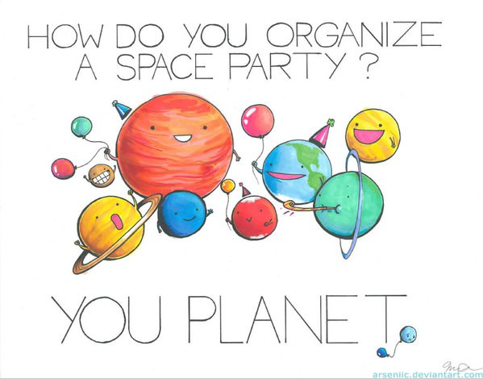
Puns
Here sound is similar,
but spelling
plan it … planet .. and meaning differ!
But it would be very difficult to
hear difference plan <pause> it vs planet (together)

Slide 8
Puns
Do you know the other word (if differently spelt) or
meaning (if there are two meanings) ??
Santa Claus' helpers are known as subordinate Clauses.
She had a photographic memory but never developed it.
The two pianists had a good marriage. They always were in a chord.
I was struggling to figure out how lightning works, but then it struck me.
The grammarian was very logical. He had a lot of comma sense.
A chicken farmer's favorite car is a coupe.
What do you call a person rabid with wordplay? An energizer punny.
I've been to the dentist many times so I know the drill.
What did one plant say to another? What's stomata?
The other day I held the door open for a clown. I thought it was a nice jester.
A chicken crossing the road is truly poultry in motion.
The politician is not one for Indian food. But he's good at currying favors.
How do construction workers party? They raise the roof.

Slide 9
Puns
A boiled egg every morning is hard to beat.
When a woman returns new clothing, that's post-traumatic dress syndrome.
After hours of waiting for the bowling alley to open, we finally got the ball rolling.
Two antennas met on a roof, fell in love and got married. The ceremony wasn't much, but the reception was brilliant!
Always trust a glue salesman. They tend to stick to their word.
Guerrilla warfare is more than just throwing a banana.
The cartoon animator felt imprisoned by his job. He could not free himself from his cel.
I thought Santa was going to be late, but he arrived in the Nick of time.
Every calendar's days are numbered.
A bicycle can't stand on its own because it is two-tired.
No matter how much you push the envelope, it will still be stationery.
A dog gave birth to puppies in the street and was cited for littering.

Slide 10
Puns
A pessimist's blood type is always B-negative.
I went to a seafood disco last week... and pulled a mussel.
Two peanuts walk into a bar, and one was a-salted.
Reading while sunbathing makes you well red.

Slide 11
Puns
Over to you …..
Thai has many homophones,
easy to make puns!!
Contribute some to this lesson!!

Slide 12
Malaprops or Malapropism
Unintentional use of a word wrongly
Mistakes by the writer or speak
From the French .. mal = bad
apropos = placed
Name of a character, “Mrs Malaprop” in “The Rivals”, Sheridan, 1775.
Mrs Malaprop constantly used words incorrectly
"Sure, if I reprehend any thing in this world it is the use of my oracular tongue, and a nice derangement of epitaphs!“
☺ Basically nonsense!!
Mrs Malaprop meant
"If I apprehend anything in this world, it is the use of my vernacular tongue, and a nice arrangement of epithets"

Slide 13
Malaprops
Unintentional use of a word wrongly
Example
Donald Trump, soon after becoming president
@realDonaldTrump:
“China steals United States Navy research drone in international waters — rips it out of water and takes it to China in unpresidented act.”
Trump meant to write “unprecedented”
This tweet has apparently been corrected, but not before it had been widely read ..
and
Used as the title of one of his biographies!!

Slide 14
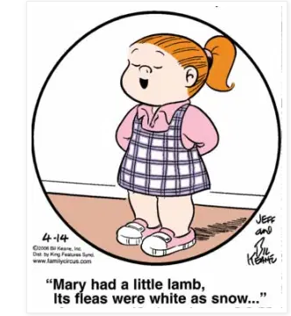
Malaprops
Unintentional use of a word wrongly
From a famous nursery rhyme
Can you pick this one?

Slide 15
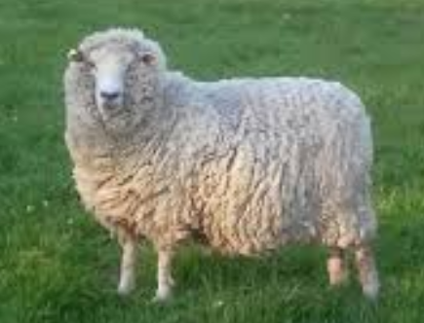
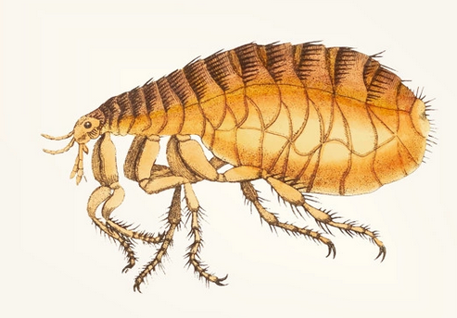
Malaprops
Unintentional use of a word wrongly
From a famous nursery rhyme
Can you pick this one?
The wool of a sheep is its fleece
This is a flea
Fleas and
fleece are
homophones
English test: fleece has another meaning – Do you know it?

Slide 16
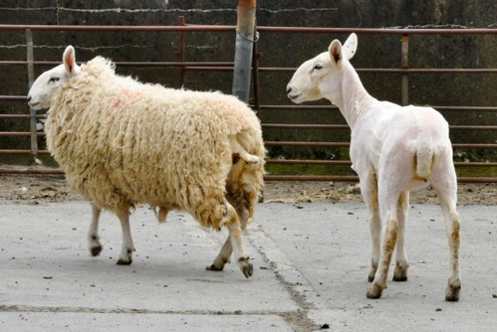
Malaprops
Unintentional use of a word wrongly
After you have been
fleeced you look
like this ..
So ‘to fleece’ means
to steal everything from someone!
English test: fleece has another meaning – Do you know it?

Slide 17
Double-entendre
From French:
Double = two
Entendre = hear
To hear something twice
First with one meaning (maybe the literal, expected one)
Second with a new interpretation
Most commonly used for puns with
Rude or Sexual Meanings
Double entendre allows you to use it in polite company
(or in front of your grandmother ☺
Example: Are we all on the same page?
Meaning: On the same page in the book
Also: Do we all understand it

Slide 18
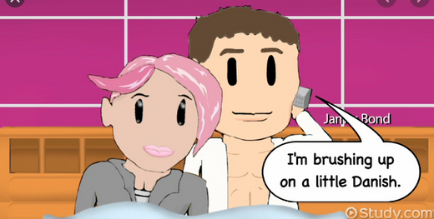
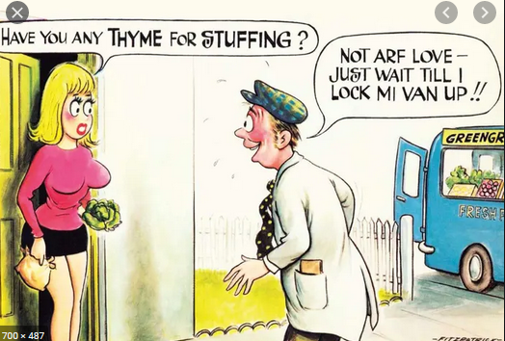
Double-entendre
Examples

