Slide 1
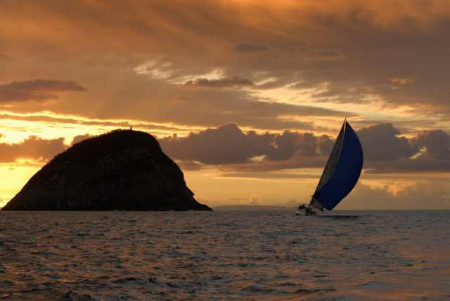
TECHNICAL WRITING WORKSHOP
Theme
KISS … Keep It Simple: .. and get accepted!
John Morris
KRIS, KMITL
previously
Engineering, Mahasarakham University
Electrical and Computer Engineering, The University of Auckland
Iolanthe II leaves the Hauraki Gulf under full sail –
Auckland-Tauranga Race, 2007

Slide 2
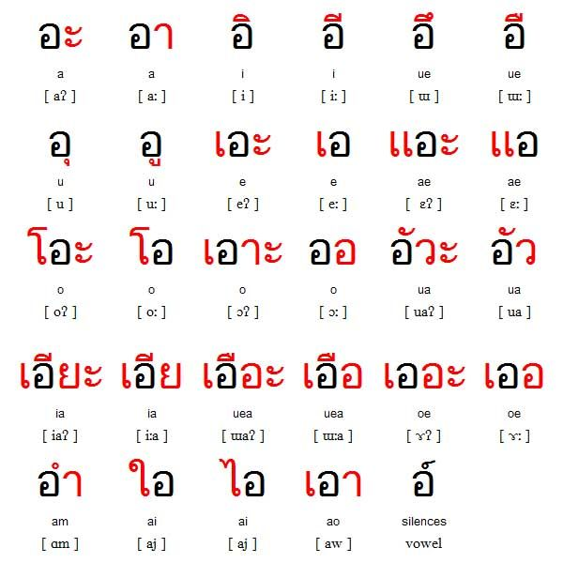
Self Introduction
John Morris, PhD(Sydney)
Before coming to KMITL ..
Assoc Professor, Electrical and Computer Engineering/Computer Science, University of Auckland, New Zealand
Engineering, Mahasarakham University
Current study

Slide 3
Brief CV
PhD – University of Sydney, Australia – optical spectroscopy
Post-doctoral:
National Research Council of Canada, Ottawa
University of Tokyo (東京大学), Japan
University positions
University of Melbourne, Physical Chemistry
University of Tasmania, Computer Science
University of Western Australia, Electrical Engineering
University of Auckland, Elec and Computer Engineering/Computer Science
Mahasarakham University, Engineering
Visiting
Institute for Molecular Science (分子科学研究所), Okazaki, Japan
Osaka University (大阪大学), Japan
MIT, Cambridge, USA
Case Western Reserve University, Cleveland, USA
ChungAng University (중앙대학교), Seoul, Korea
Kyung-pook University (경북대학교), Daegu, Korea
Shandong University (山东大学), Jinan, China
Kaohsiung National University, Kaohsiung, Taiwan

Slide 4
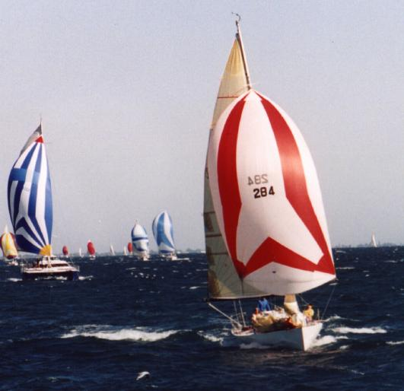
When not working …
Iolanthe
Iolanthe at 14 knots, Cockburn Sound, Western Australia

Slide 5
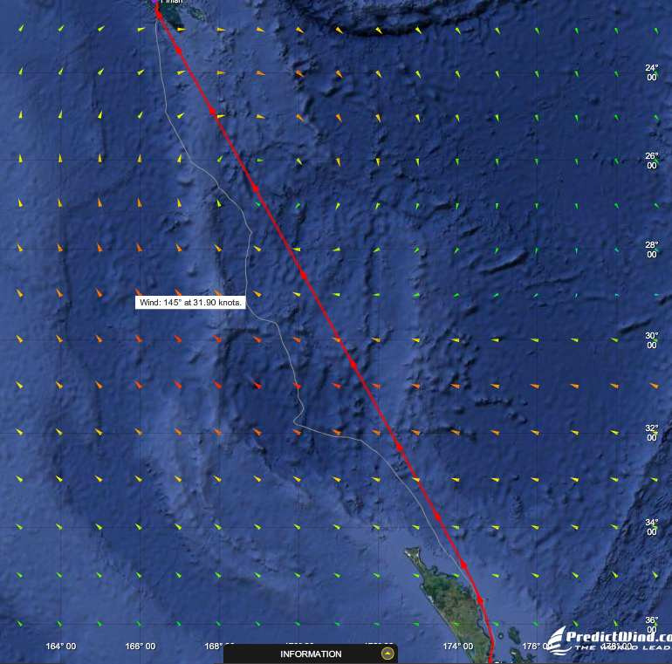
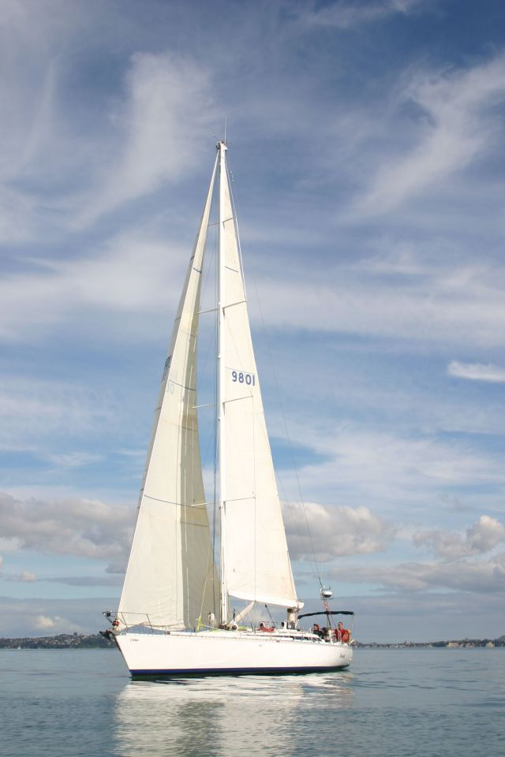
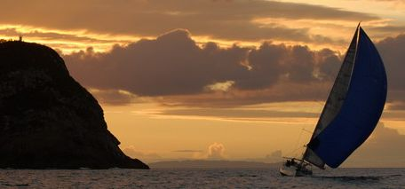
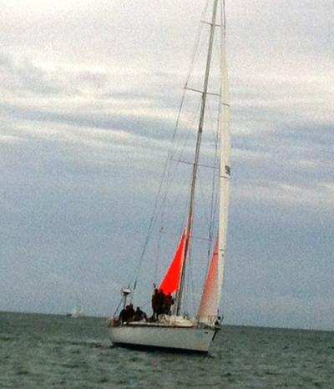
When not working …
Iolanthe II
Track – New Zealand to New Caledonia, 2012
Channel Island, Entrance to Hauraki Gulf
Hauraki Gulf, Auckland
Arriving Noumea, New Caledonia, 2012

Slide 6
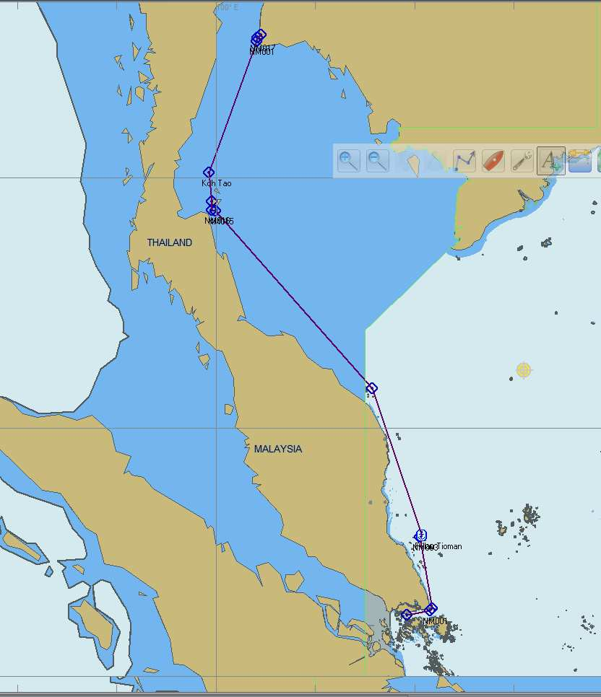
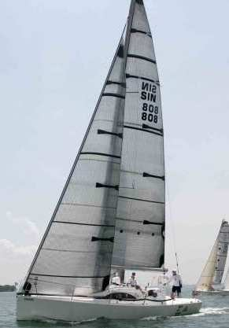
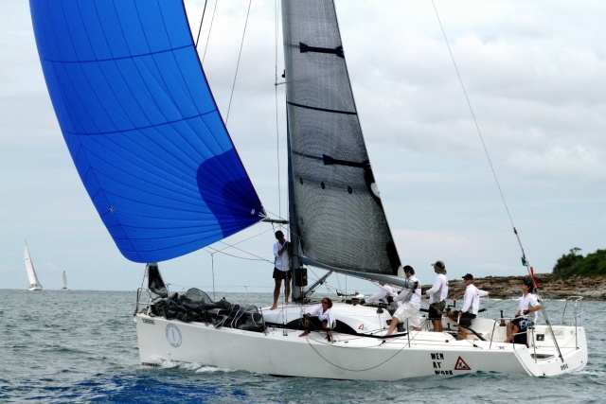
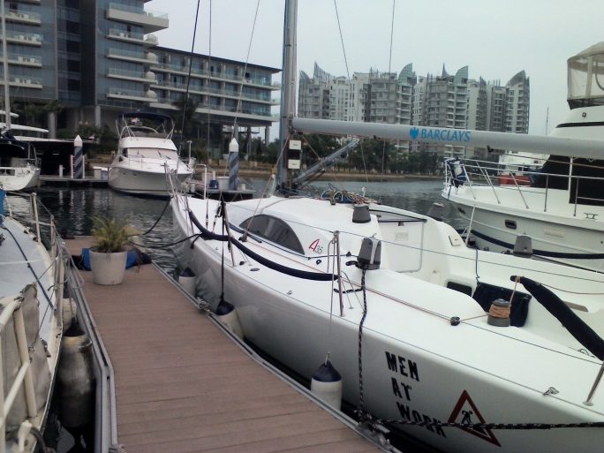
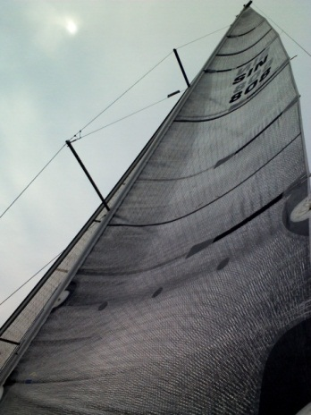
Iolanthe III
Singapore - Malaysia - Koh Samui – Koh Tao – Sattahip, January 2-20, 2013

Slide 7
Technical Papers in ENGLISH

Slide 8
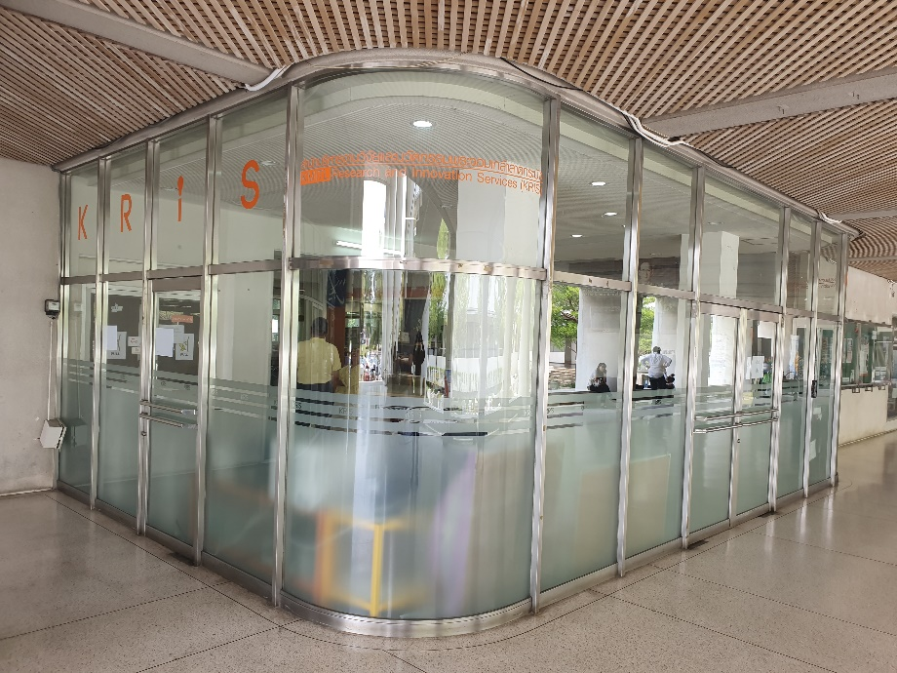
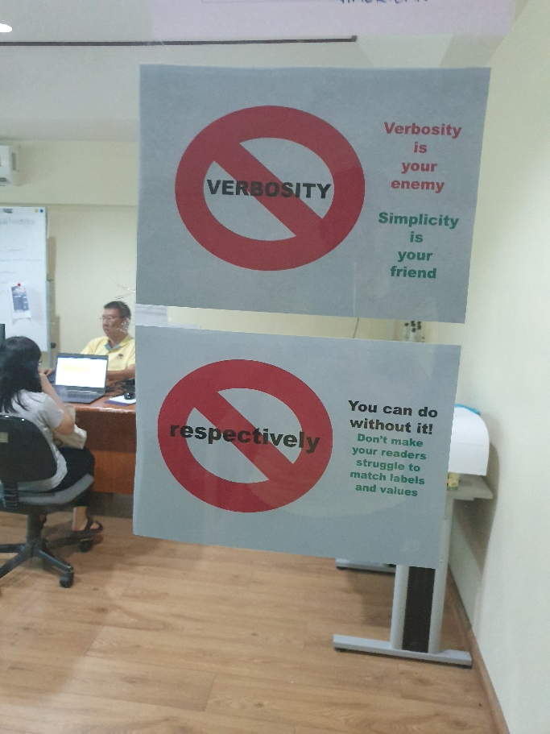
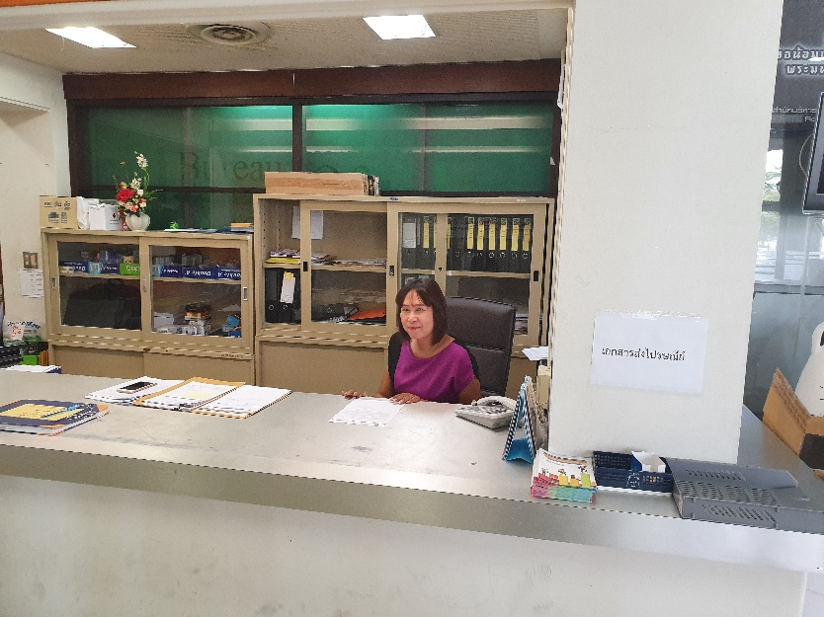
Help - KRIS Research Clinic
http://kris.kmitl.ac.th/research-clinic/
KRIS office
Our office
☺ Read the signs before entering ☺
Our friendly receptionist
She prefers that you speak 日本话 ☺

Slide 9
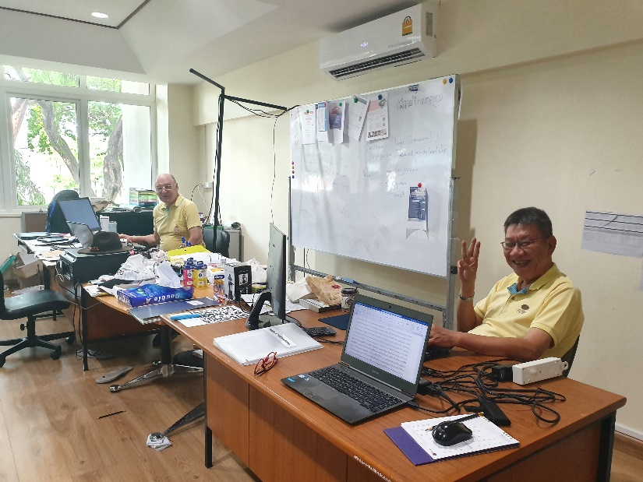
Help!!!
KRIS Consultation http://kris.kmitl.ac.th/research-clinic/
Aj Pat ปรารถนา กังสดาลย์
Speaks American and ภาษาไทย
Tuesday and Friday
Aj John
Speaks English (中文，日本话 and Indonesian badly)
Tues, Thurs, Friday 13:00-17:00
Wed 13:00-17:00 Science Faculty

Slide 10
Goal
Your goal is communication
Concise
Precise
Efficient
You are not writing
a novel
a literary masterpiece
haiku (俳句 ..日本語の十七音節の詩）
成语

Slide 11
Making your mark
Your work will be remembered for its
Clarity
Your ideas are clearly expressed
Conciseness
You have used as few words as possible
‘Style’ does matter
But only to the extent that your work is easy to read
Some variation in expression and structure
Desirable but
Not essential

Slide 12
English is not your first language?
Possibly an advantage!!
You can write a perfectly good scientific paper using the grammar you learnt in your first few English lessons!
Native speakers study the great works of English literature
Shakespeare, Chaucer, Blake, …
These authors aim to make it hard to understand
They hide meaning in metaphors, allusions, ..
They are not good models for good technical writing!!
Similarly, using many papers in the literature as models is equally bad!
There are many very badly written published works!

Slide 13
Recurring theme
Good technical English is simple!
Sentence structure is simple
You can certainly write an excellent paper with sentences that contain no more than two clauses each
Sentences are short and concise
Recommended:
Use only present and simple past tense

Slide 14
ฉันพูดภาษาไทยไม่ได้
Writing

Slide 15
但是.. 首先用英语尝试
… and I know many of you are not confident in English
BUT you should still ask questions!!
If you
If you did not understand, it is certain that others did not understand either!!
Brave lady
They will be VERY happy if you ask the question first
允许测试讲师说汉语的能力
但是.. 首先用英语尝试
Listeners
who also wanted to ask!

Slide 16
TEXTBOOK
TEXTBOOK
for Next Week …..
Writing Simply

Slide 17
QuestIONS?
….. ?
….. ?
Writing Simply

