Slide 1
TECHNICAL WRITING WORKSHOP
Theme
KISS … Keep It Simple: .. and get accepted!
John Morris
KRIS, KMITL
previously
Engineering, Mahasarakham University
Electrical and Computer Engineering, The University of Auckland
Iolanthe II leaves the Hauraki Gulf under full sail –
Auckland-Tauranga Race, 2007

Slide 2
DIRECT ACTIVE WRITING
Keep It Simple – Rule 1

Slide 3
First Rule
KISS: Ch 2, p 5-,
Direct active sentences
Verbs not nouns!
Example:
We made a measurement of the velocity
Grammatically correct, but …
Better
We measured the velocity
Statistics
We said exactly the same thing but used four words instead of seven!!

Slide 4
First Rule - Direct active sentences
Verbs not nouns!
What did we do to transform
We made a measurement of the velocity
to
We measured the velocity
We took the noun ‘measurement’ and an auxiliary verb ‘make’ and
Replaced both with the verb from of the noun
“Made a measurement” ⇒ “measured”

Slide 5
Active sentences
Verb is the important word
But remove all the meaningless verbs
Examples
This experiment produced the result that | We observed that …
This trial resulted in … | We observed that …
We made an assertion that .. | We asserted that ..
We conducted an examination of the product … | We examined the product ..
An extensive analysis of the results showed .. | We analyzed the data carefully ..

Slide 6
Active sentences
Key word is a verb!
Verb is the important word
Remove all those meaningless verbs
Examples
This experiment produced the result that | We observed that …
This trial resulted in … | We observed that …
We made an assertion that .. | We asserted that ..
We conducted an examination of the product … | We examined the product ..
An extensive analysis of the results showed .. | We analyzed the data carefully ..

Slide 7
Active sentences
Verb is the important word
Remove all the meaningless verbs
More examples
We formed a hypothesis that .. | We hypothesized that …
An annotation was made on the text .. | The text was annotated ..
We made a summary of the data .. | We summarized the data ..
An observation of the … behaviour was made .. | We observed how … behaved
A filter was used to smooth the data … | The data was filtered ..
We used dynamic programming to compute .. | We computed with dynamic programming ..
We acquired more knowledge .. | We learnt ..

Slide 8
Active sentences
Key word is a verb!
Verb is the important word
Remove all the meaningless verbs
More examples
We formed a hypothesis that .. | We hypothesized that …
An annotation was made on the text .. | The text was annotated ..
We made a summary of the data .. | We summarized the data ..
An observation of the … behaviour was made .. | We observed how … behaved
A filter was used to smooth the data … | The data was filtered ..
We used dynamic programming to compute .. | We computed with dynamic programming ..
We acquired more knowledge .. | We learnt ..

Slide 9
Useless words
KISS: Ch 2, p 6-,
Some words you can do without ….
Gave
Produced
Did
Formed
Used
Made
Performed
Acquire
You can almost always remove them and
Turn the following noun into a verb!
USELESS VERB LIST
Gave
Produced
Did
Formed
Used
Made
Conducted
Presented
Performed
Almost useless words
Acquire
Allow

Slide 10
Try some yourself
We conducted an experiment to test hypothesis: H1
Key word
We conducted an experiment to test hypothesis: H1
We tested hypothesis H1

Slide 11
Try some yourself
We made a large collection of data
Key word
We made a large collection of data
We collected a large data set

Slide 12
Try some yourself
We produced a survey to determine student impressions of ….
Key word
We produced a survey to determine student impressions of ….
We surveyed students to determine student impressions of ….

Slide 13
Try some yourself
We made a thorough analysis of the results ..
Key word
We made a thorough analysis of the results ..
We analyzed the data thoroughly ..

Slide 14
Try some yourself
We ran trials to measure the performance of Methods A and B ..
Key word
We ran trials to measure the performance of Methods A and B ..
We measured the performance of Methods A and B ..

Slide 15
Try some yourself
Our trials showed that method A had a better performance than method B ..
Our trials showed that method A had a better performance than method B ..
Method A performed better than method B ..
Key word

Slide 16
Try some yourself
Observations showed that method A had a better performance than method B ..
Key word
Observations showed that method A had a better performance than method B ..
We observed that method A performed better than method B ..

Slide 17
Try some yourself
We conducted tests of the performance our new approach by …
Key word
We conducted tests of the performance our new approach by …
We tested the performance our new approach by …
Needed ???
Obviously, you will test performance ..
We tested our new approach by …

Slide 18
KEEPING IT SIMPLE
Grammar?

Slide 19
ENGLISH TENSES

Slide 20
Tenses
KISS: Ch 3, p 9-,
Scary!!
Even native speakers find them tricky!
There are too many!
Luckily you can avoid most of them!
A technical paper does not need them!
Remember
You want to communicate ideas and results,
Not show that you were awake in English grammar classes

Slide 21
Tenses
KISS: Ch 3, p 9-,
For scientific papers, you only need a few tenses from the complete palette of English grammar
Present
Simple past
Perfect
Future
Leave the others for the native speakers!
Your paper does not need them!
Most sentences will use simple past

Slide 22
Tenses
KISS: Ch 3, p 9-,
General rules
In some parts
Many authors prefer other tenses, e.g. present instead of past
Simple past is generally safe – if in doubt, use past
Sections of your paper, technical report, thesis or ..
Introduction | Current state: Present Past work: Past
Methods | Past
Results | Past
Discussion | Past
Conclusion | Summary of results: Past Future work: Future
Safe rule
Write most (or all) of your paper in simple past tense
Very few real errors,

Slide 23
Tenses
Hardest decision
Present or Past or Perfect?
Describing your experiments
SIMPLE PAST
We measured …
The mixture exploded …
Describing the work of others
SIMPLE PAST
Robertson reported that ..
Explosions were observed by …
PERFECT (sometimes)
Many researchers have observed …
but
Many researchers observed …
is acceptable

Slide 24
Tenses
Hardest distinction
Simple past vs Perfect
Simple past
Actions that have occurred already
All your experiments
Perfect
Implies completeness
In the formal scientific theory,
no experiment proves anything ..
it only provides support for a hypothesis
So experimental work is never complete!!
perfect tense should not be used to describe it
Experiments can disprove theories so it’s reasonable to write
The experiments of x and y have demonstrated that this theory is not valid
Again
The experiments of x and y demonstrated that this theory is not valid
is acc eptable
Safe rule
Write most (or all) of your paper in simple past tense
Very few real errors,

Slide 25
Irregular verbs
Most verbs form a simple past ending in ‘ed’
However, you must learn some irregular ones
Present | Simple past
measure | measured
observe | observed
record | recorded
add | added
repeat | repeated
Present | Simple past
is | was
grind | ground
write | wrote
begin | began
beat | beat
Irregular
+ about 100 more ☹,
Use a spell checker!
It will flag many errors
e.g. ‘grinded’ for ‘ground’,

Slide 26
Tenses - Summary
Choosing which tense to use:
If in doubt, choose a simple past tense
Mostly it will be correct
Generally it will be acceptable
but
Check that you spell the past simple form correctly
Use a spell checker!

Slide 27
Tenses – Test your self
You will need to learn past versions of some verbs
Present | Past
be
display
bear
see
bind
build
catch
creep
cut
feed
freeze
grow

Slide 28
Tenses – Test your self
You will need to learn past versions of some verbs
Present | Past
be | He was | we were
display | displayed
bear | bore
see | saw
bind | bound
build | built
catch | caught
creep | crept
cut | cut
feed | fed
freeze | froze
grow | grew

Slide 29
NOUN PHRASES
Of? With? By? From?

Slide 30
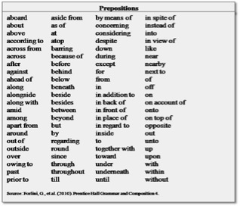
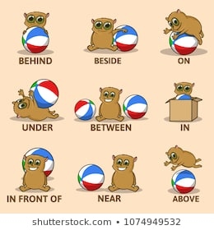
Noun phrases
KISS: Ch 4, p 11-,
Prepositions
Which one is correct?
Sometimes several?
Sometimes only one?
Sometimes almost OK
Sometimes mostly OK
?
?
?
?
?
?
?

Slide 31
Noun phrases
KISS: Ch 4, p 11-,
In English technical writing, it’s common to use nouns as adjectives
This saves a lot of space – with no loss in clarity
Change
illumination of the dynamic scene
to
dynamic scene illumination
Change
grey values of the pixels
to
pixel grey values

Slide 32
Possessives
English rules for possessive forms are troublesome
problem’, problem’s, problems’
class’, class’s, classes’
Simple solution
Use a noun phrase
problem approach
class room
When using the noun as an adjective
NO s or ‘s or s’
graduate student room
sample preparation
Even if the noun is plural!!
No grammar approach
Wastes your time as a writer
Use the simplest possible rules ☺
Wastes my time too!!
I have to think - each time!
Noun phrase
No ‘s’, no thinking ☺

Slide 33
More examples
Note: singular noun when part of noun phrase
distance to the target | target distance
Image with 640x480 resolution and 8-bit pixels | 640x480 8-bit pixel image
survey of mature age students | mature age student survey
summary of results from the survey | survey summary
assessment of results | assessment
design of experiment in detail | detailed experimental design
office for PhD students | PhD student office
queue for patients waiting for tests | test patient queue
Note: ‘results’ is rarely actually needed in an experimental paper!
Just describe the contents, values, etc.

Slide 34
REDUNDANCY
☺ Once 😐Twice ☹Three Times Four Times
KISS: Ch 6, p 17-,

Slide 35
Repetition
Makes your reader sleepy
Do not repeat anything!!
Do not use words that have the same sense twice!
Do not repeat long technical terms
Use once
Define carefully
Then use a short form

Slide 36
Long technical phrases
You just designed a small hydraulic diesel engine powered sugarcane harvester
Describe it carefully ONCE at the start of your paper
Afterwards, use some simple short phrase
the harvester
or
our harvester
Repeating the whole phrase
not again

Slide 37
Stating the obvious
Papers are littered with phrases like this ..
In this paper …
We aimed to study …
Results from our experimented showed ..
As a result of our investigation …
Our analysis showed that …
Omit these phrases, start directly with aim or your result

Slide 38
Stating the obvious
Start directly with what you did, observed or concluded ..
In this paper …We measured the effect of ..
We aimed to study … We showed the effect of ..
Results from our experimented showed ..When the pressure increased, then …
As a result of our investigation …Increasing grain size led to increased tensile strength …
Our analysis showed that …When x was used as a catalyst, …

Slide 39
Stating the obvious
Captions of figures or tables
Fig 6. Graph showing comparison of X vs Y
Obviously, it is a graph comparing …
Caption should be
Fig 6. X vs Y
‘Compare’ or ‘Graph’ are rarely needed in a figure caption
Tables are the same
‘Compare’ or ‘Table’ are rarely needed in a table caption

Slide 40
EXAMPLE

Slide 41
Example

Slide 42
Example Title
KEEP IT SIMPLE!!
Nothing unnecessary or obvious!
EVERY Research paper is a study of something!
Avoid English possesives
Rules are complex and confusing
Native speakers often make mistakes too!
Use a NOUN PHRASE
Short and Concise
Leadership Quality Management Construct Validity in Vocational Education Institutions

Slide 43
Example
Be careful with singular and plural
Student
not
Students

Slide 44
Example
Too many words!!
Try
We investigated …
Start with a VERB

Slide 45
Example
Again too many words!!
Try
We collected data from a questionnaire ..
Start with a VERB

Slide 46
Example
Use simple past tense everywhere ..
Do not try to work out
Present or past or perfect or ……. ??
Try
The question set reliability was 0.94.
Long noun phrases are simpler and OK too!

Slide 47
Example
Simple past ..
is ⇒ was

Slide 48
Example
Key word here is conform .. Start with it …
The data conformed to the model built with ..

Slide 49
Example
Use mathematical symbols – they are part of a universal international language …
χ² = 29.8, df = 23, p = 0.15 ..
The English should be ‘chi-squared’ .. But χ² is always correct, in English, ภาษาไทย,中文 or ….. !

Slide 50
Example
Do not repeat anything!!
It may difficult for you to get the English correct once … Do not risk making another mistake!!

Slide 51
Example
Possessive again .. avoid
Probably should be ..
leadership quality management model

Slide 52
Example
Do not repeat a very long complex phrase unnecessarily ..
Your (native English) readers easily get bored!
Write once:
leadership quality management model
Afterwards, abbreviate to
quality model

Slide 53
QUICK EXERCISE
Would Aj John accept this in your paper?

Slide 54
Useless words
KISS: Ch 2, p 6-,
Some words you can do without ….
Gave
Produced
Did
Formed
Used
Made
Performed
Acquire
You can almost always remove them and
Turn the following noun into a verb!
USELESS VERB LIST
Gave
Produced
Did
Formed
Used
Made
Conduct
Presented
Performed
Almost useless words
Acquire
Allow

Slide 55
FROM A RECENT PUBLISHED PAPER ☹
A similar result was observed in a study by Lee et al.(2010) who conducted a research into the production of pyrolysis oil using Napier biomass and a fixed bed reactor.
Q: What would a graduate from this workshop write?
Hint
Useless nouns list: rarely needed in experimental papers
study research
production
experiment
result

Slide 56
MYTHS
KISS: Ch 8, p 23-,
Things you may believe

Slide 57
Personal Pronouns
KISS: Ch 8, p 23
Myth 1

Slide 58
Avoiding personal pronouns ..
You should use expressions like
‘the author(s)’
to avoid ‘we’ or ‘I’
A total myth!!
It sounds pompous and
‘We’ or ‘I’ is so much simpler!

Slide 59
Personal pronouns are forbidden
Myth: Single authors should use ‘we’
Ideally, technical articles should be
Impersonal and unbiased
There is a myth that ‘we’ somehow makes it less personal that ‘I’
But ‘we’ is a personal pronoun too!!
How do you argue that’s it less personal because it’s plural??
If you’re a single author, ‘we’ is technically incorrect (or just wrong!)

Slide 60
Personal pronouns are forbidden
Convention: Avoid personal pronouns by using passive tense
The velocity was measured …
Rather than
We measured the velocity ..
However, sometimes the passive form is more complex and clumsy
So
Write ‘we’ or ‘I’
It’s your analysis that makes your work unbiased, not the words you use to talk about it!!
Overriding principle:
Simplicity and clarity is more important

Slide 61
FILLING THE SPACE
KISS: Ch 8, p 25
Myth 2

Slide 62
Filling the space
Myth
If the conference limit is SIX pages
You must write SIX pages
Reality
Editors, reviewers and readers are very happy to read less!!
If your paper seems short,
Add data, results, references, ….
Do not add words!
Everybody likes a short paper with good results

Slide 63
USE COMPLICATED WORDS
KISS: Ch 8, p 24
Myth 3

Slide 65
Use complicated words
KISS: Ch 8, p 24
Myth
Editors EXPECT or REQUIRE you to write complicated words
Reality
If you use simple, but correct, words
Editors, reviewers and your readers WILL NOT NOTICE!

Slide 66
English speakers
Native English Speakers
Commonly Fluent
Official Language but not everybody

Slide 67
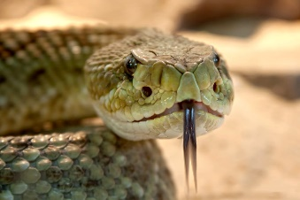
Here are your readers!
Don’t make them need their dictionaries to read your paper!
or
Rely on Google

Slide 68
Words we could manage without
Words to avoid | Simpler substitutes
Functionality | Function
Utilize | Use
Operationalize | Use
Fabricate | Make
Bifurcate | Split
Facilitate | Make easy
Finalize | Finish
Prognosticate | Predict
Disseminate | Spread

Slide 69
BAD HABITS

Slide 70
Bad habits
Referring to other’s work by numbers:
In [1], it was shown that …
There are several reasons why this is bad!
The people who wrote paper [1] probably put a lot of work into it ..
Acknowledge this by writing their names!
Smith and Jones showed that …. [1].
If you only write [1], then I’m forced to go to your reference list to find out what your source is!
However, if I know the field well, ‘Smith and Jones’ may well be enough to tell me which paper you used as a source

Slide 71
Words to avoid
Functionality
Much loved by computer scientists!
An appalling abuse of English!!
This word was formed in this way
Take a verb (or noun) ‘function’
Turn it into an adjective ‘functional’
Turn it back into a noun ‘functionality’
And use it a synonym for a much simpler word that already existed ‘capability’!!
Worse - use it in place of ‘functions’
Use ‘capability’ or ‘functions’ instead!!

Slide 72
ACRONYMS
Too many!!

Slide 73
Acronyms
Over use of acronyms makes your paper unintelligible!
Rules
Spell out in full before the first usage
Remember – you’re writing English – not in some weird language populated with capital letters known only to a few! So
Full name first (acronym in brackets), eg
Symmetric Dynamic Programming Stereo (SDPS)
Field-Programmable Gate Array (FPGA)
Not
SDPS (Symmetric Dynamic Programming Stereo)

Slide 74
Words to avoid
Functionality
Much loved by computer scientists!
An appalling abuse of English!!
This word was formed in this way
Take a verb (or noun) ‘function’
Turn it into an adjective ‘functional’
Turn it back into a noun ‘functionality’
And use it a synonym for a much simpler word that already existed ‘capability’!!
Worse - use it in place of ‘functions’
Use ‘capability’ or ‘functions’ instead!!

Slide 75
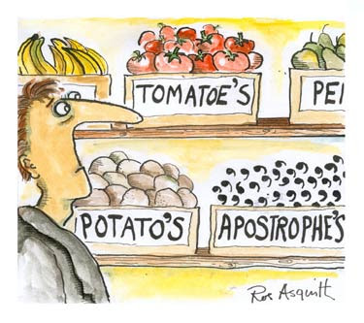
COMMON MISTAKES

Slide 76
Capitalization
Starting all ‘important’ words with capitals seems to be popular now!
English rule is simple:
First word of a sentence
Proper names
Names of people, companies, places, pets, …
Acronyms
Everything else – lower case

Slide 77
ABSTRACTS
Important

Slide 78
Abstracts
GOOD
A good abstract summarizes the results of the paper
It should have some numbers in it!
You can get the key results from the abstract
BAD
A bad abstract summarizes the contents ie it just tells you that you may find something useful if you read the paper !

Slide 79
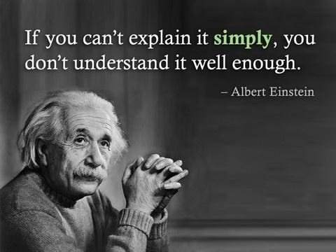

Slide 80
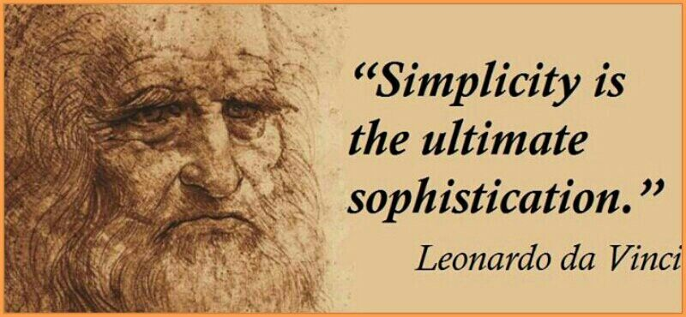
Classic example of the need to do your research thoroughly!
Wrongly attributed to Leonardo da Vinci!!

