Slide 1
Academic Listening and Speaking Understanding Technical Terms
John Morris
KRIS, KMITL
previously
Engineering, Mahasarakham University
Electrical and Computer Engineering, The University of Auckland
Iolanthe II leaves the Hauraki Gulf under full sail –
Auckland-Tauranga Race, 2007

Slide 2
Fables
Hint for possible exam question
Why did Aj John spend several lectures talking about children’s stories to a class of engineers?
(At least) Two possible answers
Language and culture cannot be completely separated: language fluency implies understanding of parts of the culture
Native speakers will often use references from fables when speaking: you need to understand the reference to understand what they are trying to tell you!
…..

Slide 3
UNDERSTANDING TECHNICAL TERMS
Academic Listening and Speaking

Slide 4
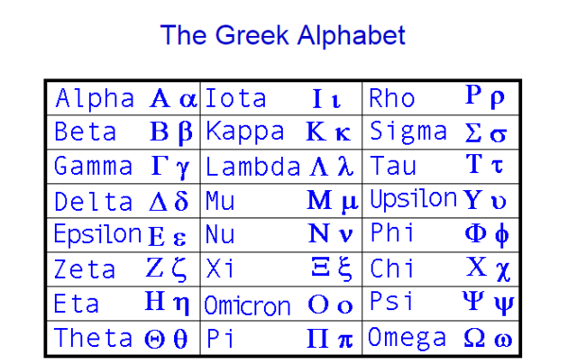
First .. A check .. Greek alphabet
Greek letters are so often used in math equations
You should be able to pronounce them easily
Only 24 + 1 (easy for a Thai ☺)

Slide 5
First .. A check .. Greek alphabet
Greek letters are so often used in math equations
You should be able to pronounce them easily
Only 24 + 1 (easy for a Thai ☺)
Often forgotten!
At end of a word,
This sigma is used!

Slide 6
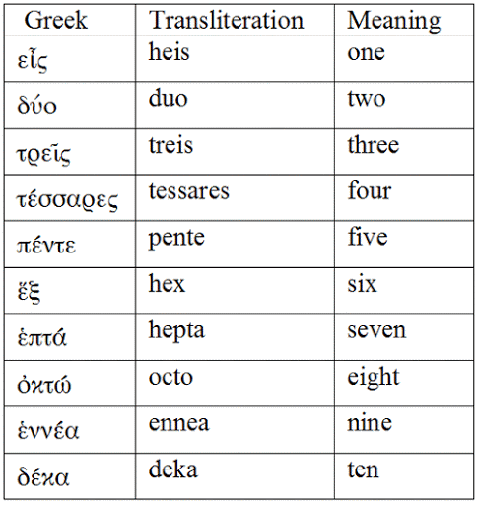
Numbers
Required memory
Used in many technical terms

Slide 7
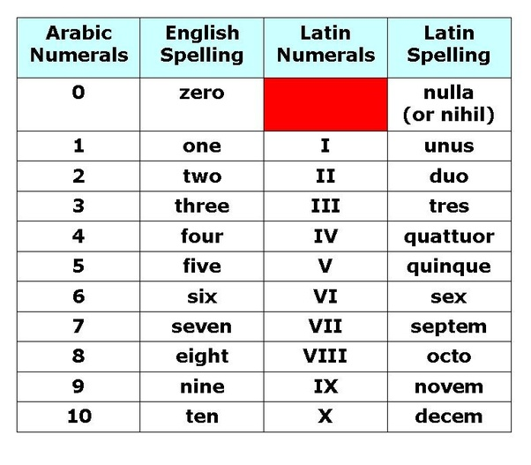
Numbers
Latin also
Required memory
Used in many technical terms
Similar to Greek

Slide 8
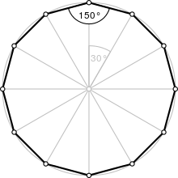
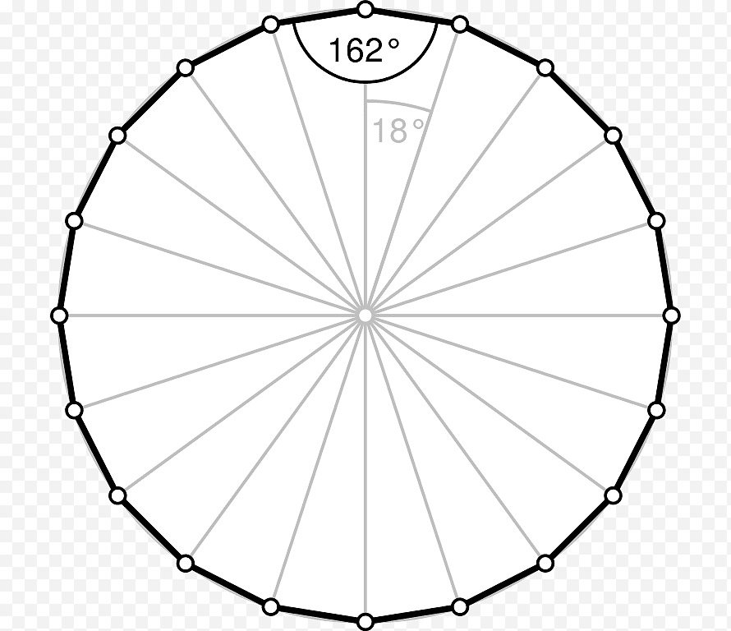
Name these shapes ..
μυριάδα
undecagon
Latin undecim = 11
dodecagon
Gk δοδεκα = 12
Latin octo
icosagon
Greek εἰκοσi = 20
Latin viginti = 20
20

Slide 9
ROOT WORDS
Basic words from which more complex ones are formed

Slide 10
Roots
Words like ‘bios’ (life) and ‘logy’ (study) form the basis of more complex ideas
Mostly derived from Greek and Latin Some from
German and Saxon
Recently a few
Asian languages – Chinese and Japanese eg kamikaze神 風 , Japanese, kami神 = god, kaze神 = wind (suicide bombers from World War II)

Slide 11
Roots
Many words have prefixes which modify them
Many derived from Greek and Latin
Prefixes
 | Greek | Latin | Meaning | Used in ….
bios | βιοσ |  | life | biology, biosphere, …
-logy | λογια |  | study | zoology, morphology
zoo- | ζώο |  | animal | zoo, zooplankton,
morpho- | μορφή |  | form, shape | morphology, amorphous, metamorphosis

Slide 12
Roots .. for chemists …
 | Greek | Latin | Meaning | Used in ….
hydrogen
helium | ἥλιος |  | sun | Helios – Greek god of the sun heliograph, heliostat, *perihelion
lithium | λίθος | lithium | stone | lithography, broncolith, gastrolith, ..
beryllium | βήρυλλος | beryllus | beryl | gemstone
boron | Buraq (ar)
carbon |  | carbo | coal
nitrogen | λῐ́τρον | nitrum | Na₂CO₃ | Ancient chemists confused ☺
oxygen | ὀξύς | oxygenium | sharp, acid | oxy + gen = acid maker
fluorine |  | fluo | flow | flux, fluent, fluorspar, fluorescence
*peri, Greek περί = near here

Slide 13
Roots .. for chemists …
 | Greek | Latin | Meaning | Used in ….
neon | νέον |  | new | neo- prefix
sodium | suwwad (Ar) | sodium | soda ash | soda ash
Na | νίτρον | natrium
magnesium | Μαγνησία |  | city in Greece
aluminium |  | alum | bitter
silicon |  | silex | flint
phosphorus | φῶς + -φόρο |  | light bearer | phospor, phorosecence
sulphur |  | sulpur | burn
chlorine | χλωρός |  | green
argon | ἀργόν |  | inactive

Slide 14
Roots .. for chemists …
 | Greek | Latin | Meaning | Used in ….
titanium | Τιτάν |  | Greek gods | titanic
chromium | χρῶμα | sodium | colour | chroma, polychromatic, achromat
iron | Isern (Saxon) |  | strong metal
Fe |  | ferrum | iron
nickel |  |  |  | American 5c coin (slang)
copper | Κύπριος |  | Cyprus | Synonym for ‘red’
gallium |  | gallia, gallius | France, rooster
arsenic | ἀρσενικόν |  | burn
selenium | σελήνη |  | Moon goddess | Refers to moon
bromine | βρόμος |  | stench
krypton | κρυπτός |  | hidden | cryptography, encrypt, cryptic

Slide 15
Roots .. for chemists …
 | Greek | Latin | Meaning | Used in ….
technetium | τεχνητός |  | artificial | technology, technocrat,
silver | Seolfor (Saxon) |  | silver
Ag |  | argentum
indium |  | indigo | deep blue | colour (between violet and blue)
xenon | ξένος |  | foreign | xenophobia, xenolith, xenogamy
barium | βαρύς |  | heavy | barycentre, barysphere, baryon
tungsten | Tung sten (Swed, Danish) |  | Heavy stone
W | Wolfram (Germ) |  | Wolf+raven | Animals following Nordic gods
gold | Anglo-saxon |  | Yellow-bright
Au |  | aurum

Slide 16
Roots .. for chemists …
 | Greek | Latin | Meaning | Used in ….
mercury |  | mercurus | fast moving | mercuric, *mm Hg (pressure), mercury (temp)
Hg | ὕδωρ and ἀργυρός |  | water silver
lead |  | plumbum | lead | plumb, plumbing,
*Do not use .. Write the SI unit, Pascal (Pa), in your thesis and papers!

Slide 17
Roots in biological names
Biologists often name species after combinations of Latin (sometimes Greek) words
 | Meaning |  | Used in ….
Canis | dog | Domestic dog | Canis lupus familiaris | lupus = wolf
 |  | Wolf | Canis lupus
 |  | Coyote | Canis latrans | latrans = bark
 |  | Jackal | Canis aureus | aureus = gold
Felis | cat | Cat | Felis catus
Lynx | lynx | Bobcat | Lynx rufus | rufus = red
Panther | Large cats | Leopard | Panthera pardus | pardus = leopard
 |  | Jaguar | Panthera onca | onca = jaguar
 |  | Tiger | Panthera tigris | tigris = tiger
 |  | Lion | Panthera leo | leo = lion
Terms referring to animal groups appear in technical and common speech
Derived from the Latin terms
Canines - dogs, wolves, etc
Felines – cats, tigers, lions, etc
also (technical use only)
Canids
Felids

Slide 18
Roots in biological names
Marine animals
 | Meaning |  | Used in ….
Cetacea | whale | Domestic dog | Canis lupus familiaris | lupus = wolf
 |  | Wolf | Canis lupus
 |  | Coyote | Canis latrans | latrans = bark
 |  | Jackal | Canis aureus | aureus = gold
Felis | cat | Cat | Felis catus
Lynx | lynx | Bobcat | Lynx rufus | rufus = red
Panther | Large cats | Leopard | Panthera pardus | pardus = leopard
 |  | Jaguar | Panthera onca | onca = jaguar
 |  | Tiger | Panthera tigris | tigris = tiger
 |  | Lion | Panthera leo | leo = lion
Terms referring to animal groups appear in technical and common speech
Derived from the Latin terms
Canines - dogs, wolves, etc
Felines – cats, tigers, lions, etc
also (technical use only)
Canids
Felids

Slide 19
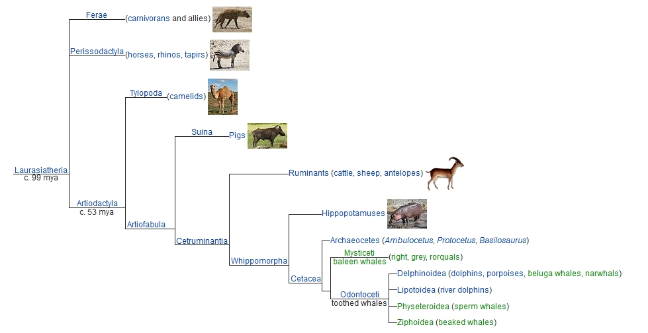
Zoological classes
Ferae - wild
Carnivores – carni (meat) + vorare (eat)

Slide 20
Zoological classes
Perissodactyla – odd toed ungulates
perissos (Gr, strange, odd number)
dactyla (Gr, finger or toe)
ungulates (L, ungula – hoof)
Herbivores – herbi (plant) + vorare (eat)

Slide 21
Zoological classes
Ruminants – cud chewing mammals
ruminans (L, cud chewing)
rumen (L, first stomach)
Herbivores – herbi (plant) + vorare (eat)
also
Ruminate – think over, ponder
ruminants chew their food slowly

Slide 22
Zoological classes
Hippopotamuses – cud chewing mammals
hippo (Gr, ἵππος horse)
potamus (Gr, ποταμός river)

Slide 23
Zoological classes
Cetacea – whales and dolphins
ketos (Gr, κῆτος sea monster)
cetus (L, cetus = dolphin)
Odontoceti – toothed whales
odont (Gr, ὀδούς tooth)
ceti (L, cetus = dolphin)

Slide 24
Zoological classes
Suina – pigs
sus (L, sus = pig)
Artiodactyla – even toed
artio (Gr, ἄρτιος even)
dactyla (Gr, δάκτυλος finger, toe)

Slide 25
Roots in physics
 | Greek | Latin | Meaning | Used in ….
motion | κινέω κίνηση | motabilem | move, moving | kinetics,
static | στατικός |  | state | thermostat, rheostat
dynamic | δυναμικός |  | moving | dynamometer, dynamite
 | δύναμις |  | power | dynamite
flow | ροή |  | flow, fluid | rheology,
flux
hygro- | υγρό |  | wet | hygrometer, hygrophyte, hygrophilous
phyto- | φυτό | plant | plant | epiphyte,
philo- | φίλος | amica | friend | hydrophilic, philosophy, anglophile, philodendron
dendro- | δενδρoς |  | tree | dendrite, dendritic, dendrogram

Slide 26
Roots - general
 | Greek | Latin | Meaning | Used in ….
motion | κινέω κίνηση | motabilem | move, moving | kinetics, electromotive
philo- | στατικός |  | friend
phobia | φαγος |  | fear | acrophobia, necrophobia, agoraphobia
necro- | νεκρο |  | death | necropolis, necrophagous, necrotic
phago- | φαγος |  | one that eats | bacteriophage, cyanophage, phytophage, halophage
halo- | υγρό |  | salt | halogen, halophyte
cyano- | κυανός |  | blue | cyanobacteria, cyanogen
phyto- | φυτό | plant | plant | epiphyte, phytochemical,
philo- | φίλος | amica | friend | hydrophilic, philosophy, anglophile, philodendron

Slide 27
Roots – general (phobias)

Slide 28
Roots – general (phobias)
 | Greek | Latin | Meaning | Used in ….
philo- | φίλος |  | friend
phobia | φαγος |  | fear | acrophobia, necrophobia,
acro- | ἄκρος |  | heights | acropolis, acrodont, acrobat
claustro- |  | claustrum | closed space
batho- | βάθος |  | depths | bathoscope, bathosphere
arachno- | ἀράχνη |  | spiders | arachnid, arachnodactyly
ophidio- | ὄφις |  | snakes | ophidian, coniophis
cryo- | κρύο |  | cold | cryogenic,
agora- | ἀγορά |  | market
xeno- | ξένος |  | stranger | xenotropic
ataxo- | α τάξις |  | disorder | taxonomy, taxa, ataxia
iatro- | ιατρός |  | doctor | iatrophysicist, iatromechanical

Slide 29
Roots – politics
 | Greek | Latin | Meaning | Used in ….
demo- | φίλος |  | people | demographics
cracy | κρατέω |  | power | democracy, autocracy
arch | άρχης |  | rule | monarchy
oliga- | ὀλιγος |  | few | oligarchy
pluto- | πλουτο |  | rich | plutocracy
 |  |  | God of the underworld | plutonic
minister |  | minister | servant | administer
secretary |  | secretus | secret
orator |  | orator | speaker
lecturer |  | legere | reader | legend
cede |  | cedere | yield | precedent
law |  | lex | law | privilege, legal

Slide 30
Roots .. for chemists …
 | Greek | Latin | Meaning | Used in ….
mercury |  | mercurus | fast moving | mercuric, *mm Hg (pressure), mercury (temp)
Hg | ὕδωρ and ἀργυρός |  | water silver
lead |  | plumbum | lead | plumb, plumbing,
*Do not use .. Write the SI unit, Pascal (Pa), in your thesis and papers!

Slide 31
RooT WORDS
Basic words – combined together to form complex technical terms

