Slide 1
Academic Listening and Speaking Understanding Technical Terms
John Morris
KRIS, KMITL
previously
Engineering, Mahasarakham University
Electrical and Computer Engineering, The University of Auckland
Iolanthe II leaves the Hauraki Gulf under full sail –
Auckland-Tauranga Race, 2007

Slide 2
Fables
Hint for possible exam question
Why did Aj John spend several lectures talking about children’s stories to a class of engineers?
(At least) Two possible answers
Language and culture cannot be completely separated: language fluency implies understanding of parts of the culture
Native speakers will often use references from fables when speaking: you need to understand the reference to understand what they are trying to tell you!
…..

Slide 3
UNDERSTANDING TECHNICAL TERMS
Academic Listening and Speaking

Slide 4
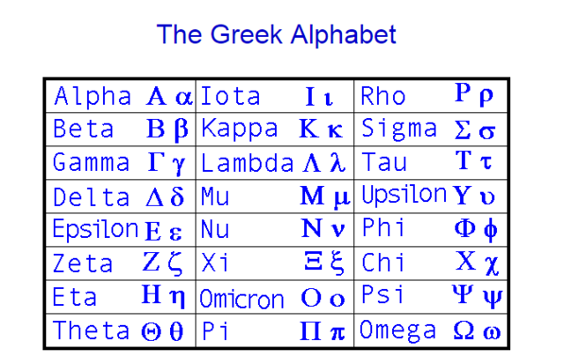
First .. A check .. Greek alphabet
Greek letters are so often used in math equations
You should be able to pronounce them easily
Only 24 + 1 (easy for a Thai ☺)

Slide 5
First .. A check .. Greek alphabet
Greek letters are so often used in math equations
You should be able to pronounce them easily
Only 24 + 1 (easy for a Thai ☺)
Often forgotten!
At end of a word,
This sigma is used!

Slide 6
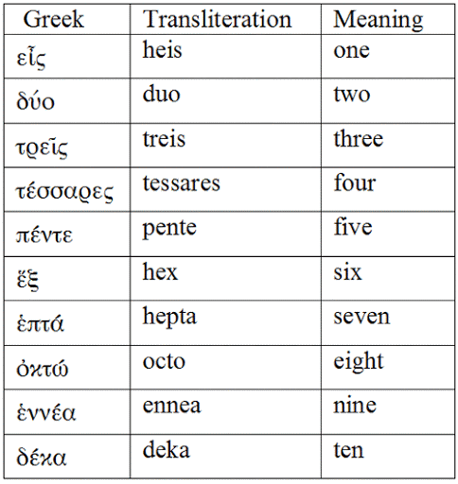
Numbers
Required memory
Used in many technical terms

Slide 7
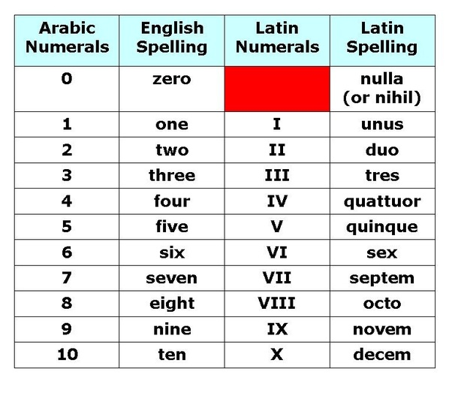
Numbers
Latin also
Required memory
Used in many technical terms
Similar to Greek

Slide 8
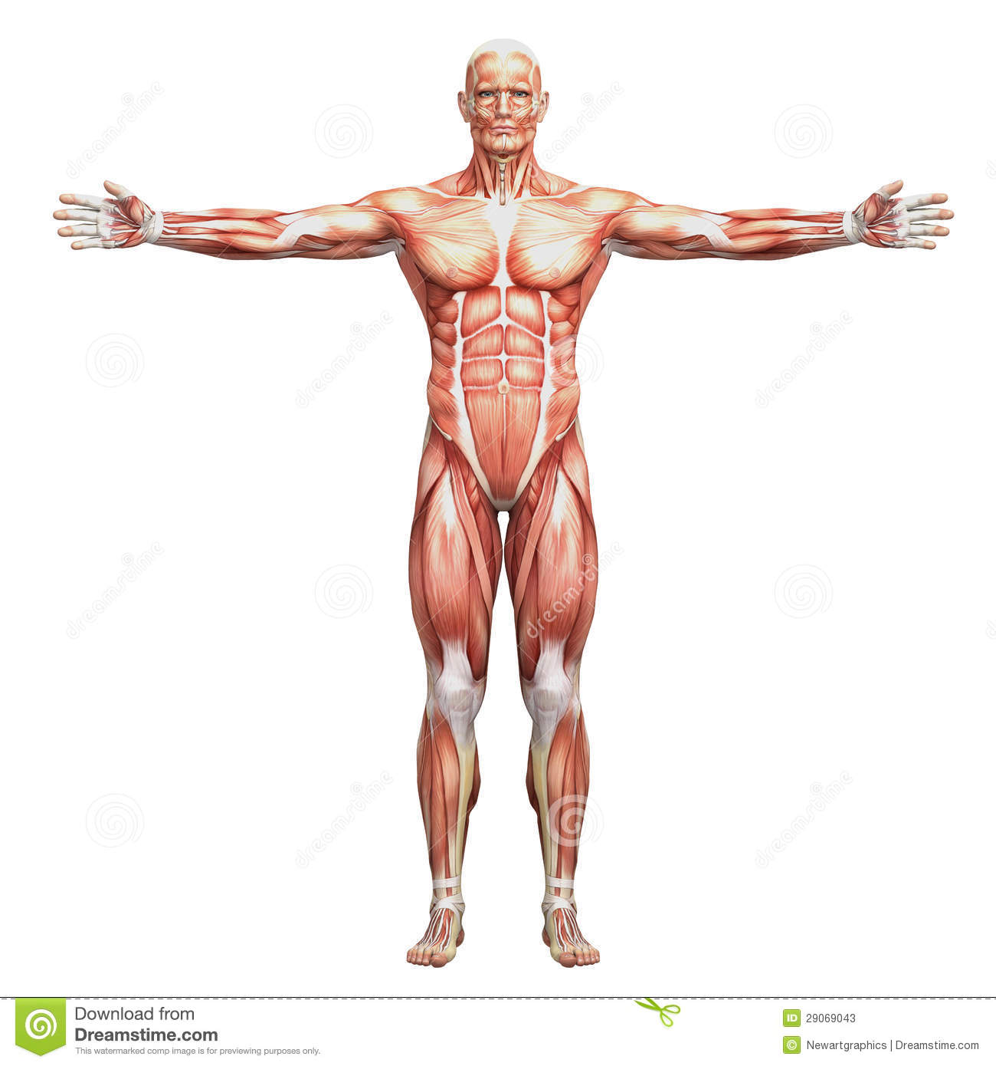
Feet
How many?
From Greek, πούς or ποδ
Or Latin, pes or ped
This animal is a biped
Latin bi- = two
Small numbers are irregular
So duo- or bi- = two

Slide 9
Feet
How many?
From Greek, πούς or ποδ
Or Latin, pes or ped
This animal is a ..
quadruped
Latin quattuor = four
Usually quadr-
e.g.
quadrangle, quadrilateral, quadripartite,

Slide 10
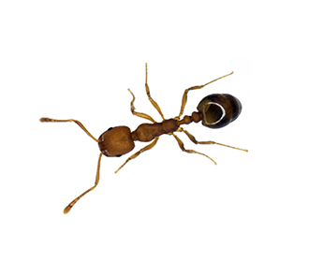
Feet
How many?
From Greek, πούς or ποδ
Or Latin, pes or ped
This animal is a ..
hexapod
Greek εξα = six
Latin hexa
e.g.
hexagon, hexose, hexadecimal, hexameter

Slide 11
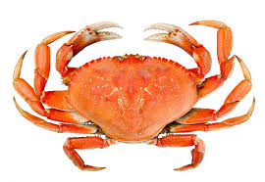
Feet
How many?
From Greek, πούς or ποδ
Or Latin, pes or ped
This animal is a ..
octopod
Greek οκτω = eight
Latin octo
e.g.
octagon, octane, octogenarian, October (8+2 for July and August), ..

Slide 12
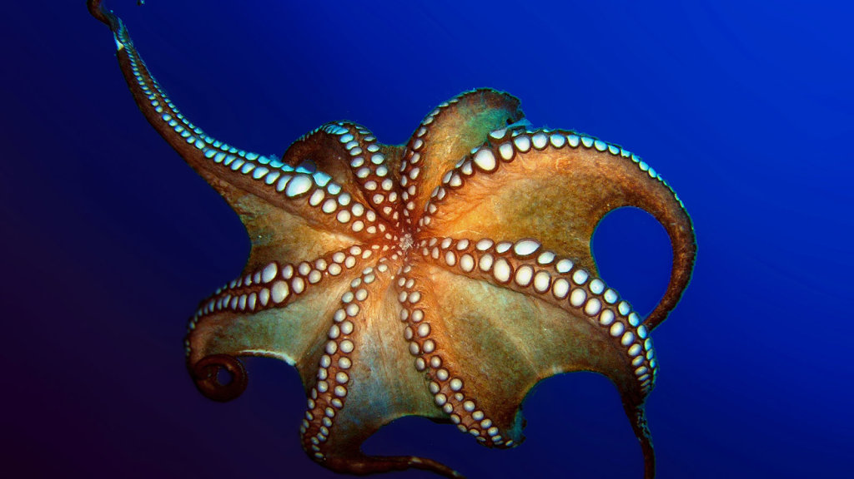
Feet
How many?
From Greek, πούς or ποδ
Or Latin, pes or ped
This animal is a ..
octopus
Greek οκτω = eight
+ Greek, πούς
Latin octo
Zoological order: Octopeda

Slide 13
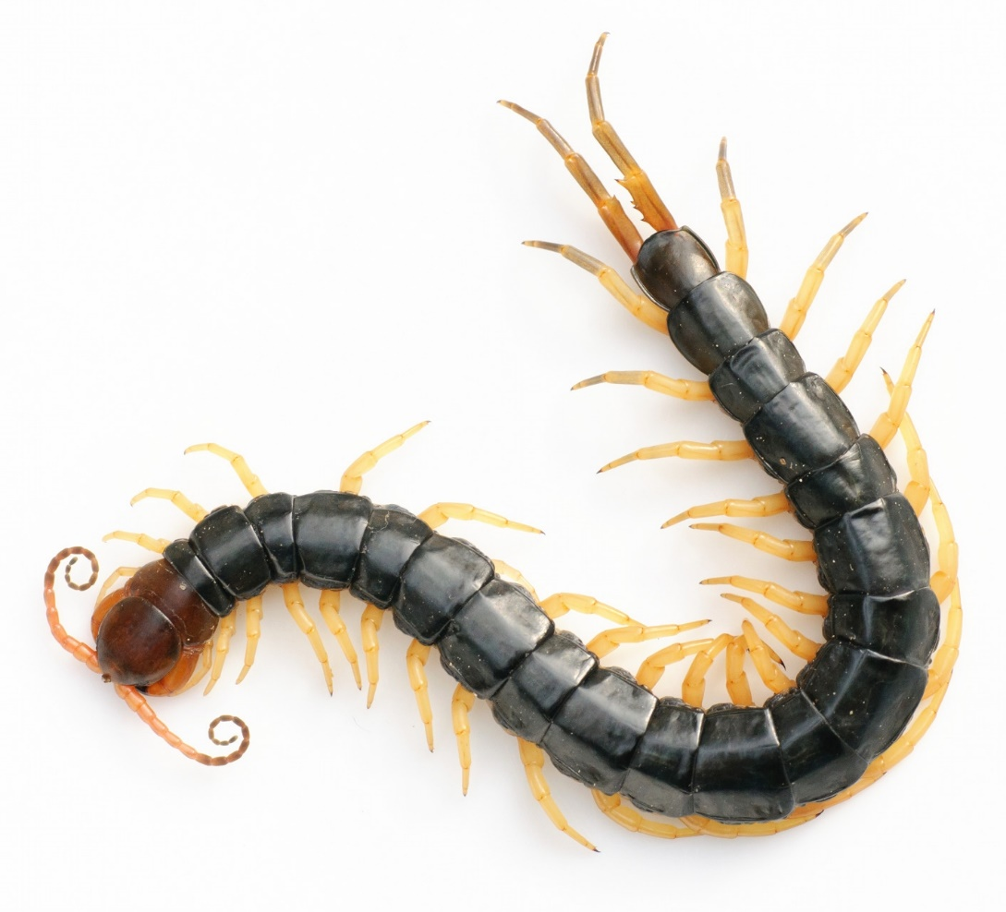
Feet
How many?
From Greek, πούς or ποδ
Or Latin, pes or ped
This animal is a ..
centipede
Latin centum = 100

Slide 14
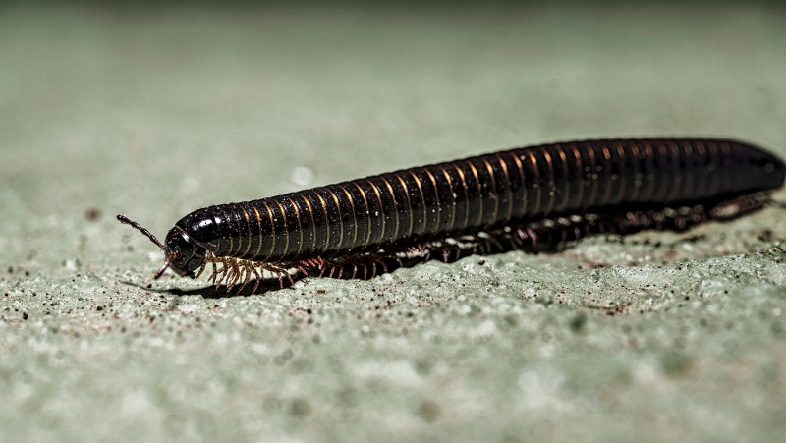
Feet
μυριάδα
How many?
From Greek, πούς or ποδ
Or Latin, pes or ped
This animal is a ..
millipede
Latin milia = 1000
Zoological name:
Subphylum: Myriapoda
Myriad = a very large number from Greek μυριαδα

Slide 15
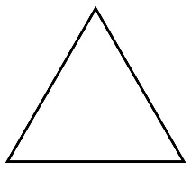
Name these shapes ..
μυριάδα
triangle
Gk, Latin tres = 3
rectangle, square
quadrangle (area on ground)
Latin quattuor = 4
pentagon
Greek πεντε = 5
hexagon
Greek εξα = 5
Latin sex

Slide 16
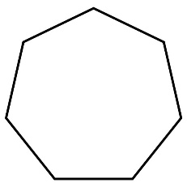
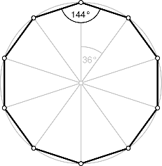
Name these shapes ..
μυριάδα
heptagon
Gk επτα = 7
octagon
Gk οκτω = 8
Latin octo
nonagon
Greek εννεα = 9
Latin novem, nonus = 9th
decagon
Greek δεκα = 10
Latin decem

Slide 17
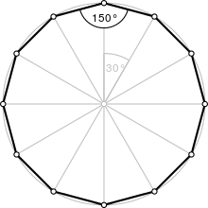
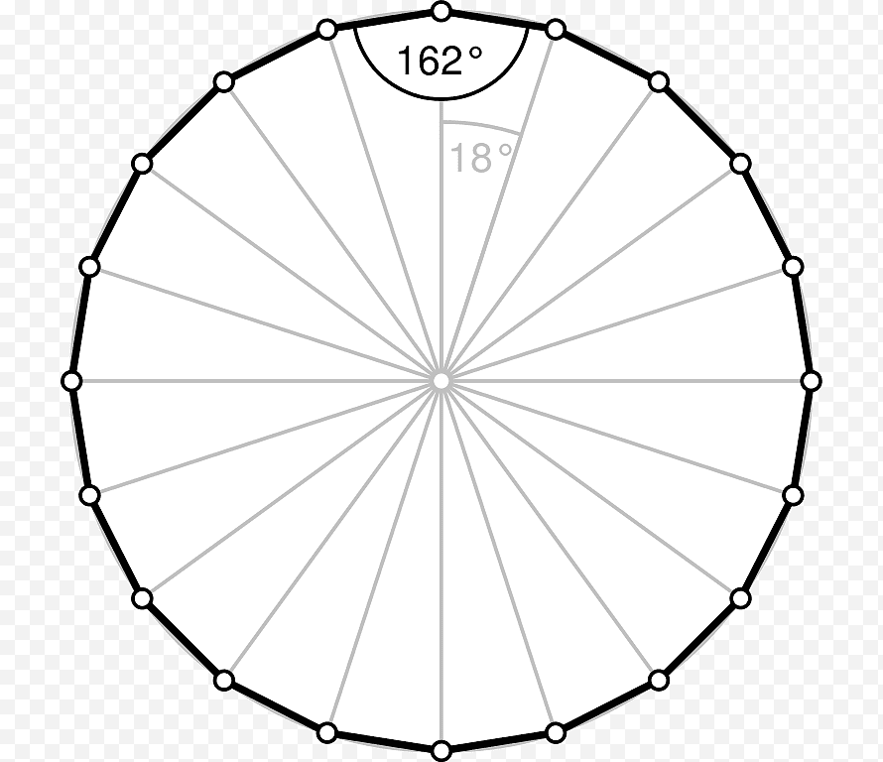
Name these shapes ..
μυριάδα
undecagon
Latin undecim = 11
dodecagon
Gk δοδεκα = 12
Latin octo
icosagon
Greek εἰκοσi = 20
Latin viginti = 20
20

Slide 18
Culture for engineers
Scott Adams
Well known American cartoonist
Writes a series about Dilbert
An engineer in a large multi-national company

Slide 19
Culture
Wally

Slide 20
Culture from Dilbert
Golem – single minded half-human creature in ‘Lord of the Rings’
Would you understand what Wally or Asok is talking about?
Asok
Maybe Dilbert should be required reading for aspiring engineers ☺

Slide 21
PREFIXES
Syllables that modify nouns …. more

Slide 22
Prefixes
Many words have prefixes which modify them
Many derived from Greek and Latin
Prefixes
 | Greek | Latin | Meaning | Used in ….
a- | α- |  | not | asynchronous
 | Greek only |  |  | atypical
in- |  |  |  | Inactive, insecure
 |  |  |  | inexpensive
im- |  |  |  | impossible
il- |  |  |  | illegal
ir- |  |  |  | irresponsible
un- |  |  |  | unattractive, unable
non- |  |  |  | non-payment

Slide 23
Prefixes
Many words have prefixes which modify them
Many derived from Greek and Latin
Prefixes
 | Greek | Latin | Meaning | Used in ….
a- | α- |  | not | asynchronous
 | Greek only |  |  | atypical
in- |  |  |  | Inactive, insecure
 |  |  |  | inexpensive
im- |  |  |  | impossible
il- |  |  |  | illegal
ir- |  |  |  | irresponsible
un- |  |  |  | unattractive, unable
non- |  |  |  | non-payment, non-smoking

Slide 24
Prefixes - negative
Many words have prefixes which modify them
Many derived from Greek and Latin
Prefixes
 | Greek | Latin | Meaning | Used in ….
dis- | δια | dis | difference, negate, | disagree
 |  |  |  | disqualify
 |  |  |  | displeasure
de- | υπο | de- | reverse, change | declassify, demote, decontaminate
anti- | αντι- | anti- | opposed | anti-racist, anti-war
mis- | παρα | de- | Incorrectly, badly | misalign, mislead, misspell

Slide 25
Prefixes - sizes
Many words have prefixes which modify them
Many derived from Greek and Latin
Prefixes
 | Greek | Latin | Meaning | Used in ….
mega- | μεγα | mega | large | megabyte, megapolis
 |  |  |  | mega-<anything> (slang)
micro- | μικρο- | micro- | small | microscope, microbe

Slide 26
Prefixes - time
Many words have prefixes which modify them
Many derived from Greek and Latin
Prefixes
 | Greek | Latin | Meaning | Used in ….
pre- | πρό | prae | before | preparation, prefix, preposition
pro- |  |  |  | prologue, proposition
ante- | μικρο- | micro- | before | antenatal, antemeridian, anterior
post- |  | posterus | after | posterior, postprandial

Slide 27
Prefixes (more)
Quantities
Prefixes
 | Greek | Latin | Meaning | Used in ….
mono- |  | mono | single | monochrome, monotonous, monolithic
uni- |  | uni | single | adhere, adjust, adopt, advice, advisor,
bi |  | bi- |  | biannual, biaxial, bicarbonate, bicycle
tri |  | tri- |  | tricycle, triple,
quad |  | quad- |  | quadruplicate
multi | πολλά | multi- | many | multilingual, multifaceted
poly- | πολλά |  | many | polymer, polygon, polynomial

Slide 28
Prefixes (more)
Quantities
Prefixes
 | Greek | Latin | Meaning | Used in ….
milli- |  |  | 1/1000 | millimetre, millivolt
centi- |  | centi- | 1/100 | centimetre,
semi- |  | semi- | half | semicircle,
hemi | ἡμι | hemi- |  | hemisphere

Slide 29
Prefixes (more)
Directions
Prefixes
 | Greek | Latin | Meaning | Used in ….
ab- |  | ab | away from | abnormal, abscess, absent, absolute, aberration, abstract, abstruse, abuse, absurd
 |  |  |  | ab initio – from the beginning
ad- |  | ad | towards | adhere, adjust, adopt, advice, advisor, ..

Slide 30
Prefixes (more)
Relationships
Prefixes
 | Greek | Latin | Meaning | Used in ….
anti- | English? | anti | against | antibacterial, antibiotic, anticipate,
contra- |  | contra |  | contravene, contradict,
com, con |  | com- | together, with | compound**, combine, confluence
sym, syn | συν συμ
 |  |  |  | symbiotic, synergy
** One source suggests compound is derived from Indonesian ‘kampung’
imported into Europe by the Dutch

Slide 31
Prefixes (more)
Positions
Prefixes
 | Greek | Latin | Meaning | Used in ….
circum |  | circum- | around | circumcircle, circumspect,
exo- | εξο | outside |  | exocrine
inter- |  |  | among, between | Internecine, intermingle, intermittent,
intra- |  |  | within | intraday, intraoral, intraocular
peri- | περι |  | around | perimeter, periscope,
sub- |  |  | below | subordinate,
super- |  |  | above | superlative, super-<anything> slang .. Very good
trans | μετα |  | across | transisomer, translate, transmigration, transfer

Slide 32
Prefixes (more)
Quality
Prefixes
 | Greek | Latin | Meaning | Used in ….
eu- | ευ | eu- | good | eukaryotes, euphony, eubiotics, eucalyptus, euphemism, eugenics
mal- | κακο | mal | bad | malaise, malign, malefactor, malady, malignant, malediction
hyper- | υπερ |  | excess | hyperactive, hyperbole
hypo- | English? |  | below | hypodermic, hypochondria,

Slide 33
RooT WORDS
Basic words – combined together to form complex technical terms

Slide 34
α | β | γ | δ | ε | ζ
η | θ | ι | κ | λ | μ
ν | ξ | ο | π | ρ | σ
τ | υ | φ | χ | ψ | ω

Slide 35
α | β | γ | δ | ε | ζ
η | θ | ι | κ | λ | μ
ν | ξ | ο | π | ρ | σ
τ | υ | φ | χ | ψ | ω

