Slide 1
Research Methods and Techniques
Measurements and Errors
John Morris
KRIS, King Mongkut’s Institute of Technology Ladkrabang
previously
Faculty of Engineering, Mahasarakham University Computer Science/ Electrical and Computer Engineering,
The University of Auckland
Iolanthe II leaves the Hauraki Gulf under full sail –
Auckland-Tauranga Race, 2007

Slide 2
MEASUREMENTS and ERRORS

Slide 3
Measurement Error
Any measurement of a value, x, has two components
x_{measured} = x_{true} + ε
x_{true} - true value of the quantity measured
ε - measurement error
Measurement error has two components
Systematic error, ε_{s}
and
Random error, ε_{r}
ε = ε_{s} + ε_{r}

Slide 4
Measurement Error - Systematic
Systematic error or bias
Generally
fixed value and
same sign for each measurement
under the same conditions
eg temperature expands or contracts a rule but the error will be the same at any given T
Caused by systematic faults or deviations in the measuring device or system, eg
End effects – zeroes on rulers or meters
Meniscus of a liquid
Slippage between wheel and tachometer or odometer
Inertia of rotating sensors, eg anemometers, flow meters
Temperature affecting length of a rule or volume of a fluid

Slide 5
Measurement Error - Systematic
Systematic error or bias
but can include
Loss of data or inputs
eg loss of responses to a survey
Spoilage of data
Accidental duplication of data
Errors reading data
Mistakes by automated form reader
Counting people (or anything else) in images
Note
You might choose to combine all factors like this
Consider as random errors
Some positive, some negative

Slide 6
Measurement Error - Systematic
End error
Zero error
If the end is not machined carefully
or worn
Object being measured
Then placing this ruler against an edge will lead
to a length longer than the correct one –
A systematic error

Slide 7
Measurement Error - Systematic
End error
Zero error
91mm
instead of 90mm
If the end is not machined carefully
or worn
Object being measured
Then placing this ruler against an edge will lead
to a length longer than the correct one –
A systematic error

Slide 8
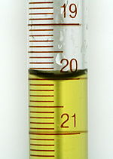
Measurement Error - Systematic
Meniscus in a liquid
Volume is usually read from the
bottom of the meniscus -
Ignoring the volume above it!
Ignore this
Read here
In precise work, the cylinder is calibrated to allow for the water meniscus!

Slide 9
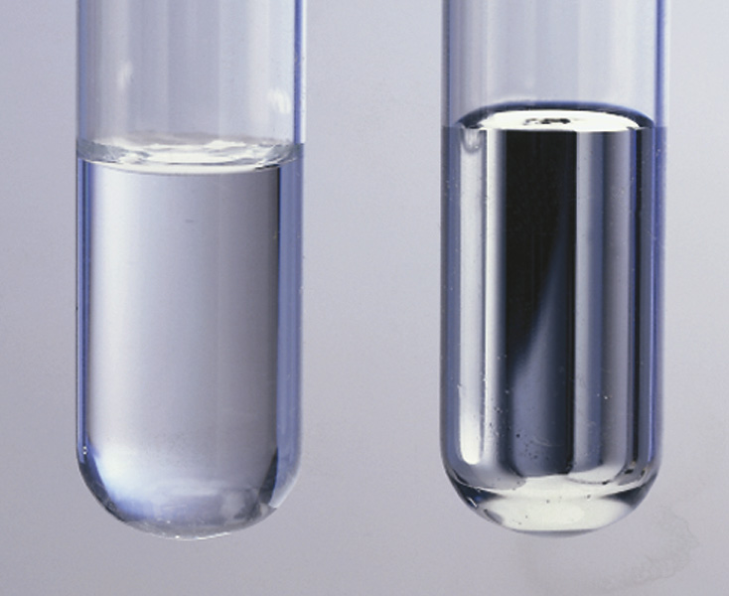
Measurement Error - Systematic
Water
Mercury
But ..
For some liquids, the
meniscus is convex!
This would lead to a systematic error if you try to measure the volume of such a liquid in a cylinder
calibrated for water!

Slide 10
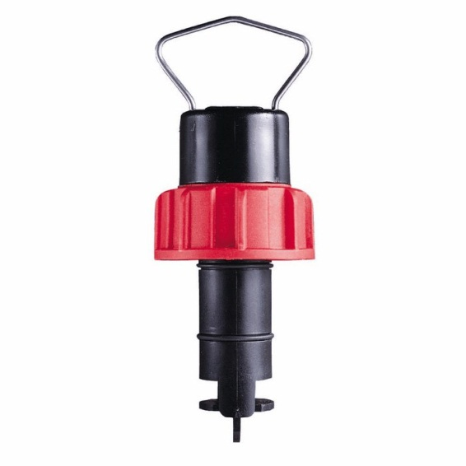
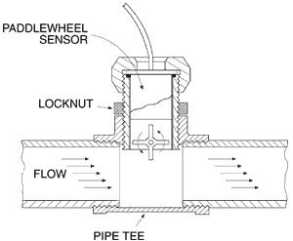
Measurement Error - Systematic
Mechanical measuring devices have inertia
Usually won’t ‘start’ with small flows, etc
Leading to zero offset error .. A systematic error
Hall effect sensor here
Sends pulses to counter and timer circuit
Rotating paddle wheel
Usually with small magnet in one vane
Sensor built into pipe
to measure flow rate

Slide 11
Measurement Error - Systematic
Systematic error or bias
Corrected by calibration
Simple ‘offset’ errors (end effects) are easily removed by careful calibration
Small deviation is added or subtracted from each measurement
eg a compass does not point to true North because of local deviations in the Earth’s magnetic field
These are available as corrections (called magnetic deviation) to a compass reading on maps
Especially marine charts!
Modern GPS systems may be making these corrections less obviously needed ☺
Deviation is simply added or subtracted from the actual reading to get the true reading

Slide 12
Measurement Error - Systematic
Systematic error or bias
Corrected by calibration
Incorrect or poor calibration also leads to systematic errors!
eg the flow rate of a liquid is determined by measuring the frequency of pulses emitted by a paddle wheel
flow = c f
where f is the frequency in Hz and c the calibration factor
A calibration procedure gives
c = 5.5 m³/s/Hz
when the correct value is
c = 5.0 m³/s/Hz
All measurements are systematically high by 10%

Slide 13
Measurement Error - Systematic
Systematic error
Corrected by calibration
Incorrect models also lead to systematic errors!
eg for the paddle wheel flow meter, flow is assumed to be linear with frequency
flow = c f
Actually, the relationship is only approximately linear
Deviations are systematic errors
In this case, accuracy can be improved by using an empirical model – the actual calibration points
Frequency
Linear model
Measured
Flow rate
Note the ‘end error’ here!
The paddle wheel doesn’t rotate at all until the flow reaches a minimum value

Slide 14
Measurement Error - Systematic
Quantum effects
Always remember: measuring a system perturbs it!
Ammeters and voltmeters have internal resistance
Presence of the meter may drop the voltage across the device
or
reduce the current it draws
These are systematic errors
Correctable if source impedance and internal resistance of meter is known
A
dV
Constant V
source
Device
V-dV
A-dA
dA
Current limited
source
Device
V

Slide 15
RandOM ERRORS

Slide 16
Random errors
Almost all measurements have random errors
Even ‘counting’ exercises such as
Census of population
On the census ‘day’
Some people are missed
Some are counted twice
Some more are born
Some die
Leading to some deviations from the ‘correct’ value
Taking another census will involve a different set of ‘errors’
Every time we count, we will get a new value
Sometimes larger, sometimes smaller ..
The deviations are random errors

Slide 17
Quick Test
You do an experiment on students in a class
You want to measure % of students who remembered yesterday’s class
So far, 23 students in a class of 31 showed good memory (or paid attention)
Today, it is raining, so some students miss the class
Next 3 days are expected to rain too
Will this introduce a random? Or a systematic error?
Reporting your experiment
% of students with good memories is $\frac{23}{31}×100=74.193\%$
So you report 74.193% have good memories
Correct or not?
Next day, a new student (with a good memory) enrols
Now good memory % is $\frac{24}{31}×100=77.419\%$

Slide 18
Quick Test
You do an experiment on students in a class
You want to measure % of students who remembered yesterday’s class
So far, 23 students in a class of 31 showed good memory (or paid attention)
Today, it is raining, so some students miss the class
Next 3 days are expected to rain too
Will this introduce a random? Or a systematic error?
Reporting your experiment
% of students with good memories is $\frac{23}{31}×100=74.193\%$
So you report 74.193% have good memories
Correct or not?
Next day, a new student (with a good memory) enrols
Now good memory % is $\frac{24}{31}×100=77.419\%$
Now you report 77.419% have good memories ?
Comment?

Slide 19
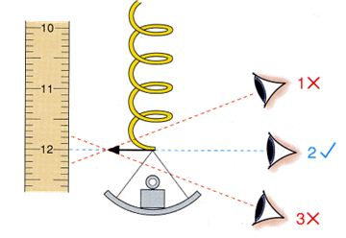
Random errors
Parallax error reading a ruler
Minor changes in the observer location
Different readings
Note
Good experimental design will minimize these errors but never eliminate them!
In this case,
Place the ruler closer to the pointer
or
Fix the observer’s position with an aperture
or
Place a mirror behind the pointer
All of these will reduce random errors,
but
some will remain!

Slide 20
Random errors
Key property of random errors is their distribution
If you can model processes causing errors, then
you can estimate how errors will be distributed and
how to best estimate the true value of the variable you are measuring
However, this is often hard or impractical
Real physical systems are complex and have many variables
So we commonly assume that random errors will be normally distributed
This is empirically justified in many situations
But there are some exceptions .. See later
Theoretical support comes from the central limit theorem

Slide 21
Normal distribution
We have a measurement, x_{measured} = x_{true} + ε
We’ll assume that
systematic errors have been removed from x_{measured} by calibration and
ε represents random errors only.
If we know how ε is distributed, we can infer a value for x_{true} and its likely error

Slide 22
Error Distribution
We have a measurement, x_{measured} = x_{true} + ε
We’ll assume that systematic errors have been removed from x_{measured} by calibration and that ε represents random errors only
If we know how ε is distributed, we can infer a value for x_{true} and its likely error
Normally distributed errors have a probability function
where μ is the mean (usually μ=0) and σ the standard deviation

Slide 23
Random Errors – Normal distribution
We have a measurement, x_{measured} = x_{true} + ε
We’ll assume that systematic errors have been removed from x_{measured} by calibration and that ε represents random errors only
If we know how ε is distributed, we can infer a value for x_{true} and its likely error
Normally distributed errors have a probability function
where μ is the mean and σ the standard deviation

Slide 24
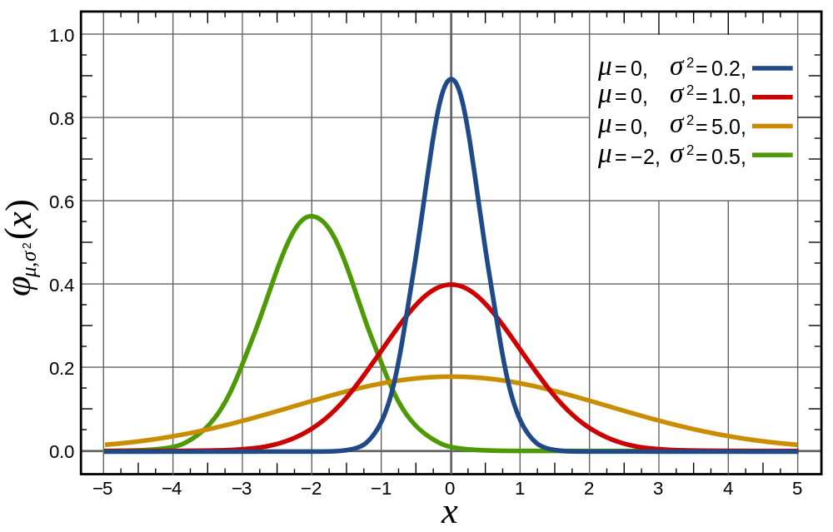
Normal distribution
A single parameter, σ, describes the error distribution so measurements are commonly reported as
μ ±σ

Slide 25
Significance of standard deviation, σ
Note that
68.2% of measurements should fall in the range x ±σ
95.4% lie in range x ±2σ
99.7% x ±3σ
<0.3% have errors greater than 3σ
So in systems where error is critical (eg safety systems) , you will see references to “3σ” errors
Only 0.3% of cases will fall outside the x ±3σ range

Slide 26
Non-standard distributions
Although normally distributed random errors are common …
Some situations lead to skewed distributions
Timing computer programs on a PC
It’s multi-tasking, so the OS gives some time to housekeeping and other tasks
These times are sometimes bounded, but generally random and unpredictable
Thus the measured time is always lengthened by time taken for these tasks
Weight of a person – skewed
Price of a share on the stock market
Chaotic!

Slide 27
Non-standard distributions
Although normally distributed random errors are common …
Some situations lead to skewed distributions
The normal distribution is practically zero for values x lying more than a few standard deviations away from the mean
ie x < μ – 3σ or x > μ + 3σ
Therefore, it is generally not appropriate when there are many outliers, values that lie many standard deviations away from the mean

Slide 28
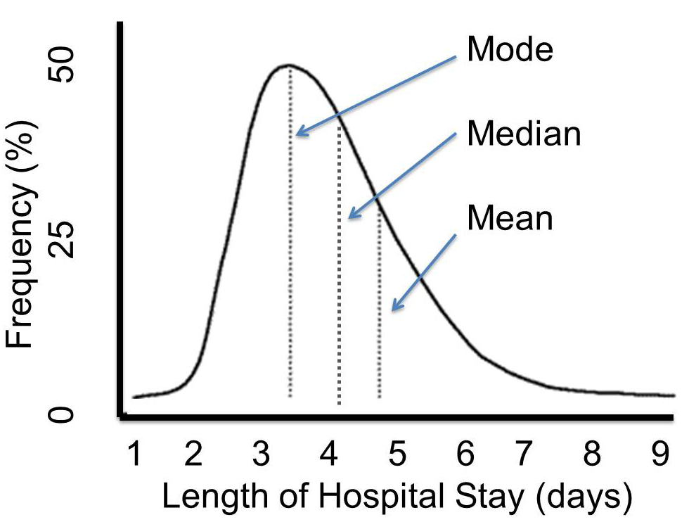
Skewed distributions
Mode
Most common value
Median
50% of values lie below
50% of value lie above
Mean
Arithmetic mean
Note that there are also other means, eg geometric mean
Normal distributions
Mode = median = mean

Slide 29
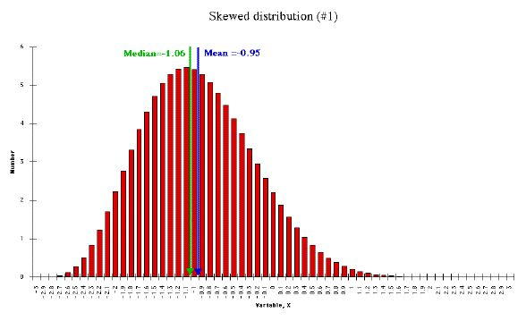
Skewed distributions
‘Slightly skewed’ distribution
mode ≈ median ≈ mean
Is the standard deviation meaningful or useful?
With care!!
Distribution of values is ‘almost’ normal
Outliers ( >3σ ) are few

Slide 30
Skewed distributions
Very skewed distribution
mode ≠ median ≠ mean
Is the standard deviation meaningful or useful?
No! Outliers ( >3σ ) are significant
Skewness measures, eg kurtosis, Pearson moments, can be used – see your statistics text

Slide 31
ACCURACY, PRECISION and RESOLUTION

Slide 32
Terms .. Do not confuse them!
ACCURACY ความแม่นยำ
How close the actual measurement is to the true one
If voltmeter reads 5.0V when true voltage is 5.5V, then accuracy is 0.5V or 10%
PRECISION (also REPRODUCIBILITY or REPEATABILITY) ความถูกต้อง ความสามารถในการทำซ้ำ
Repeatability or variation in measurement
If readings vary from 4.5V to 5.5V, then precision is 1V or 20%
RESOLUTION ความละเอียด
Smallest change in value that an instrument can measure
If the voltmeter displays 5.00, then the resolution is 0.01V or 0.2%
But note that the accuracy may be much worse!!

Slide 33
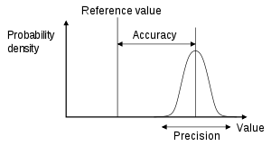
Terms .. Do not confuse them!
These two are commonly used loosely in English for the same thing!
However, precision has a very specific meaning when talking about scientific measurements
Resolution
ACCURACY
How close the actual measurement is to the true one
PRECISION
Repeatability or variation in measurement
RESOLUTION
Smallest change than an instrument can measure
But note that the accuracy may be much worse!!

Slide 34
Some observations
A measurement system can be accurate but not precise, precise but not accurate, neither or both.
eg if an experiment contains a systematic error, then increasing the sample size generally increases precision but does not improve accuracy. The result would be a consistent yet inaccurate string of results from the flawed experiment.
Eliminating the systematic error improves accuracy but does not change precision.
A measurement system is designated valid if it is both accurate and precise.
Wikipedia, https://en.wikipedia.org/wiki/Accuracy_and_precision

Slide 35
Valid systems
Be careful with this statement
A measurement system is designated valid if it is both accurate and precise
All measurement systems have errors!
So validity is always related to some acceptable level of error
If 1% error is acceptable, then a valid system must have both accuracy and precision less than 1%

Slide 36
Accuracy and precision
Target analogy demonstrates the difference well
High accuracy but low precision
Results are all close to the centre (accurate), but scattered from each other (low precision)
Low accuracy but high precision
Results are all far from correct one (low accuracy) but close to each other (precise)
Accuracy and precision are commonly used interchangeably when speaking
DO NOT confuse them in your papers, reports or thesis!

Slide 37
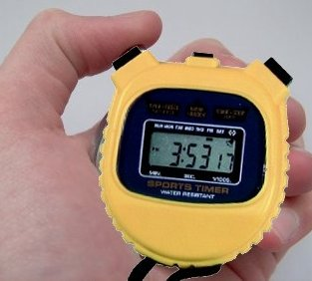
Resolution and precision
Analogue stopwatch
You can estimate the time to 1/10 second
Resolution is 0.1s
Digital stopwatch
You can read the time to 1/100 second
Resolution is 0.01s
but
Both are triggered by a human
Response time typically ~1/10 second
For both, precision is 0.1s
With modern digital readouts, resolution is often better than precision!

Slide 38
Targets again Systematic and random errors; precision and accuracy
Add a rest to steady the rifle
Low precision, low accuracy
Large systematic error
High precision, low accuracy
Large systematic error remains
Align the sight to reduce systematic error …
Align the sight
Add a rest
High accuracy but precision (repeatability) is still low
High precision, high accuracy
Images from Dave Tutelman, http://www.tutelman.com/golf/measure/precision.php, 2007

Slide 39
Reporting results Half the least significant digit rule
When you write numerical results in your report, you can
Either state the error explicitly: 3.4 ± 0.3 V
or rely on the half the least significant digit rule
3.4V means 3.4 ± 0.05 V
Value | Implied error | % error
1 | ±0.5 | 50% | Guessing is good enough
1.2 | ±0.05 | 5% | Rough measurement, field measurements
1.23 | ±0.005 | 0.5% | Normal laboratory result
1.234 | ±0.0005 | 0.05% | Very careful laboratory work
1.2345 | ±0.00005 | 0.005% | Extremely precise laboratory work usually only in standards laboratories

Slide 40
Reporting results Half the least significant digit rule
Integer results, eg counts
If you write 3042
You imply 3042 ± 0.5
This may not be appropriate if you report the number of people who gave a particular answer in a survey
Report the actual count and explicitly state the estimated error
3042 (margin of error of 3%)
In papers reporting surveys, it is common to state the margin of error in the methods section
We surveyed 4027 people from a population of ~20,000, so our estimated margin of error is 3%
This is efficient – write actual counts in tables and text –
you don’t need to add an error to every figure!
but you should repeat the margin of error in the conclusion and the abstract!

Slide 41
Reporting results Half the least significant digit rule
Integer results
For other measurements, eg
4024 m² was planted with taro
Either
Replace irrelevant digits with 0 and
state the error explicitly 4020 m² (±1%)
or
use scientific notation 4.0 × 10³ m²
implying (4.0 ± 0.05) × 10³ m²

Slide 42
Calibration
Most instruments require calibration because they convert one measure to another
Digital scale converts pressure (or strain) to weight
Using pressure gauge or strain gauge, analogue to digital converter, microprocessor
Calibrations determine
Scaling factors and offsets
ie parameters in the relation between, eg, weight and strain
Deviations from linearity
…
In some cases, calibrations serve to reduce systematic errors
Small offsets can be measured and subtracted
Non-linearity can be corrected by using a look up table or function
They also give a good idea of accuracy obtainable
Deviations from curved fitted in calibration exercises indicate accuracy

Slide 43
Reporting results Half the least significant digit rule
Do not add excess significant digits to your reports!
Even if you did not explicitly estimate the error, write values that imply reasonable errors!
Generally laboratory work is only accurate to ~1%
Only 2 (maximum 3) significant digits are justified!
Writing 3.4V ⇨ 3.4 ± 0.05 V or ~1% error
Writing 3.42V ⇨ 3.42 ± 0.005 V or ~0.1% error
It’s unlikely that your measurement was accurate to 5mV!
However, it may be accurate to 20mV so 3.42V is reasonable
but 3.427V ⇨ 3.427 ± 0.0005 V is definitely not!!
Only special laboratories with high precision equipment routinely achieve < 1% accuracy
Standards laboratories and some university laboratories

Slide 44
Reporting results A useful convention
Most workers are reluctant to throw away a 3rd digit
They don’t want to write 3.4V
they think their work is a ‘bit’ more accurate and 3.42V is OK
An old convention allowed them to write 3.4₂V
Subscript ‘2’ indicates a value which is not certain
So 3.4₂V ⇨ 3.42 ± ~0.02 V or ~1% error
Your voltmeter is accurate to 20mV (a modern digital one might well be!) but
not 5mV (unless you take extraordinary precautions!)
This convention is found in literature about very precise measurements
You should use it!
It shows your reviewer, examiner and reader that you do understand experimental accuracy even if you did not analyze errors in detail

Slide 45
Other ‘measurements’
Almost every number has an error associated with it!
but
“I’m studying farm economics, fertilizer is B1000/50kg sack! Where’s the error there?”
The supplier’s price is fixed
Many actually …
Can you think of some?

Slide 46
Other ‘measurements’
“I’m studying farm economics, fertilizer is B1000 / 50kg sack! Where’s the error?”
Many actually …
Variation in price over several years
Do you get exactly 50kg per sack? ±how much?
Farmer wants to apply 80kg/rai ..
How accurately can he do that?
He uses a spring scale in the field ± 10% if he’s very careful!
How much
Gets lost in transport,
Spilt on ground when filling spreading devices
Spread onto paths, roads instead of crops
… ?
Overall, this probably means that the effective cost/rai is B1000*80/50 = B1600 ± 20%
rai used here for Thai audience only!
In a paper sent anywhere else, you should use m²!

Slide 47
Other ‘measurements’
Almost every number has an error associated with it!
but
“I’m carrying out a survey! Where’s the error there?”
I am just going to ask questions and collect data
Many actually …
Can you think of some?

Slide 48
Other ‘measurements’
“I’m carrying out a survey! Where’s the error there?”
Many actually …
Number of people|companies|schools| …. surveyed
If you survey 80 people and discover
79 eat very spicy food
47 own motorcycles
Your results
79/80 = 98.75% eat spicy food (you asked 1 farang)
47/80 = 58.75% own motorcycles (MSU students)
Anything wrong?
If you only survey 80 people, then your error is at least 1%!!
Reasonable results
99% eat spicy food (you asked 1 farang)
59% own motorcycles (MSU students)

Slide 49
Errors accumulate!!
If you calculate
z = x op y
for any arithmetic operator, op, with x ± 1%, y± 2%
Then the error in z is (very roughly) 1%+2% or 3%
It doesn’t matter whether op is +, -, ×, / or ..
Note that the error estimate is an error estimate!
Only one significant figure has any meaning
So your error is 0.5 or 5%
NOT 0.54 or 5.4%!!

Slide 50
Temperature Accuracy
Generally, you should NOT express any thermometer’s accuracy as %
temperature ± 1%, temperature ± 2%
Report accuracy as ± x deg C!
eg ± 1 deg C
Reason: Temperature is measured relative to a reference temperature eg 0ºC, 100ºC
So accuracy is referenced to this temperature
But differences in temperature can be expressed as % error
eg two measurements: T₁ = 20 ±1 ºC, T₂ = 70 ±1 ºC
So δT = T₂ – T₁ = 50 ±2 ºC or ± 4%

Slide 51
Standards – side note
Use international standards whenever appropriate (unless you are in the United States ☺)
Measurement units
SI system
Incredibly …
The system has been nearly globally adopted. Only Burma, Liberia and the United States have not adopted SI units as their official system of weights and measures. In the United States metric units are not commonly used outside of science, medicine and the government; however, United States customary units are officially defined in terms of SI units.
Wikipedia, International System of Units

Slide 52
Standards
Measurement units
Absolutely forbidden!
Imperial units
feet, inches, miles, pounds, acres, …
gallons (there are two versions – imperial and US!)
rai (only Thai understand!)
use m² or, possibly, hA = 10⁴ m²
Tons (imperial version)
Metric tonne (spelt that way) is OK but possibly confused with imperial ton, so kg are better
Horsepower – use W or kW

Slide 53
Standards
Measurement units
Discouraged
Non SI metric units
cm, …
Use m, mm, ..
Consistent, fast comparisons with other papers following convention
Times in minutes, hours, days, ..
Use seconds when possible
1 day = 8.64 × 10⁴ s
But sometimes result looks odd ! So hours, days, .. are OK
kWh and similar
Half SI, half customary ..
Use Joules for preference

Slide 54
Assignment (assessed 5%)
Find out what instruments you will need for your research
Find out what their accuracy, precision and resolution is
Write a report summarizing what you found
Outline for this report …

Slide 55
Assignment (assessed 5%)
Outline for your report
Type of instrument .. What does it measure?
Machine or device details – manufacturer, model number, date of manufacture, any attachments used
Physical principle on which it operates
Very brief (1 or 2 sentences only) + reference
Calibration method
Very brief (maximum 1 paragraph)
Focus on accuracy of calibration!
Accuracy
Resolution
Systematic errors present
How do you minimize them?
Random errors
What causes them?
What is its precision?
Summary: overall accuracy and precision

Slide 56
Assignment (assessed 5%)
Outline for your report
Use outline to guide your report format
You should have 10 sections …
In English, but no grammar needed
Write lists, use bullet points, ….
If you’re not confident in English
You can write in Thai and use Google translator or …
You can use this information (after comment and correction) in your thesis!
It should include detailed experimental method
Including description of measuring equipment used!
Submit by email to j.morris@auckland.ac.nz
Put ‘RESEARCH METHODS’ in the subject line
Due January 12, 2014
Next lecture : January 18, 2014
Happy New Year!!

Slide 57
Warning: Google Translator
Google Translator is a good dictionary
It will generally correctly look up the English equivalent of a Thai word
However
It is very poor at converting Thai sentences to meaningful English sentences!
You must check the English result and make sure that it makes sense!
Tips
Write very simple, short Thai sentences
Google can handle these better than long complex ones!
Good technical writing is simple and short in any language!

