Slide 1
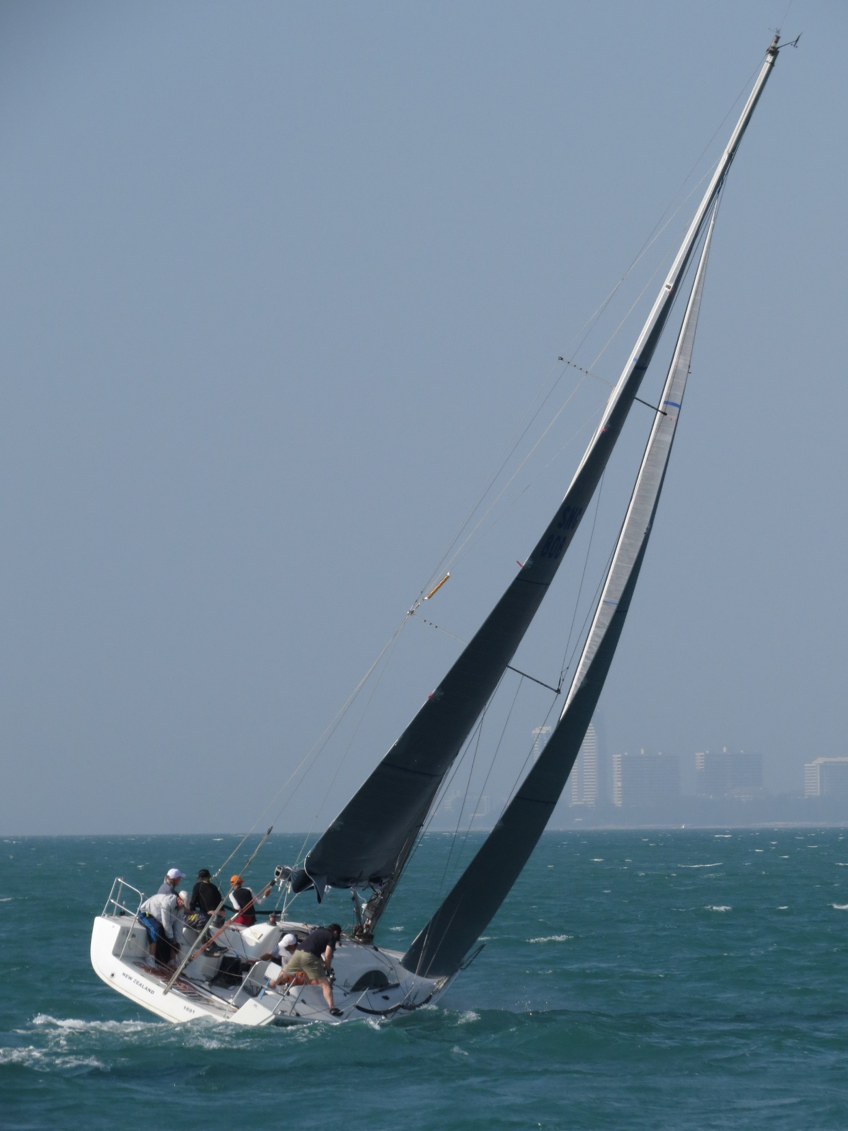
Research Methods: Instrument Accuracy
John Morris
Faculty of Engineering, Mahasarakham University
Computer Science/ Electrical and Computer Engineering,
The University of Auckland
Iolanthe II races off Jomtien, Chonburi Province

Slide 2
Experiment
GPS Accuracy
Notes
Earth is circular
Distance between two points
Lat1,Lon1 and Lat2,Lon2
acos(sin(Lat1)*sin(Lat2) + cos(Lat1)*cos(Lat2)*cos(Lon2-Lon1)) *6371
Excel spreadsheet with formula encoded is available!!
Latx, Lonx in RADIANS
Radius of earth ~6371 km
Hypothesis
What is the accuracy of a GPS position?
‘Safe’ expectation ~100m
Recent GLONASS system: accuracy MAY be as good as 10m

Slide 3
Experiment – GPS Accuracy
Set GPS to read degrees as 160.xxxxxx
If you can’t do this, convert deg:min:sec or deg:min.xxxx to degrees
Choose a point that you can recognize from Google Earth
Choose a reproducible point, eg a corner, recognizable feature
Being able to repeat the experiment is important
Locate that point using Google Earth
Record Lat/Long from Google Earth
Go to that point
Record the GPS reading lat/long
Take at least 30 readings, ~1-2 mins apart
Enter your points data in a spreadsheet
Calculate mean, std dev
Make a histogram showing to distribution of readings
Make a histogram for 10 points only
Make another histogram from the 30+ points
Is the distribution normal?
What is (1) Resolution, (2) Precision , (3) Accuracy?

Slide 4
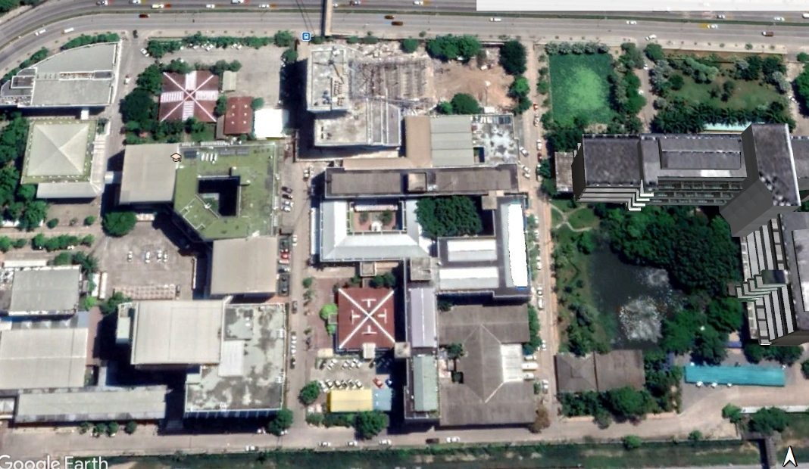

Slide 5
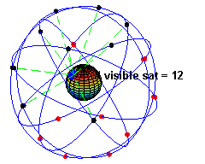
Experiment – GPS Accuracy - Results
Operation
GPS receivers measure time of flight from a signal positioned ~20,200 km above the earth
Usually 6+ satellites are visible at any one time
Need 4 for accurate position
~30 s needed to receive complete data from a satellite

Slide 6
Experiment – GPS Accuracy - Results
Resolution
iPad ‘GPS’ program
Reports lat / long as
16.247149ºN 103.253024ºE
Smallest measurable change is 0.000001 deg
Calculate distance between
16.247149ºN 103.253024ºE and
16.247148ºN 103.253024ºE
0.09 m ???
Did you see ± 0.09 m ??
Resolution is much smaller than accuracy
Common in modern digital instruments
A
D
B
C

Slide 7
Experiment – GPS Accuracy - Results
Precision
Variations in measured distances
Typically 5-8 m
Precision is ~ 8m
Actually good, since satellites are ~20,200km* above the surface of the earth!
Clock accuracy is better than 1 in 10¹³ !
Resolution is much smaller than precision
Common in modern digital instruments
19,100km for the Russian GLONASS satellites
A
D
B
C

Slide 8
Experiment – GPS Accuracy - Results
Accuracy
Compared with an (approximate) 30m for A-B
Typically 18-22 m
Accuracy ~ 10 m
Actually good, since satellites are ~20,200km above the surface of the earth!
Accuracy is much worse than resolution
Accuracy appears slightly worse than precision
Historical note
Originally, GPS accuracy was only ~100m
Accuracy is ~10m now
Can be affected by atmospheric conditions
A
D
B
C

Slide 9
Experiment Notes
Important Principle
For any experiment
Always make multiple measurements of each point
Important Principle
For any experiment
Always make multiple measurements of each point
Reliability is increased by having more points

Slide 10
Experiment Notes
Check measurements AS YOU RECORD THEM!!
Do they match your expectation?
If not, repeat immediately!!
For GPS experiment
Each measurement at same point should be close to previous one
Within 10-20m
If you are not getting the same answer next time
Check everything
Recording
Equipment setting
Did something change?
Temperature, wind speed, ..

Slide 11
Report – First Assignment
Make a short report (in English, grammar-free is OK)
Report structure
AIM
What were you trying to demonstrate?
(here .. Accuracy and resolution of GPS)
METHODS
Exactly what did you do?
What tools did you use?
RESULTS
Table of experimental results
Calculations from those results (distances between points)
Mention accuracy, precision, resolution!!
CONCLUSION
Summarize important results (eg ‘safe’ accuracy of GPS
? 3 pages (1 page for table of results!!)

Slide 12
Experiment Notes
Check measurements AS YOU RECORD THEM!!
Do they match your expectation?
If not, repeat immediately!!
For GPS experiment
Each measurement at same point should be close to previous one
Within 10-20m
If you are not getting the same answer next time
Check everything
Recording
Equipment setting
Did something change?
Temperature, wind speed, ..

Slide 13
Task before next class
Check GPS experiment data
Check mean, sd
Check conversions to m
x_{i} – mean x
Convert metres … dev * 60 * 1852
Range for mean deviation … about -10m to +10m
Now we want to make a HISTOGRAM
In Excel
DATA -> DATA ANALYSIS -> Histogram
Usually DATA ANALYSIS TOOL PAK needs to be downloaded and installed
Find on web .. Microsoft web site
Download
Run installer
Then ‘DATA ANALYSIS’ tab will appear

Slide 14
Making a histogram
Makes more flexible plots for your thesis or paper!

Slide 15
Making a Histogram
If you cannot load the Excel ‘Data Analysis Tool Pak’
Then you can make a histogram yourself
Not very hard
More flexible for generating histograms for papers or your thesis!
You can use this procedure for visualizing many types of data
Scores in a student test
Measurements of many things, eg speed, time to run 100m, ..
Steps
Start by copying columns J-L from the GPSVariations sheet
Make a new sheet and paste them in Columns C-E
Use the Paste Values option!

Slide 16
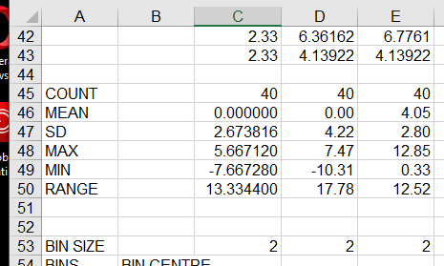
Making a Histogram
In the new (clean) sheet
Note that you will have 3 columns
Deviations Latitude (North-South), Longitude (East-West) and Distance
So you can make 3 different histograms
Make sure that Excel has calculated
COUNT
MEAN
SD
MAX
MIN
RANGE
in columns C-E
Follow the example
Put COUNT in row 45

Slide 17
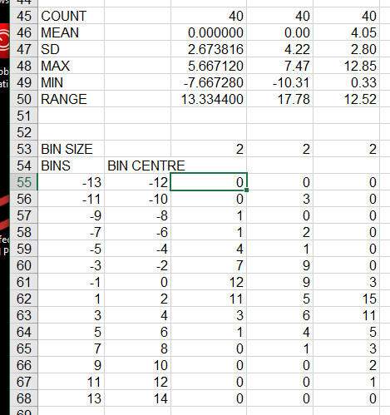
Making a Histogram
A Histogram shows the FREQUENCY of VALUES in each ‘bin’
A bin is a range of values
In this example, the RANGE is 13
Choose a bin size so that we have 8-20 bins
More bins if you have more data
Try a bin size of 2
We will have bins -12, -10, -8, …, -2, 0, 2, 4, … 12
In bin ‘0’ (‘0’ is the mean) we will count the values from
-1 < x_{i} <= 1
In bin ‘2’ , we will count values
1 < x_{i} <= 3
Make a list of bin START values in column A
Here it is -13, -11, -9
Put the minimum -13 in A56
and “=A56+C$2” in A57
Copy down (ctrl-D) A57 to A65
Set the bin CENTRES in column B
B55 “=A55+C$53/2” and copy down

Slide 18
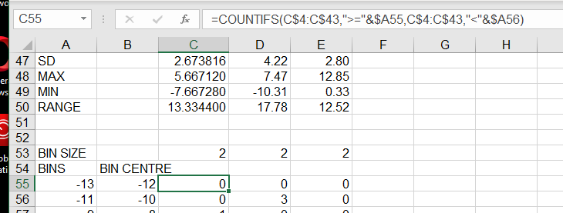
Making a Histogram
Carefully copy the formula to B55
Be careful to copy the $s correctly, C$4:C$43, etc .. The $ must be in the right place!
This formula counts values in cells B$4:B$43 IF it is >= bin start (A55) AND < bin end (A56)
Copy the formula from C55 left and down to E68, use ctrl-R
Then you should a set of counts in C55:E68
Now you can make a graph of the data in B55:E68

Slide 19
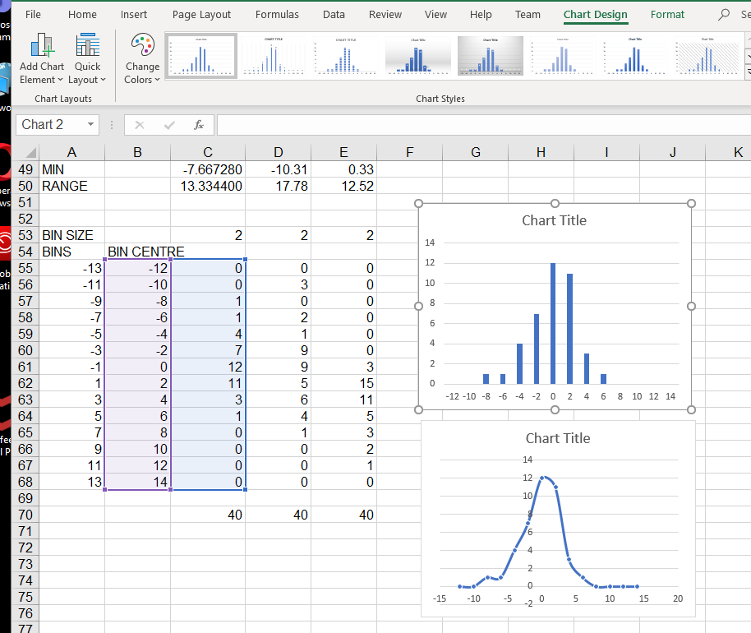
Making a Histogram
CHECK what you have down
Note COUNTs in row 70
C70 has “=SUM(C55:C68)”
This should match the count in C45
Matches
So formula was correct
If you had typing error, counts would not match!

Slide 20
Making a Histogram
To make a single histogram of latitude deviations
Choose B56:C68
Select the chart type you want .. INSERT -> select chart type
Two examples shown here
Bar chart
Usual for Histograms
Freq distribution as graph
Note approximately normal distribution

