Slide 1
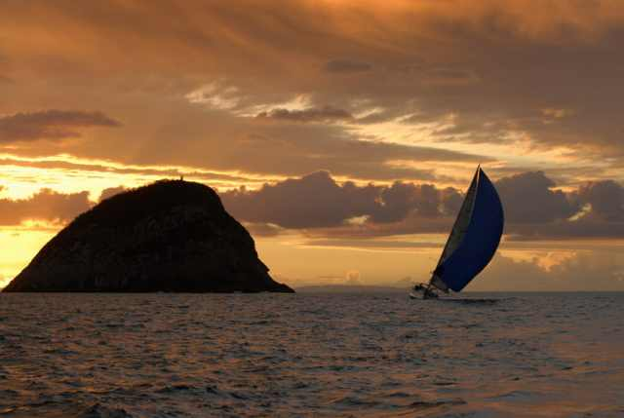
KISS …Keep It Simple:
.. and get accepted!
John Morris
KRIS, KMITL
previously
Engineering, Mahasarakham University
Electrical and Computer Engineering, The University of Auckland
Iolanthe II leaves the Hauraki Gulf under full sail –
Auckland-Tauranga Race, 2007

Slide 2

WORDS TO AVOID
☺ Once 😐Twice ☹Three Times Four Times
KISS: Ch 9, p 27-,

Slide 3
Respectively
KISS: Ch 9.1, p 27
Some writers love ‘respectively’
Sample A results were pressure, density and viscosity – 2.2Pa, 3.1 kg/m3 and 3.9 m3/s, respectively
This is very slow to read
Sample A results were pressure 2.2 Pa, density 3.1 kg/m3 and viscosity 3.9 m3/s
Much faster to read
Reader does not jump
label list ⇔ value list
to understand
Keep labels and values together!

Slide 4
Vague words
KISS: Ch 9.2, p 28
Could? May? Might?
These words imply uncertainty
  Weakness in a scientific paper
  Expect a reviewer to demand precision
  or
  just reject your paper
When you are not sure, but believe you know
  Use ‘attributed to’
The density increase was attributed to crosslinking in polymer chains
Still uncertain
but
shows that you believe you understand

Slide 5
Pompous words and expressions
An initial study was published by the present authors ..
Write simply ..
We published an initial study ..
Do not promote your work to something ‘grander’
Expect a reviewer to object
  He or she may not accept the ‘grand claim’
  OK --- More realistic claim
KISS: Ch 9.3, p 28
‘Grand’ words | Realistic words
framework | system
architecture | circuit
grandiose | important
objectives | aims
Write safely!
Always make realistic claims
Do not invite a reviewer to criticize!

Slide 6
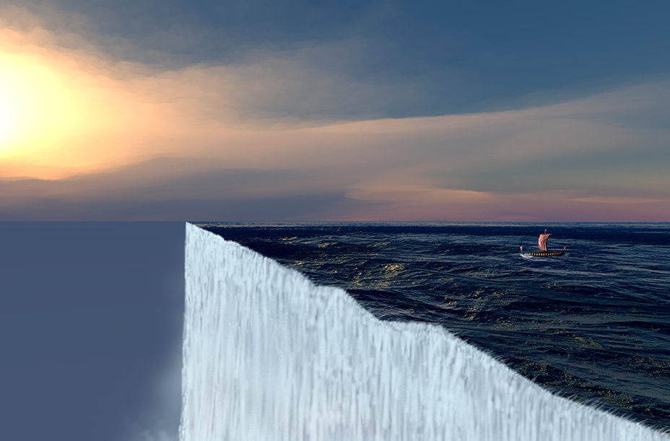
Popular
KISS: Ch 9.4, p 29
Popular is a bad word to support scientific work
History shows that many ‘popular’ theories were wrong
A popular idea until ~1500
  The world is flat,
  therefore you will fall off the edge
Although Pythagoras had good evidence for a round earth in ~500BC
‘Popular’ in science is dangerous!!
Do not write
The popular approach is to …
You may regret this in 10 years
Safer ….
We followed the approach [ref] …
You understand that ‘popular’ may be wrong!
Popular
⇒ you believe it too!

Slide 7
Superlatives
KISS: Ch 9.5, p 29
English superlatives .. ‘most’, ‘strongest’, ‘best’, …
Most studies ..
The best approach is ..
The strongest agent is …
Invites a reviewer to disagree !!
Many studies ..
A good approach is ..
X is a strong agent for …
Expect a reviewer to object
  He or she may not accept the ‘grand claim’
  OK --- More realistic claim
Write safely!
Note this will not weaken your argument
but
Allows that there may be a stronger case
Write safely!
Always make realistic claims
Do not invite a reviewer to criticize!

Slide 8
Propose
KISS: Ch 9.6, p 30
Propose is ambiguous in English
It usually implies something that you put forward
for the future!!
but
If you already implemented your idea
Write more precisely
We implemented and tested our new approach ..
We designed and built a system using this concept ..
Clearly indicating that it is no longer a proposal!
It exists (and works ☺)
Expect a reviewer to object
  He or she may not accept the ‘grand claim’
  OK --- More realistic claim
PROPOSE

Slide 9
Invented words
KISS: Ch 9.7, p 30
Do not follow bad examples of other authors
Inventing new words!!
English has enough words already!!!
No more are needed!!
Use existing words
  Even if you have to use two or three
  to substitute for the ‘new’ word
Example ..
Inventing ‘functionality’ as a synonym for ‘functions’
  Just silly!!
Remember your readers ………
OK .. Advances in science will create new terms
but
Let’s keep the new terms to necessary ones

Slide 10

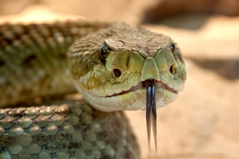
Here are your readers!
Don’t make them need their dictionaries
to read your paper!
or
Rely on Google

