Slide 1
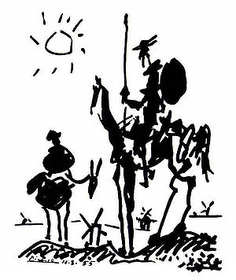
Presentations Do’s and don’t s Keep them simple too!!
John Morris KRIS, King Mongkut’s Institute of Technology, Ladkrabang
Pablo Picasso: Don Quixote

Slide 2
General Rules
Preparing the slides
Easier than papers
Grammar-free!!
Grammar is dangerous …
Avoid it whenever possible

Slide 3
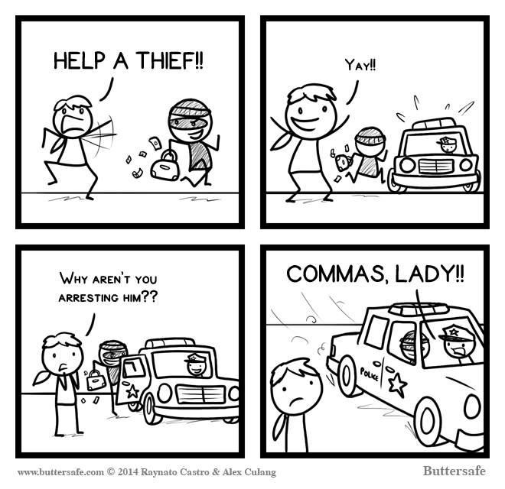

Slide 4
Did you work it out
Help a thief ช่วยขโมยด้วย
Help, a thief! ช่วยด้วย! ขโมย
Commas help in English
I recommend adding more!

Slide 5
General Rules
Preparing the slides
Easier than papers
Grammar-free!!
Most important ‘grammar’ is
Bullet points
Images
Pictures help!
“A picture is worth a thousand words”
Graphs
Diagrams
Videos
With care!

Slide 6
General Rules
Use this slide as an example
Grammar-free!!
Keywords only
Omit articles (‘a’, ‘the’) often
Concise
No long sentences!!
Rarely need sentences at all!
Use bullet points extensively
Pictures help!
“A picture is worth a thousand words”

Slide 7
Google and English
If necessary, use Google to translate phrases and keywords (not sentences) from ภาษาไทย
Translation tools are usually good dictionaries!
Check the translation though!
If it doesn’t look right in English, make small changes to the original Thai
Try different words that mean the same thing

Slide 8
Universal Language
Symbols
Understood by 100% of viewers
Well …… 90% 😐
Use them!!
Mathematics – a universal language
Also
☒ ☑ ☺  ⬆ ⬇ ➔  
Mostly OK
Be careful
Some cultural differences may confuse
    

Slide 9
Use symbols
Better than English words in a presentation!
Meaning is universal – no language needed!
Everybody understands
คนไทย，中国人，日本人，한국인
Symbol | Meaning
⇨ | ‘implies’ or ‘leads to’
∴ | therefore
Mathematical symbols
∀ | For all
∩ ∪ | and or
⊂ ∈ | includes
∉ ⊄ | excludes
。。。

Slide 10
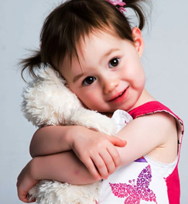
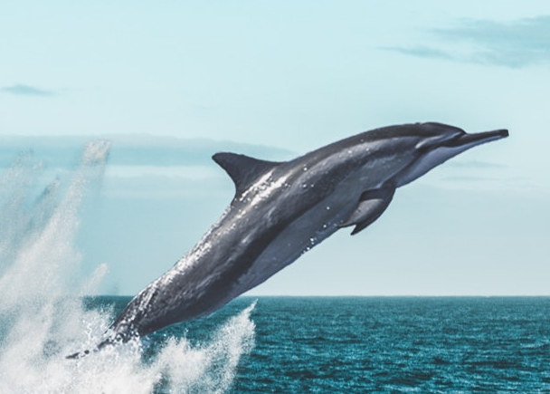
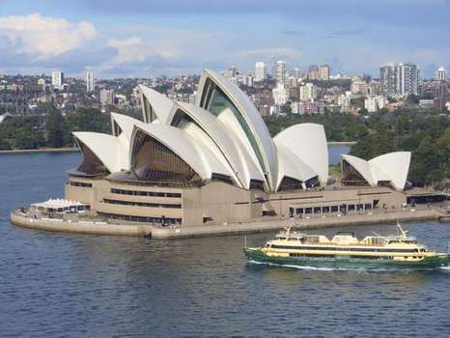
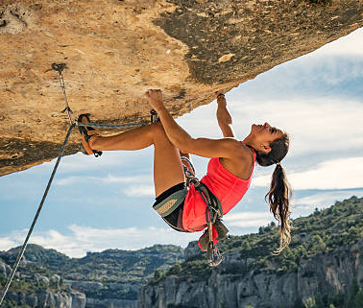
General
Pictures help!
“A picture is worth a thousand words”
Relevant pictures only
Random trees, flowers, mountains, dogs, cats, children, ……………………
Distractions
Your audience is understanding the photo
Not your research

Slide 11
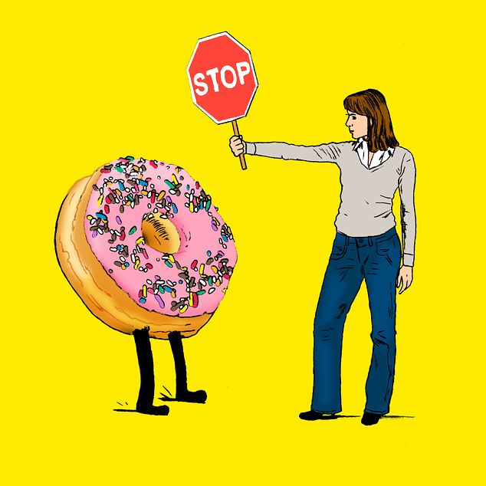
PowerPoint is dangerous!!
PP provides all these fancy ‘designs’
Encourages new users
To ‘try’ them!
Resist the temptation!
Keep your audience focused on your science!

Slide 12
PowerPoint WARNING!!
Trying to add a slide with a ‘fancy’ design to show it here
Caused PowerPoint to reformat EVERY slide
Trying to use the ‘Slide Master’ to beg it to return to the original ..
FAILED COMPLETELY!!
WARNING: Do not try this!
Start with a simple layout that works!
Keep it …
ADVICE: Once you have a clean design that works for you .. COPY that set of slides to start the next presentation

Slide 13
PowerPoint WARNING #2!!
Preparing slides for an international conference
START with a ‘clean’ (empty) presentation
Add text to slides using these fonts
Arial
Times New Roman
Courier
AVOID ThaiSaraban
It is not available on computers outside Thailand
Do not add text and tables in ThaiSaraban!!
Make sure they are converted to Arial
Example follows later …
Safe - international fonts
Likely to be available anywhere

Slide 14
Universal Language
Symbols
Understood by 100% of viewers
Well …… 90% 😐
Use them!!
Mathematics – a universal language
Also
☒ ☑ ☺  ⬆ ⬇ ➔  
Mostly OK
Be careful
Some cultural differences may confuse
    

Slide 15
Use symbols
Better than English words in a presentation!
Meaning is universal – no language needed!
Everybody understands
คนไทย，中国人，日本人，한국인
Symbol | Meaning
⇨ | ‘implies’ or ‘leads to’
∴ | therefore
Mathematical symbols
∀ | For all
∩ ∪ | and or
⊂ ∈ | includes
∉ ⊄ | excludes
。。。

Slide 16
General
Pictures help!
“A picture is worth a thousand words”
Relevant pictures only
Random trees, flowers, mountains, dogs, cats, children, ……………………
Distractions
Your audience is understanding the photo
Not your research

Slide 17
PowerPoint is dangerous!!
PP provides all these fancy ‘designs’
Encourages new users
To ‘try’ them!
Resist the temptation!
Keep your audience focused on your science!

Slide 18
PowerPoint WARNING!!
Trying to add a slide with a ‘fancy’ design to show it here
Caused PowerPoint to reformat EVERY slide
Trying to use the ‘Slide Master’ to beg it to return to the original ..
FAILED COMPLETELY!!
WARNING: Do not try this!
Start with a simple layout that works!
Keep it …
ADVICE: Once you have a clean design that works for you .. COPY that set of slides to start the next presentation

Slide 19
PowerPoint WARNING #2!!
Preparing slides for an international conference
START with a ‘clean’ (empty) presentation
Add text to slides using these fonts
Arial
Times New Roman
Courier
AVOID ThaiSaraban
It is not available on computers outside Thailand
Do not add text and tables in ThaiSaraban!!
Make sure they are converted to Arial
Example follows later …
Safe - international fonts
Likely to be available anywhere

Slide 20
Cute .. But what is it telling you??

Slide 21
General
Do not put too much on one slide!
Font – usually 20 pt or larger
Check by going to the back of the room: can you read it from 20m away?
This is 20 pt
but
Do not ‘shout’ with 40+ pt text!
It’s not a sales presentation
Better than English words in a presentation!
Meaning is universal – no language needed!
Everybody understands
คนไทย，中国人，日本人，한국인
This is 20 pt
This is 24 pt
This is 28 pt
This is 32 pt
This is 40 pt
Used car and real estate salesmen use it!
Serious researchers do not!

Slide 22
Colours
Avoid ‘fancy’ backgrounds!
Distracting
Waste space on each slide
Focus on information content
Presentations are not works of art!
Use simple colour combinations
Black on white background
or
Dark coloured text on a light background
White on black background
or
Light coloured text on a dark background
Key – CONTRAST
between background and text

Slide 23
Colours
Remember
Your reader may be 20 m away
You can read it on your desk,
but at 20m ???
First time presentation for you?
Go to a large room and test!
Colour schemes
High contrast is important!
Light colour on white
Worse .. Light colour on same colour
Worse .. Light colour on same colour
Black on white – boring but readable
For variety – white on black is OK
For variety – strong red on light red is OK
For variety – red on yellow
For variety – red on light blue

Slide 24
Colour schemes
Simple consistent colour scheme
for example
Normal text: black
Red to highlight key words or expressions
Blue for some special terms or key topics
Generally: no more than 3 or 4 colours
No Rainbow colour scheme
Previous slide ..
Messy if your whole presentation is like that!!!

Slide 25
PowerPoint is for salesmen
PowerPoint has many bad features
Wants you to waste time with pretty slides
Two on left are OK
All the others .. You have better things to do!
OK
FORGET

Slide 26
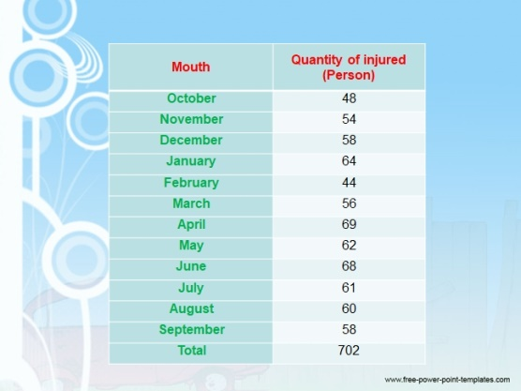
Background Toys
Examples of distracting templates
Simple background, but adds nothing
Listeners are thinking
“Do the patterns mean anything?”

Irrelevant pictures, distracting templates
Circles???
Audience will wonder about them
For EVERY slide!!

AVOID this site (and others like it!)
http://www.free-power-point-templates.com
Many ‘pretty’ slides, but not for serious presentations!/

Pictures are irrelevant, pattern is distracting

Slide 27
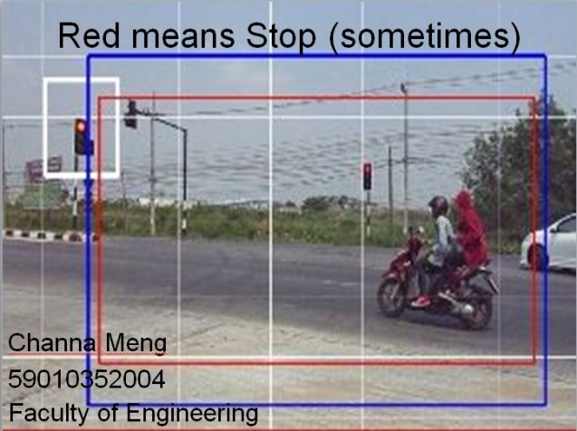
Images on title slide
images leading directly to the topic


Add a few images – relevant to YOUR project
They will make your slides stand out ..
and
save time in your presentation!/
Speaker can introduce subject directly from first slide

University logo is OK!
Listeners may remember MSU and connect to you later!

Slide 28
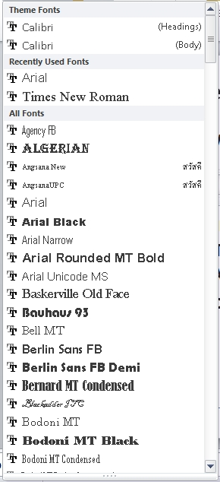
PowerPoint – bad features
Too many fonts
Use
Arial (mostly)
Easier to read on slides
Other sans-serif fonts OK
Helvetica
Calibri
Symbol for math α β χ δ ∴ ∈ ...
Times New Roman
Easier to read in printed reports
Script fonts
Crazy fonts

Slide 29
Animations also!
Simple animations are effective
eg fonts ..
Make it appear
and
Disappear
But … ??
Waste of time
for you – to make it work!)
and
For your audience
Headache
Trying to work out
Does it mean anything??

Slide 30
Animations also!
Simple animations are effective
eg fonts ..
Make it appear
and
Disappear
But … ??
Waste of time
for you – to make it work!)
and
For your audience
Headache
Trying to work out
Does it mean anything??
Special Warning for Thais!
Do NOT USE ThaiSarabanPSK!
It MAY NOT be installed on the computer in your conference room!!
Use common international fonts
Arial, Times, Helvetica, …
These are always available

Slide 31
Do not use ThaiSaraban PSK font !
Computers outside Thailand
Do not know how to process it properly!
You may get this!
Looks good on a Thai computer
but
on a ฝรั่ง one,
you get a mess!!

Slide 32
No SENTENCES
Experiment

Slide 33
Experiment
I will read the next slide at presentation speed
For a native speaker
Expect a non-native to be even slower
Aj Lamul is going to read the slide
at rate for a good English speaker in the audience
Aj Lamul will raise her hand when she has finished reading the slide
When you see her hand go up, note how much of the slide I have finished

Slide 34
Sentences
Experimental detail
The production of organic fertilizers with "engineering Maejo 1"
This is a very simple principle: fragments of plant material and animal waste only. You mix the three plants with manure 1 part by volume of the mixture and mix thoroughly with water for moisture. Form a pyramid with a width of not less than 1.50 m, depending on the amount of the unrestricted crop residues and dung available.
A 1.5 meter high pile of manure is able to retain the heat generated by degradation of microbes added to the compost pile. This heat, in addition to being environment friendly encourages microorganisms to grow in thewith manure in it. Heat flows up to the compost pile carried by an air flow induced by the colder outside of the compost pile. Drawing outside air into the compost pile encourages degradation. Further microorganisms inside do not smell or cause any waste water.

Slide 35
No SENTENCES
Experiment

Slide 36
Experiment
I will read the next slide at presentation speed
For a native speaker
Expect a non-native to be even slower
Aj Lamul is going to read the slide
at rate for a good English speaker in the audience
Aj Lamul will raise her hand when she has finished reading the slide
When you see her hand go up, note how much of the slide I have finished

Slide 37
Sentences
Experimental detail
The production of organic fertilizers with "engineering Maejo 1"
This is a very simple principle: fragments of plant material and animal waste only. You mix the three plants with manure 1 part by volume of the mixture and mix thoroughly with water for moisture. Form a pyramid with a width of not less than 1.50 m, depending on the amount of the unrestricted crop residues and dung available.
A 1.5 meter high pile of manure is able to retain the heat generated by degradation of microbes added to the compost pile. This heat, in addition to being environment friendly encourages microorganisms to grow in thewith manure in it. Heat flows up to the compost pile carried by an air flow induced by the colder outside of the compost pile. Drawing outside air into the compost pile encourages degradation. Further microorganisms inside do not smell or cause any waste water.

Slide 38
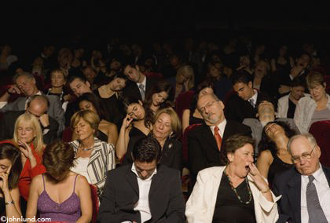
Observations
For large blocks of sentences, English speakers in your audience will be asleep
before you have finished reading!!!
Typically, they will take ½ time to read that you take to speak
Sleeping listeners are bored listeners!!
Clear Rule
No long sentences on your slides
Keywords or short phrases only
Keep your audience awake!

Slide 39
Using keywords and short phrases
Experimental detail
Producing organic fertilizers with "engineering Maejo 1"
Procedure
Fragment plant material and animal waste
Mix plants with manure 1 : 1 by volume
Add water for moisture
Form a pyramid ≥ 1.50 m base, ≥ 1.5 m height
Retains heat generated by microbes
environment friendly
encourages microorganisms to grow
Heat flows up the pile
induced by colder outside
Outside air drawn in encourages degradation
Microorganisms inside
do not smell
cause any waste water
Same content
Same time to speak
but Audience follows what you say
and
Stays awake!

Slide 40
Information density
Just right amount of information on each slide!
Too little – boring for a technical audience
Too much – no one can read it!
You are using 16pt to fit everything in?
You have too much information for one slide!!!
This is 16 pt – can you read it?
Not readable at 20m!!
Make a second slide!
Images (pictures, graphs)
Usually high information density
One per slide is OK
Previous slide – probably too much information!
This slide - about maximum for one slide!

Slide 41
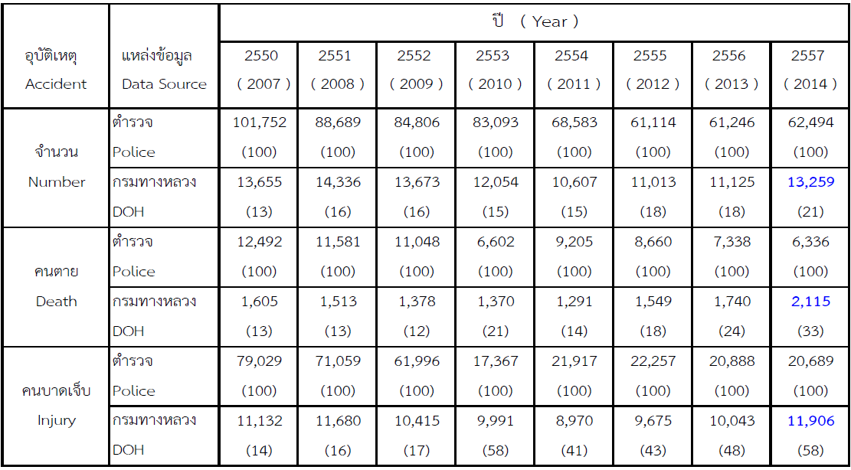
Numbers
How long does it take you to make sense of it?
Too much NOISE
Your eye and brain has to read every digit
11,132 .. 11,680 … 10,415 ….
but
Next year, 11,132 will be 11,387
ie
Only the 11,100 is significant
32 and 87 are noise
Difference between 11,132 and 11,680 can be safely displayed as 11,100 and 11,700
Look at this slide ..
Fewer digits
⇨ less NOISE
Your eye and brain
Reads faster
Sees significant differences faster
Fewer digits
Figures can be larger
Easier to read
x10³ 11.1 11.7 10.4 10.0 9.0 9.7 10.0 11.9

Slide 42
Rule: Remove insignificant digits
Most experimental results
Only accurate to 1%
Often much less!
Maximum 3 significant digits are realistic
Do not write 4.1234 ⇨ 4.1234 ± 0.00005 or 0.001 %
If only 4.12 ⇨ 4.12 ± 0.005 or 0.1 % is reasonable
In fact, 0.1% accuracy is rare in normal lab work
Write 4.1 ⇨ 4.1 ± 0.05 or 1 % which is reasonable
Excess digits really bad in presentations
Audience has limited time to read
Should not appear in your paper either

Slide 43
Too many digits!
Distributor category | 2014 ( 1 OCT. 2013-25 SEP. 2014 | 2015 (1 OCT. 2014 -25 SEP. 2015) | Percentage (%)
1.D/C or discharge | 434 | 474 | Upper 9.21
2.Admitted | 75 | 103 | Upper 37.33
3.Refer | 83 | 92 | Upper 1.084
4.Die | 4 | 4 | Be the same
Total | 596 | 673 | Upper 12.91
Look at this slide
Sample size ~450 .. Change of 1 in 450 ≈ 0.2%
So 9.21% is silly .. Significant changes is ~9%
Next row is even sillier .. 75 -> 103 .. Only 100 patients, so significant change is 37%

Slide 45
CULTURAL DIFFERENCES

Slide 46
Making your presentation
Stand up!!
Most western cultures
People stand up when addressing
Audiences
Superiors
…
In an international conference
Expect
Computer
Place for you to stand beside it
Stand there and face your audience
Next to the screen is best
Use a laser pointer to help

Slide 47
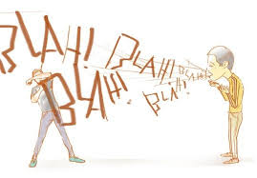
Timing
Find out how many minutes allowed!!
Look on conference website
May require some searching
Presentation schedule provides clues
Practise (at home!!)
Use colleagues, friends, …
Ask someone to time you!
Usually
20 min ‘time slot’
15 min for you
5 min for questions
Sometimes 15 + 5
For Japanese Chemical Society
7 mins
10,000 people

Slide 48
ORGANIZATION
General outline

Slide 49
Outline
Similar - reports, theses and papers
Typically
Introduction
Hypotheses and methods
Results
Analysis
Conclusion
Future work
Acknowledgments
References | Bibliography

Slide 50
Additional sections
Important:
Don’t run over time!!
Each slide takes (wastes) time!
Research paper in conference
15 min + 5 min questions
Sometimes less!!
Each slide uses 30 seconds min
15 min ≡ 20 slides max (safety margin)
Abstract
Rarely
Consider presenting quick summary of whole presentation at beginning but
Usually keep this for conclusion
Outline (replaces Table of contents)
Many people present outline of talk in 2nd or 3rd slide
After introducing topic
I usually don’t … just wastes time
More important to just present in logical order
Glossaries of terms, symbols and acronyms
May be useful if you have lots of acronyms or special terms
BUT
Relevant pictures on title slide
Saves time!
Use every slide effectively!
Outline uses 30 seconds
Maybe forget it!
Glossary – good idea but
No time in 15 min conference talk!
Glossary – good idea but
No time in 15 min conference talk!

Slide 51
Content and order
Same as reports, theses and papers
Typically
Introduction
Hypotheses and methods
Results
Analysis
Conclusion
Future work
Acknowledgments
References | Bibliography
References – usually omitted
No time
Keep printed copy of your paper with you
Answer questions from it afterwards

Slide 52
Question Time - The scary part!!
First rule
Difficult question from the audience?
If you don’t know the answer, say so QUICKLY
It is OK to say .. “I don’t know”
Even experts get questions that are hard!!
Do not waffle
Do not stand there looking dumb
If answer is complicated or long ..
You may reply “May I answer that in the break?”
or “I can show you more data from my laptop in the break”
or “There’s more data in the printed version .. I can take you through it in the break”

Slide 53
Question Time - The scary part!!
Second rule
Make sure you understood the question!
If you did not, ask the questioner to repeat QUICKLY
Do not answer the WRONG QUESTION
Makes you look silly and
Annoys the audience
You may pass the question to your colleague or อาจารย์
Who is hopefully there to help
“Joe did this part of the work, I’ll let him answer”

Slide 54
Question Time - The scary part!!
Some questions are predictable
Practise with you colleagues
Get answers ready
Add some extra slides at the end
Skip to them quickly if the question comes up
Practice makes perfect!
You must practise!
Check timing
Make sure you can finish in time
Don’t forget to allow for questions!
Ask your friends to ask questions
Your audience may ask the same questions

Slide 55
Question time – Things NOT to do
Stand there saying nothing
Check that you understood the question
You can ask for clarification
Try to work out (quickly) what the question was about
Move to slide that you thought was relevant
Ask “Are you asking about this slide?”
You will get a yes or no answer
or if lucky, questioner will tell you “go to slide #14”
Can narrow down the meaning of the question
Chairman is there to help too
He or she wants the session to go smoothly

Slide 56
Question time – Things NOT to do
Stand there saying nothing
Say “I didn’t quite understand your question, may we discuss it ‘off-line’ ?”
‘off-line’ means ‘in the next break’

Slide 57
Question time – Things NOT to do
Sometimes you get an impossible question
About work you are doing now or will do next month
No problem – say “We are working on the answer to your question now, please ask me at the next conference ☺”
Questioner has recognized something that was weak in your results and you know it was weak!
Do not bull-shit !
Do not try to cover up !
Do not make weak excuses!
Say “We know that problem: we are working on it!”
Stops questioner arguing with you!

Slide 58
21 REASONS
Why you should keep it simple

Slide 60
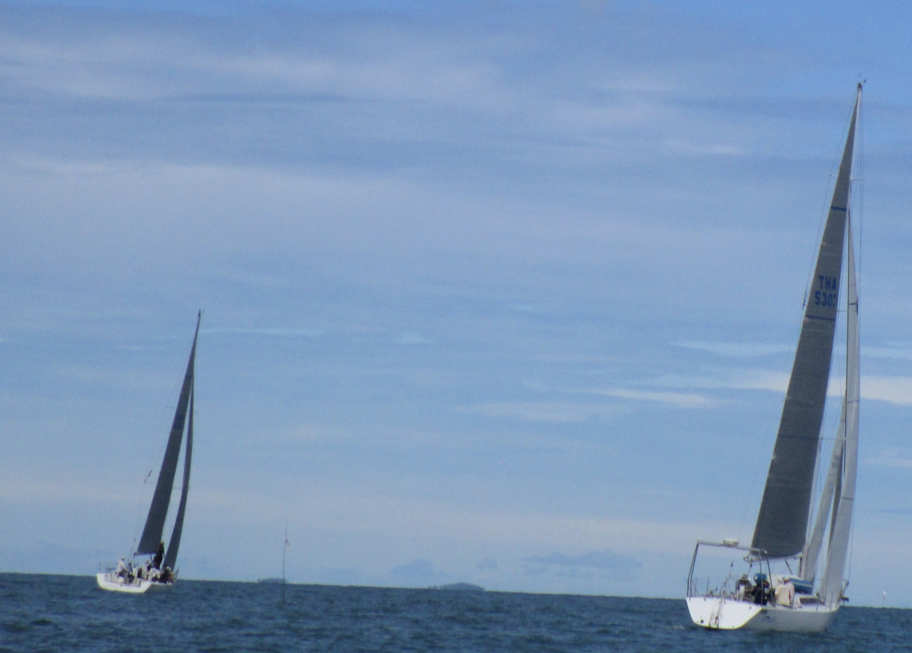
Iolanthe (on left) leads the fleet to Koh SiChang September, 2015

