Slide 1
RUST Building projects
John Morris
School of Industrial Education and Technology, KMITL
previously
Engineering, Mahasarakham University
Electrical and Computer Engineering, The University of Auckland
Iolanthe II leaves the Hauraki Gulf under full sail –
Auckland-Tauranga Race, 2007

Slide 2
Making THINGS RUN
Programming Languages

Slide 3
Rust concepts
Crates
Rust stores libraries of existing functions in
Manifest
Crates needed for a program are defined in the manifest
Cargo.toml
Text file
[package]
name = "pi“
version = "0.1.0“
edition = "2021“
# See more keys and their definitions at https://doc.rust-lang.org/cargo/reference/manifest.html
[dependencies]
rand = "0.8.5"

Slide 4
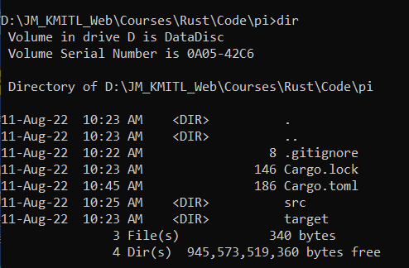
Manifest
Various information about your program, versions, authors, etc
Basic manifest automatically generated by
cargo build pi
Found in project directory, pi
cd pi

Slide 5
Manifest
Edit Cargo.toml with any text editor, e.g. Notepad
Add additional crates to the [dependencies] section
<name of crate> = “<version number>”
eg
rand = “0.8.5”
Find the most recent version from
https://crates.io/crates
Search by name of crate, e.g. rand
Find the most recent version number, e.g. 0.8.5
Add the crate name + version number to manifest
Save!
[package]
name = "pi“
version = "0.1.0“
edition = "2021“
# See more keys and their definitions at …………………….
[dependencies]
rand = "0.8.5“cd

Slide 6
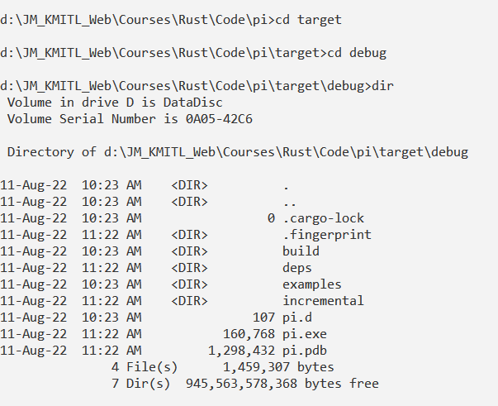
Rust concepts
In your project directory
cargo build
After (possibly a long delay) cargo will update its crates
Now you can run your program
cargo run
Optionally
Executable pi.exe will be found in the target directory

Slide 7
Rust manifests
Executable pi.exe
Can now be copied anywhere
It will run independently
i.e. not need the Rust system

Slide 8
Rust - Annoying Habits
cargo tries to remember what you previously compiled
Even if you have updated the default ‘main.rs’
Containing the ‘Hello world’ program!!
In this case, clean its memory
cargo clean –p pi
Build and run again
cargo build
cargo run

