Slide 1
RUST Introduction
John Morris
School of Industrial Education and Technology, KMITL
previously
Engineering, Mahasarakham University
Electrical and Computer Engineering, The University of Auckland
Iolanthe II leaves the Hauraki Gulf under full sail –
Auckland-Tauranga Race, 2007

Slide 2
HISTORY and Taxonomy
Programming Languages

Slide 3
Programming Languages
Programming Languages
Sets of instructions that your computer hardware interprets to do its work, e.g.
Calculations
Data transformations
Data storage
Communicating data
Controlling output
Images that appear on your screen
Text that is printed on your printer
Command to turn on devices, run motors, etc

Slide 4
Programming Languages
Programming Language Taxonomy
Assembly languages or Assemblers
High level languages
Procedural languages C, Algol, Ada, Java, …, Rust
Functional languages
LISP, Simula

Slide 5
Assembly languages or Assemblers
Two classes –
Based on architecture of underlying CPU
Reduced Instruction Set Computers (RISC)
Each instruction translates to one CPU operation
add R1, R2, EAX
Add value in register R1 to value in register R2 and store sum in register R4
This takes one basic cycle of CPU master clock
e.g. clock frequency, f =1.3 GHz, one cycle = 1/f = 0.77 ns
mov R1, R6
Move value in register R1 to memory address in register R6
This may take 2-10 cycles, depending on the memory location (cache or main memory)
Clearly, anything useful requires many basic instructions!

Slide 6
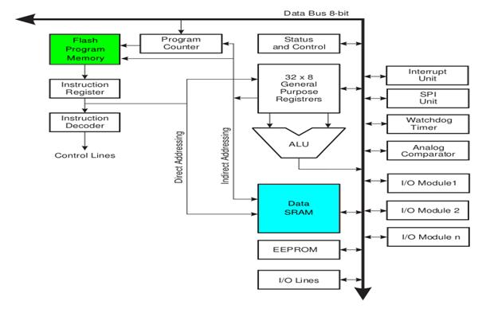
Internals of a synchronous computer
Reduced Instruction Set Computers (RISC) generally have simple internal structure
Diagram of an ARM processor

Slide 7
Internals of a synchronous computer
Reduced Instruction Set Computers (RISC) generally have simple internal structure
Diagram of an ARM processors
Arithmetic Logic Unit (ALU)
Actual calculations
Two inputs
One output

Slide 8
Internals of a synchronous computer
Reduced Instruction Set Computers (RISC) generally have simple internal structure
Diagram of an ARM processors
Registers
Small memory (~32)
128 bit – 8 bit
Fast (one cycle, t=1/f ns)
Supplies values to ALU

Slide 9
Internals of a synchronous computer
Reduced Instruction Set Computers (RISC) generally have simple internal structure
Diagram of an ARM processors
Bus
‘Highway’ between units

Slide 10
Internals of a synchronous computer
Reduced Instruction Set Computers (RISC) generally have simple internal structure
Diagram of an ARM processors
Main memory
SRAM or
DRAM (Gbytes)

Slide 11
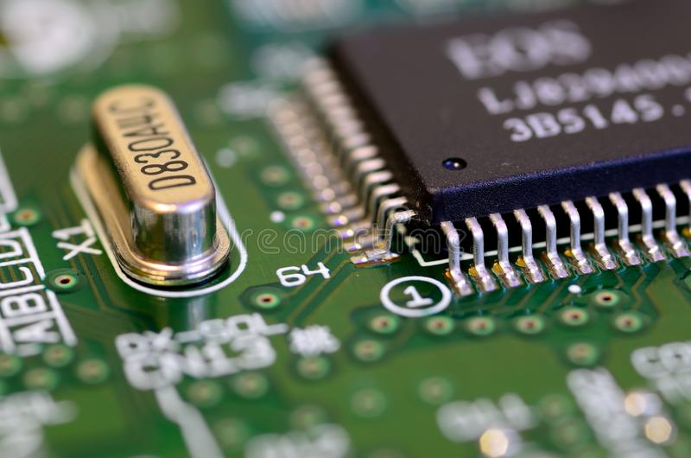
Internals of a synchronous computer
Reduced Instruction Set Computers (RISC) generally have simple internal structure
Diagram of an ARM processors
All controlled by a master clock
Quartz crystal

Slide 12
Assembly languages or Assemblers
Complex Instruction Set Computers (CISC)
CPU runs an internal program (microcode)
Which may take several clock cycles for one CPU operation
add R1, R2, EAX
Add value in register R1 to value in register R2 and store sum in address in EAX
This takes several basic cycle of master clock
e.g. clock frequency, f = 3.4 GHz, one cycle = 1/f ≈ 0.29 ns
This may take 3+ cycles, for the fastest memory (cache)
So one ‘instruction’ takes ∼0.90 ns
CISC computer instructions are more complex but take several basic cycles to execute
Again, anything useful requires many basic instructions!

Slide 13
RISC vs CISC
Which is best?
Subject of a major debate ~20 years ago
Many RISC machines were built and marketed
MIPS
SPARC
Motorola 68000
IBM PowerPC
ARM
Apparently only ARM survived and is found in modern machines
For probably purely commercial reasons,
Only Intel CISC machines (x86, Pentium, etc) have survived in high end computers

Slide 14
Arduino
However, Arduino is readily available
but
Although more powerful than many early processors,
Probably now referred to as a microcontroller

Slide 15
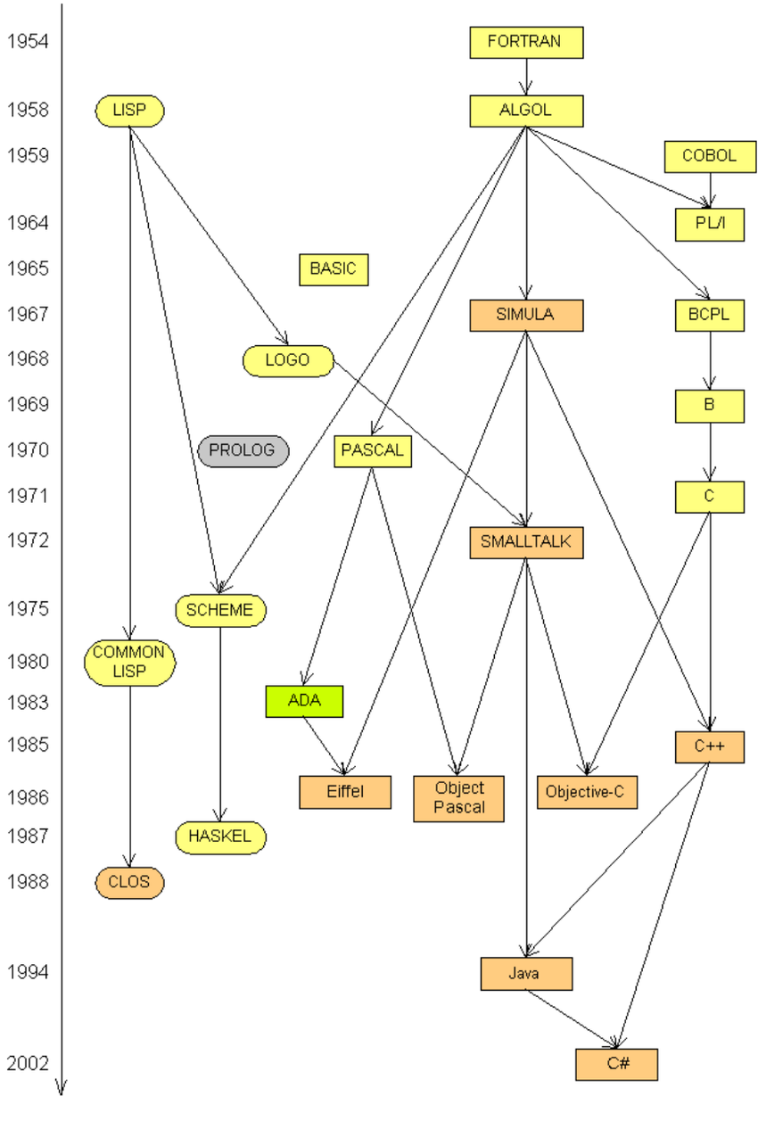
High Level Languages
Clearly programming at assembly level
Using basic machine instructions
Was inefficient and error prone
So, from ~1968 on, many high level languages (HLLs) were developed
Rust joined the family ~2012 when a stable version became readily available
Rust

Slide 16
Disclaimer
Rust is new to all of us
Tutors are trying to learn faster than you
They have experience with several HLLs
From which Rust has derived many features
Your class leader claims familiarity with the HLLs marked in red
But will occasionally be caught ‘off guard’ by ‘new’ features in Rust

Slide 17
Rust Reference
Formal definition of Rust may be found here
Includes formal definitions of syntax and semantics
https://doc.rust-lang.org/reference/index.html
Standard library
All the functions that are available to support the language
https://doc.rust-lang.org/std/index.html
Disconcerting feature
Rust has a new language release every six weeks.
The first stable release of the language was Rust 1.0.0, followed by Rust 1.1.0 and so on.
Tools (rustc, cargo, etc.) and documentation (Standard library, this book, etc.) are released with the language release.

Slide 18
Use of Rust
C and C++ have many well-known problems and traps for the unwary
But C is still used after 50 years!
One aim of this course
You will be able to rapidly adapt to a new HLL
Notes will highlight differences from other HLLs that should allow you to rapidly switch
C, C++ and Java are not expected to die soon
Many references to differences to them will be seen as we go

Slide 19
RUST BaSICS
Low level details

Slide 20
Definition of Terms
Rust term | Definition | Comment
Crate | Library of modules | std is the Rust standard library
Module | Collection of related items
Path separator | :: | Used to separate parts of a full name
Trait | Capabilities that a type provides | ‘somewhat’ similar to the methods of a C++ class
Example
std::Vec::new()
Path separators
Crate
(Rust standard library here)
Module
(Functions for vectors)
Function in Vec
(Construct new vector)

Slide 21
Variables
Like most HLLs, basic program elements are named variables
Enabling you to write high level instructions, e.g.
fn main() { let num:i32 = 5; if num > 0 { println!("number is positive") ; } }
num is a variable
Occupying 32 bits of the computer memory
Representing an integer
In the range { -2³² .. 2³² – 1 }

Slide 22
Variables
When you declare a variable
With the ‘let’ reserved word
Code created by the Rust compiler, rustc, will allocate a memory location
Occupying (in this case) 32 bits (4 bytes) to store an integer
When describing a programming language, we distinguish between
Syntax
Language rules
Equivalent to the spelling and grammar rules for a natural language, e.g. English
and
Semantics
…..

Slide 23
Variables
When you declare a variable
With the ‘let’ reserved word
Code created by the Rust compiler, rustc, will allocate a memory location
Occupying (in this case) 32 bits (4 bytes) to store an integer
When describing a programming language, we distinguish between
Syntax
and
Semantics
Meaning of any statement
What the instructions generated by computer will do in response to this statement

Slide 24
Syntax
Programming languages have (by necessity) have very strict syntax rules
This distinguishes them from natural languages
Examples
Reserved words are defined and may NOT be used for variable names
as, break, const, continue, crate, else, enum, extern, false, fn, for, if, impl, in, let, …
Full list here: https://doc.rust-lang.org/reference/keywords.html
Identifier (Variable) names
Names characters ∈ {‘A’,..,’Z’, ’a’,…,’z’, ‘0’, … ‘9’, ‘_’}
Initial character of a name ∉ {‘0’, … ‘9’}
Actually characters from Unicode Standard Annex #31
Implies that ภาษาไทย characters are permitted

Slide 25
Syntax
Programming languages have (by necessity) have very strict syntax rules
This distinguishes them from natural languages
Examples
Reserved words are defined and may NOT be used for variable names
as, break, const, continue, crate, else, enum, extern, false, fn, for, if, impl, in, let, …
Full list here: https://doc.rust-lang.org/reference/keywords.html
Identifier (Variable) names
Names characters ∈ {‘A’,..,’Z’, ’a’,…,’z’, ‘0’, … ‘9’, ‘_’}
Initial character of a name ∉ {‘0’, … ‘9’}
Actually characters from Unicode Standard Annex #31
Implies that ภาษาไทย characters are permitted
Thus names are case sensitive ..
A and a differ

Slide 26
Syntax
Syntax rules (many) will be introduced as needed
Compilers are very strict about these rules
Particularly punctuation marks
; : . , { } ( ) [ ] …
However, they will report when rules are violated
Reports are sometimes (often) cryptic ☹
Recommended practice:
When the compiler reports more than one syntax error
Fix the first one and
Try again
Many errors, especially { } ( ), cause more ‘flow on’ errors
Fixing the first one may remove the following ones

Slide 27
Semantic errors
Occur when you have not understood the statement in your program correctly
Program compiles but runs incorrectly
Classic semantics problem
Incorrect use of pointers in C and C++
Rust claims to prevent some of these ☺
Experience will show ☺

Slide 28
Variables
Several data types
Integers
Floating point values
Characters
Complex structures
Including strings and arrays

Slide 29
Integers
Integral values
Represented precisely
Limited only by number of available bits
eg 32-bit signed integers represent values ∈ {-2³², 2³²-1}
Several integer types, signed or unsigned, with varying precision are supported
Length | Signed | Unsigned
8-bit | i8 | u8
16-bit | i16 | u16
32-bit | i32 | u32
64-bit | i64 | u64
128-bit | i128 | u128
arch | isize | usize

Slide 30
Integers
const MIN: u32 = u32::MIN;
Integral value ranges
For signed values the range is -2^{n-1} – 2^{n-1}-1
For unsigned values, it is 0 – 2^{n}-1
where n is the number of bits - 8, 16, 32, 64 or 128
Maxima and minima
Pre-defined maxima and minina are available
You can add
const MIN: u32 = u32::MIN;
const MAX: u32 = u32::MAX;
Similar constants for i8, u8, i16, u16, …..
Using them is strongly recommened
Don’t risk setting a max with the wrong n ☺

Slide 31
Integers
Good Software Engineering Practice Note
Good S/W engineers use the tools (compilers, etc) to avoid cluttering their brains with minor detail
Allowing them to focus on the REAL problem
Only hackers (hopefully none of you!) boast that they can remember lots of trivia!!
Integral value ranges
For signed values the range is -2^{n-1} – 2^{n-1}-1
For unsigned values, it is 0 – 2^{n}-1
where n is the number of bits - 8, 16, 32, 64 or 128
Maxima and minima
Pre-defined maxima and minina are available
You can add
const MIN: u32 = u32::MIN;
const MAX: u32 = u32::MAX;
Similar constants for i8, u8, i16, u16, …..
Using them is strongly recommened
Don’t risk setting a max with the wrong n ☺

Slide 32
Integers
At the bottom of the list of integer data types
There is a special type
arch
According to the documentation, your compiler should choose a primitive type for your architecture, usually 32 bits of 64 bits
Integral values
Represented precisely
Limited only by number of available bits
eg 32-bit signed integers represent values ∈ {-2³², 2³²-1}
Several integer types, signed or unsigned, with varying precision are supported
Length | Signed | Unsigned
8-bit | i8 | u8
16-bit | i16 | u16
32-bit | i32 | u32
64-bit | i64 | u64
128-bit | i128 | u128
arch | isize | usize

Slide 33
Integers
Generally, you should design portable programs, which execute correctly on any architecture, x86, x64, arm, etc.
This capability presumably allows you to extract maximum performance out of any machine
However modern CPUs are so fast that the extra programming effort (and your expensive time) rarely justifies the benefit!
USE THIS CAPABILITY WITH CARE!!
It will require extra testing time to verify that expected benefits were obtained AND
Your program does run correctly
Integral values
Represented precisely
Limited only by number of available bits
eg 32-bit signed integers represent values ∈ {-2³², 2³²-1}
Several integer types, signed or unsigned, with varying precision are supported
Length | Signed | Unsigned
8-bit | i8 | u8
16-bit | i16 | u16
32-bit | i32 | u32
64-bit | i64 | u64
128-bit | i128 | u128
arch | isize | usize

Slide 34
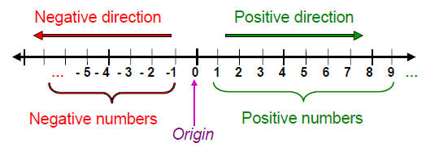
Floating Point Values
Inconveniently, not many problems can be solved (ideally) by integers
Most engineering problems rely on real numbers, ie points that appear at arbitrary points on a real line
Firstly, important to understand
From the lab exercise: Who can explain the result from the ‘squares’ program?
e
π

Slide 35
Floating Point Values
Inconveniently, not many problems can be solved (ideally) by integers
Most engineering problems rely on real numbers, ie points that appear at arbitrary points on a real line
Firstly, important to understand
Binary representations (with string of binary bits) are not precise
e
π

Slide 36
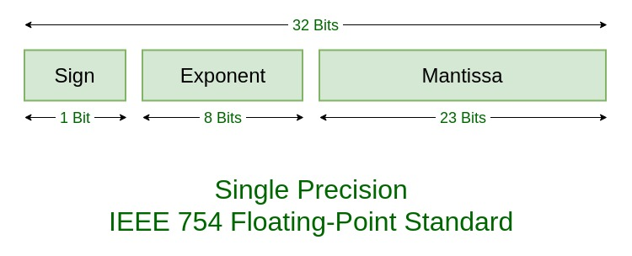
Floating Point Representations
IEEE standard 754 defines representations a real numbers
Single precision – 32 bits
Double precision – 64 bits
e
π

Slide 37
Floating Point Representations
IEEE standard 754 defines representations a real numbers
Quadruple precision – 128 bits
When any arbitrary real number is converted to binary representation
Least significant bit (LSB) may round (up or down)
In following calculations, this error may accumulate
For example
For every term, an error of 1 in the LSB may be added
LSB

Slide 38
Floating Point Representations
Representation problem occurs in most number systems
In decimal representations
1/3 = 0.333…33
2/3 = 0.666…67
So
2 × 1/3 = 0.666…66 ≠ 2/3
Independent of the number of bits used, this problem may still occur
Major trap
let a:f64 = 0.3333; let b:f64 = 0.6667; if 2.0 * a = b { … // here? } else { … // or here? }

Slide 39
Floating Point Practicalities
When building your program, to choose the appropriate data type, you need to know
Range
Maximum and minimum values
Signed or unsigned
Only for integer types
All floating point types are signed
Precision
Smallest change detected
Space (number of bytes used)
1, 2, 4, 8, 16

Slide 40
Floating Point Practicalities
When building your program, to choose the appropriate data type, you need to know
Rust type | f32 | f64 | f128
Bytes | 4 | 8 | 16
Bits | 32 | 64 | 128
Min | ±1.18×10⁻³⁸ | ±2.23×10⁻³⁰⁸ | ±1.2 × 10⁻⁴⁹³²
Max | ±3.4×10³⁸ | ±2.23×10⁻³⁰⁸ | ±1.2 × 10⁻⁴⁹³²
Rust name | f32:min | f64:min | f128:min
 | f32:max | f64:max | f128:max
Precision | 1 in 2²³ 1 in 8×10⁶ | 1 in 2⁵² 1 in 4×10¹⁵ | 1 in 2¹¹² 1 in 5×10³³
Speed | Similar on 64 bit architecture |  | Slow

Slide 41
Floating Point Practicalities
Recommended for new applications
Memory usually not a constraint
Speed – no benefit for f32
Safer
When building your program, to choose the appropriate data type, you need to know
Rust type | f32 | f64 | f128
Bytes | 4 | 8 | 16
Bits | 32 | 64 | 128
Min | ±1.18×10⁻³⁸ | ±2.23×10⁻³⁰⁸ | ±1.2 × 10⁻⁴⁹³²
Max | ±3.4×10³⁸ | ±2.23×10⁻³⁰⁸ | ±1.2 × 10⁻⁴⁹³²
Rust name | f32:min | f64:min | f128:min
 | f32:max | f64:max | f128:max
Precision | 1 in 2²³ 1 in 8×10⁶ | 1 in 2⁵² 1 in 4×10¹⁵ | 1 in 2¹¹² 1 in 5×10³³
Speed | Similar on 64 bit architecture |  | Slow

Slide 42
Floating Point Practicalities
Be careful
Large (2022) applications can generate overflow .. ~1 in 10⁶ precision
Consider for small CPUs - Microprocessors, e.g. Arduino
Perhaps for also memory intensive, e.g. image processing, applications
When building your program, to choose the appropriate data type, you need to know
Rust type | f32 | f64 | f128
Bytes | 4 | 8 | 16
Bits | 32 | 64 | 128
Min | ±1.18×10⁻³⁸ | ±2.23×10⁻³⁰⁸ | ±1.2 × 10⁻⁴⁹³²
Max | ±3.4×10³⁸ | ±2.23×10⁻³⁰⁸ | ±1.2 × 10⁻⁴⁹³²
Rust name | f32:min | f64:min | f128:min
 | f32:max | f64:max | f128:max
Precision | 1 in 2²³ 1 in 8×10⁶ | 1 in 2⁵² 1 in 4×10¹⁵ | 1 in 2¹¹² 1 in 5×10³³
Speed | Similar on 64 bit architecture |  | Slow

Slide 43
More data types
Boolean – Rust type ‘bool’
Logical values – true or false
Strongly recommended for clear programs
Set the state – true | false
Rather than repeating the test condition
Note the operators
& (and) | (or) ^ (xor) == (equal) > (avoid!!)
let ok: bool = true;
ok = ((n < 1000) & (m < 100)) | (x < eps);
Requires reader to remember precedence rules

Slide 44
Precedence rules
Bad idea invented by program language designers years ago
In every language, orders of operators are defined
Thus × and ÷ precede + and –
i.e. to evaluate
g = a×b + c ÷ d
First, compute a×b, then c ÷ d, then add
While theoretically interesting, you can always write
g = (a×b) + (c ÷ d)
and
forget about the precedence rules!!
As a software engineer,
you have more important things to worry about than precedence rules
You can forget them .. and always add parentheses to your code
Guarantees code will be correct

Slide 45
More data types
boolean
Logical values – true or false
Strongly recommended for clear programs
Set the state – true | false
Rather than repeating the test condition
Note the operators
& (and) | (or) ^ (xor) == (equal) > (avoid!!)
let ok: bool = true;
ok = ((n < 1000) & (m < 100)) | (x < eps);
In this case, the precedence rules define an order
true, false or maybe false, true???

Slide 46
More data types
Boolean – Rust type ‘bool’
Logical values – true or false
Strongly recommended for clear programs
Set the state – true | false
Rather than repeating the test condition
Note the operators
& (and) | (or) ^ (xor) == (equal) > (avoid!!)
Note this example, there are precedence rules for < & and |
but
I avoided remembering them, by adding the parentheses ( )
let ok: bool = true;
ok = ((n < 1000) & (m < 100)) | (x < eps);
In this case, the precedence rules define an order
true, false or maybe false, true???

Slide 47
More types - character
(Mostly) Printable characters
Originally coming from the set of Latin characters
Original ASCII character set
A … Z (26 of them)
Punctuation marks . , ; / : …..
Formal definition is ‘Unicode scalar value’
Unicode allows ‘code points’ in 0 to 0x10FFFF
Enabling characters from most languages to be used
but a single character may need more than one byte!
char variables use 4 bytes
Declaration
let mut _a:char = 'a';

Slide 48
Literals
Constants
Needed to assign values to variables
Used in expressions
Function arguments
Note ‘_’ can be inserted to enhance readability
Integers
Decimal | let x:i32 = 203;
Hexadecimal | let y:i64 = 0x5672_03;
Octal | let z:i64 = 0o70
Binary | let b:i128 = 0b1111_1111_1001_0000;

Slide 49
Literals
Constants
Needed to assign values to variables
Used in expressions
Function arguments
Characters
ASCII | let x:char = ‘a’;
Escaped | let y:char = ‘\n’; let cr:char = ‘\r’; let tab:char = ‘\t’; let slash:char = ‘\\’;
Hexadecimal 24 bit unicode | let z :char = ‘\u{7FFF}’;
Binary | let b:i128 = 0b1111_1111_1001_0000;

Slide 50
Literals
const rho: f64 = 0.02786; const N: i32 = 216; const L: f64 = (N as f64 / rho).powf(1.0 / 3.0); ... const TIME_STEP: f64 = dt * f64::sqrt(MASS * SIGMA * SIGMA / EPSILON;
Constants
Needed to assign values to variables
Used in expressions
Function arguments
Floating point numbers
Decimal | let f:f64 = 1.546; let g:f64 = 1.5e-6;
Escaped | let y:char = ‘\n’; let cr:char = ‘\r’; let tab:char = ‘\t’; let slash:char = ‘\\’;
Hexadecimal 24 bit unicode | let z :char = ‘\u{7FFF}’;
Binary | let b:i128 = 0b1111_1111_1001_0000;

Slide 51
Literals
Constants
Defined with expressions
Very useful capability
Notes
Rust rejects mixed mode arithmetic!
Integer N must be explicitly cast as f64 before it can appear in an floating point calculation! Using the keyword as
const rho: f64 = 0.02786;
const N: i32 = 216;
const L: f64 = ( N as f64 / rho).powf(1.0 / 3.0);
const TIME_STEP: f64 = dt * f64::sqrt(MASS * SIGMA * SIGMA / EPSILON);

Slide 52
Literals
Constants
Defined with expressions
Very useful capability
Notes
powf function – raise its argument to a power – formally defined as
pub fn powf(self, n: f64) -> f64
Can be applied to any f64 expression
L = (N/rho)^{1/3} or L = ³√(N/rho)
const rho: f64 = 0.02786;
const N: i32 = 216;
const L: f64 = ( N as f64 / rho).powf(1.0 / 3.0);
const TIME_STEP: f64 = dt * f64::sqrt(MASS * SIGMA * SIGMA / EPSILON);
self refers to the preceding expression

Slide 53
Arithmetic functions
std has an extensive set
Monadic
abs(self) sqrt(self) cbrt(self) sin(self) cos(self)
…
Dyadic
log(self, base) powf(self,power)
…
Apply as
x.abs() or f64::abs(x)
Has a single argument
Has two arguments

