Slide 1

KISS …Keep It Simple:
.. and get accepted!
John Morris
KRIS, KMITL
previously
Engineering, Mahasarakham University
Electrical and Computer Engineering, The University of Auckland
Iolanthe II leaves the Hauraki Gulf under full sail –
Auckland-Tauranga Race, 2007

Slide 2
GRAPHS
Tips
KISS: 2nd edition,

Slide 3
Graphs
Easy to generate
  Excel will do it for you!
  Remember
    Microsoft’s Largest Market BUSINESS
    Scientific papers …
      #53 on their list
  Be careful when generating graphs for papers

Slide 4
Graphs
Easy to generate
  Excel will do it for you!
but
Good, clear graphs need
  time,
  effort and
  skill
  or
  practice!
Tables are faster and simpler
  If you can present data effectively in a table,
  use a table!
Graphs are good … but expensive!!
  If short of time, put your data in a table

Slide 5
Rule #1
Graphs
  If possible,
  Plot the original data points
    Make them clearly visible
    Original data points
    visual clue for experimental accuracy
Reasonably
accurate
Very
accurate

Slide 6
Rule #1
Graphs
  Multiple graphs
    Select symbols large enough
      Ideally you should be able to see original data points
    Dashes or dots better than colours
      Your graph may (very likely) printed in monochrome
Remember
  Colour screen or printer?
  Not always available
    Even in 2019 😐
If you really need colour to make it clear
  Say so in caption
  Fig 3 Langmuir vs Freundlich Models for Adsorption
  Note: This graph will be viewed better on a colour screen

Slide 7
Factors to check
Graphs
  Plot the original data points
  Add the predicted behavior as a smooth curve
    Usually linear
    Non-linear models: normalize data and plot as straight line
      Your brain instantly recognizes straight lines!
      but
      x² or x³ or log x or ….
      Many look similar to your eye

Slide 8
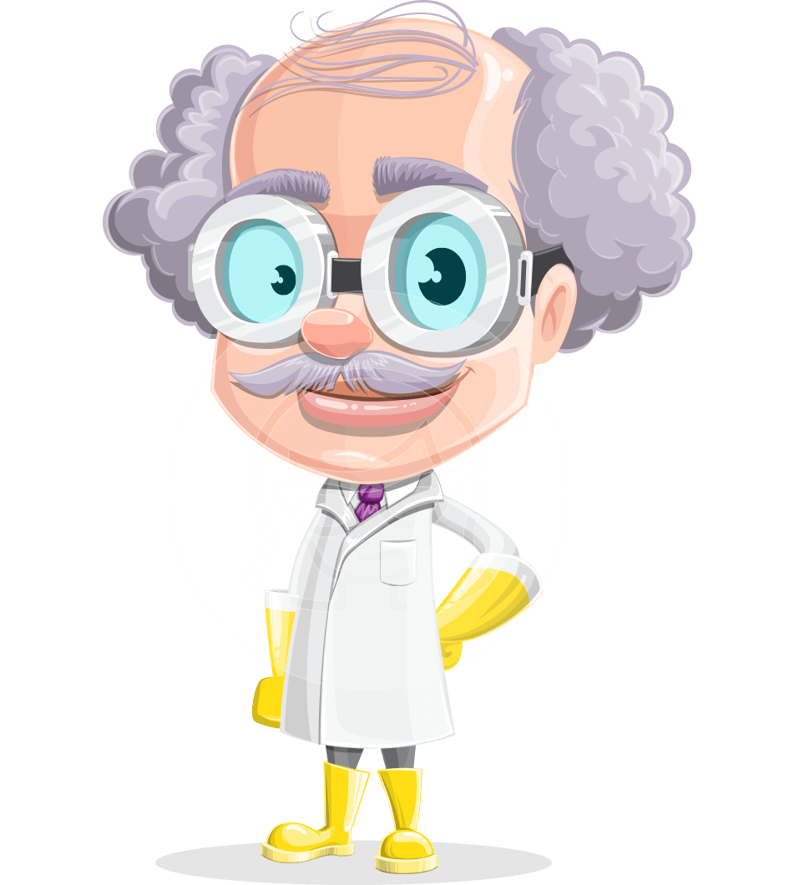
Factors to check
Graphs
  Is everything legible
    Same as presentation check
    Do you need your glasses to read it?
      If so, detail is not large enough!
    Even if you can read it,
      Can your senior professor read it too?
  Axes labels and units
    Often ignored!
    Excel allows you to make them larger
      With difficulty!
      Part of the time required to make a good graph

Slide 9
Very important!!!
Graphs
  Plot the original data points
  Do NOT ‘join the dots’ with Excel
    Your observations have errors!
    Joining the dots is physically meaningless!
  Do NOT add a high-order polynomial trend line with Excel
    Nice curve, but physically meaningless!
    Plot the theoretically predicted model

Slide 10
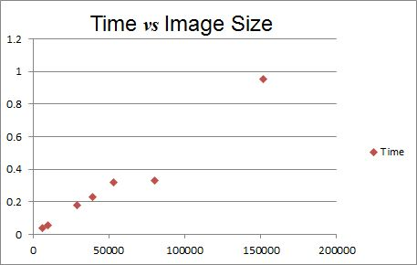
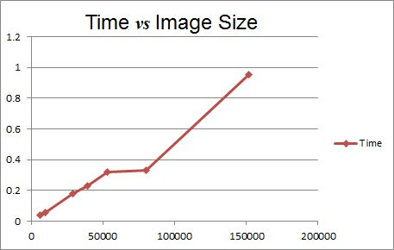
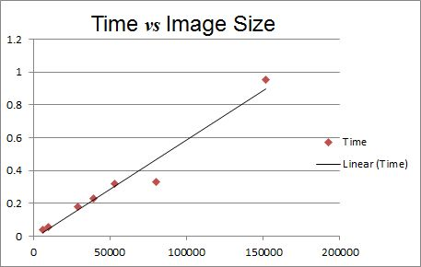
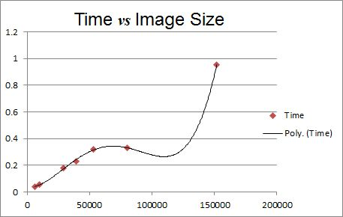
Factors to check
✓Original Data
☒Join the dots
✓Predicted model
☒Physically meaningless!

Slide 11
SUPPLEMENTARY DATA
Gbytes of data?

Slide 12
Supplementary Data
Many journals now allow supplementary data
  Large blocks of data
    Tables of original data
    Model calculations
    Databases of images
    …
  Good idea
  Some referees will insist on it
  Allows you to add lots of detail
  that might make the paper boring for a general reader
  but
  Useful for someone using your results
  and
  Citing your results!!
Attach this data to your original submission
Referees will need it
They may be the only people who read it

Slide 13

Tables
Next 5 pages

