Slide 1
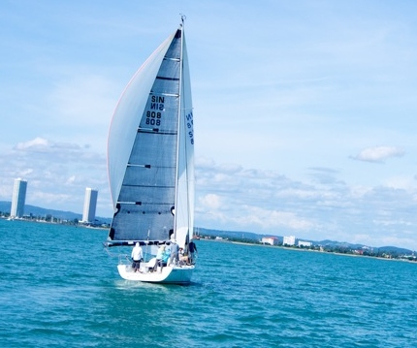
Research Methods and Techniques Reports and Presentations
John Morris
KRIS, King Mongkut’s Institute of Technology Ladkrabang
previously
Faculty of Engineering, Mahasarakham University
and Computer Science/ Electrical and Computer Engineering,
The University of Auckland
Iolanthe II leaves the Hauraki Gulf under full sail –
Auckland-Tauranga Race, 2007
Iolanthe III racing off Jomtien, with full gennaker set

Slide 2
REPORTS and PRESENTATIONS

Slide 3
RepORT FORMAT

Slide 4
General Outline
Reports, theses, papers, … will generally have similar patterns
Typical pattern
Introduction
Hypotheses and methods
Results
Analysis
Conclusion
Future work
Acknowledgments
References | Bibliography
Commonly each item will be a separate
Section of a paper or report
Chapter of a thesis

Slide 5
Additional sections
Abstract
Not necessary for short documents
Tables of contents
Only for longer documents, eg theses
Don’t make a ToC for a 2 page document!
Glossaries of terms, symbols and acronyms
Very good idea if you have space
In particular, not all acronyms are obvious to even expert readers
Index
Long documents only
Lists of tables, figures
Actually of limited use, but can be generated automatically ☺

Slide 6
General Outline
Introduction
General aim of the research
Introduce topic very briefly, eg
We will study road accident prevention
Background – why is this problem important?
Road accidents cost the community a large amount [1]
Cost is estimated to be $x billion per year [2]
Previous research
What have other researchers said about this problem
Survey of safety mechanisms used or proposed by others [3]
Detailed aim of this research
We think we can use cameras in the car to reduce collisions
This is your first hypothesis!

Slide 7
Background
Key component of your introduction is a summary of existing work or literature review
Literature search
Vital to good research
Know what others have done
Know what problems still exist
Critical review of existing work
Did previous authors
Miss anything?
Make weak assumptions?
Make mistakes?
Forget to study important cases?
Study only trivial cases – ignoring important real cases?

Slide 8
Background
Searching
Almost everyone uses Google or Google Scholar!
Textbooks first
Basic theory
Carefully prepared
Almost every published work has errors!
Some are small and trivial but …
Authors spend more time and effort on textbooks
Reduction in errors
Library (physical)
Old-fashioned but highly recommended
Paper journals
Easy to browse looking for relevant work

Slide 9
Background
Journals online
Browse recent volumes of important journals in your area
Look for recent work in related fields
eg if you are studying drying of macadamia nuts
A paper on drying beans might just have some new ideas for drying food
You may not see it in Google because your keywords were
macadamia + nuts + drying
So papers on macadamia nuts appear first
Followed by papers on other types of nuts
Finally, on page 6, drying of things that are not nuts
Look for recent survey or review papers
Invaluable for preparing your introduction!!
Most of the work may have been done for you!
Conferences also

Slide 10
Good sources and bad sources
Find out which textbooks, journals and conferences are important in your area
Ask your supervisor, other staff members, classmates, ..
Example: for electrical and electronic engineers, most important is IEEE (Institute of Electrical and Electronic Engineers)
Indexed journals and conferences are important
High rating journals attract the best (most important) papers
Web pages
Much good and useful work online in webpages
but
Much rubbish (bull-shit) too!
Authority
A good source can be traced back to its author(s)!
If you know the author’s name – at least one person stood by the statements in the souce

Slide 11
Good sources and bad sources
Authority – is it rubbish or not?
Textbooks, refereed journals and conferences
At least two other people read the paper and agreed that it was basically correct
A good source can be traced back to its author(s)!
If you know the author’s name – at least one person stood by the statements in the source
If you don’t know the author’s name .. Can you trust it?
No! Nobody put their name so this work, so it could well be rubbish!
RULE: if you can’t find an author, don’t use it as a source!
Note: Companies and institutions are authors when you apply this rule
For example, data sheets for electronic devices – no person but the company name is there
Use the company name in place of the author in your reference list

Slide 12
Good sources and bad sources
Web pages
If there’s a clear author
eg it’s somebody’s home page or there’s a name on the page somewhere
Then it may be a good source
But nobody has checked it!
So use with care!!
Web pages with no author’s name .. Can you trust it?
No!
There is an enormous amount of just wrong information on the web!
RULE: Don’t use web pages (URLs) as references unless you know the author’s name!
Note: Companies and institutions are authors when you apply this rule
eg information on Intel’s web site is likely to be reliable

Slide 13
Good sources and bad sources
Wikipedia
Contains thousands of good pages
But there is never an author’s name
Wikipedia’s founders wanted everybody to be able to contribute
They did not realize that many people would
contribute biased pages or
edit good pages to reflect their view
So use with care!!
Generally scientific and mathematical pages are good
Some projects have been started by (anonymous) groups to make these comprehensive and correct
Good wikipedia pages have references at the bottom
RULE: Use the reference on the wikipedia page if possible!
It’s the original source anyway
It will have a name (person, company or institution)

Slide 14
Background
Searching
Almost everyone uses Google or Google Scholar!
Journals online
Browse recent volumes of important journals in your area
Look for work in related fields
eg if you are studying drying of macadamia nuts
A paper on drying beans might just have some new ideas for drying food
You may not see it in Google because your keywords were
macadamia + nuts + drying
So papers on macadamia nuts appear first
Followed by papers on other types of nuts
Finally, on page 6, drying of things that are not nuts

Slide 15
RepORT PreParation TOOLS

Slide 16
Tools
Short documents
Letters, short proposals, …
Word is fast and easy
Longer documents (> 5 pages)
LaTeX saves time overall
It takes a little time to learn
Follow templates from other researchers
Use style files provided by journals and conference organizers
Download style files and example docs
Remove the example text and substitute your own
LaTeX uses global styles and produces very consistent output
Time spent learning LaTeX is saved compared to the time someone using Word will spend editing and re-editing and re-editing documents

Slide 17
LaTeX
LaTeX is a document formatting tool
Not a WYSIWYG editor like Word
Freely available for Linux, Windows (miktex), IOS, ..
Prepare a document marked with LaTeX directives
Use any text editor (even Word .. but save as text file!)
It’s often called a markup language ..
You add LaTeX formatting directives to plain text
Process the marked up document with pdfLatex
pdf document
Check the result with acrobat or other pdf reader
Integrated tools exist
Just click on a button in the editor to see the pdf

Slide 18
LaTeX
Uses formatting commands
\section
\abstract
\title
Easy to change the style of the whole document consistently by changing
document class
This will change title, abstract, section headings, …
other macros
Biggest advantages
Consistent formatting of whole document
LaTeX does most of it for you!
Very powerful equation and math formatting
Bibliography management – using bibtex
Many journals provide bibtex entries for you
Just cut and paste into your own bibliography

Slide 19
FONTS, FORMATTING

Slide 20
Fonts
In papers, theses and reports
Fonts with serifs are easier to read
Times New Roman, Palatino
Use them in preference to sans-serif fonts
Arial, Verdana, …
or ‘typewriter’ fonts
Courier
In contrast, sans-serif fonts are easier to read at a distance
So use them for presentations (like these slides) and posters
Some use them for headings too

Slide 21
Serifs
Sans-serif font – sans (Fr) = without; serif (Fr) = tail

Slide 22
Fonts
Keep the number of fonts to a minimum
Text: Times New Roman
Headings: Arial
Code fragments: Courier
Script for some mathematical symbols: A, B, ..
Too many fonts makes a report look messy
It also takes longer to write
You must be consistent, so you waste time checking that you’ve used the same font for this part before!

Slide 23
Fonts
Use widely available fonts
Document formatting systems will now substitute ‘best guesses’ for unknown fonts
Unintended results
Misaligned tables, etc
Really messy output
Microsoft seems to be in the font business too!
I now have a set of proprietary fonts on my computer
Avoid these strictly!
There are many common alternatives
Not all publishing software is controlled by Microsoft!
Even though they might be trying to get control!

Slide 24
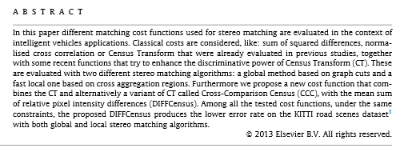
Formatting
Justified text
Ragged right text
Right margin aligned
Right margin
not aligned
‘ragged’

Slide 25
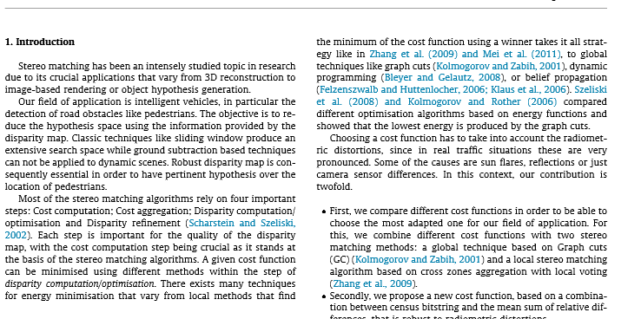
Formatting
Justified text
Almost always used when setting text in more than one column
Both right margins aligned

Slide 26
Formatting
Research has shown that ‘ragged-right’ aligned text is easier to read than justified text
Editors of newspapers, proceedings, etc which use a two-column format prefer justified text because it makes the columns look ‘pretty’!
So you have no choice if submitting to, for example, IEEE conferences
but
Single column text should be aligned ‘ragged-right’

Slide 27
GRAPHS and TABLES

Slide 28
Graphs
Show actual measurements
Do not connect individual measurements
Even though Excel makes it easy!
Lines should reflect model
Your graph should show how well actual measurements matched the theory (hypothesis)
Show error bars whenever possible
If your line goes through the error bars, then you have a possible fit to the theory!
Even an apparently poor fit to theory may be OK if you show errors properly!

Slide 29
Graphs
Correct graph
Actual measurements shown without joining them
Smooth line represents model
Graph clearly shows good correlation between model and experiment – even with inaccurate measurements!
Incorrect graph
Actual measurements joined by
meaningless line
This graph shows typical random measurement error σ ~ 3

Slide 30
Graphs
Transform data to linear form before plotting!
Our eyes can recognize straight lines easily
But can’t tell the difference between x² and x³ without help!

Slide 31
Graphs
Correct graph + error bars
Adding error bars is a good idea
(but time consuming!)
Graph clearly shows good correlation between model and experiment – model value lies within error range for each measurement!

Slide 32
Graphs
Transform data before plotting
Linear relationships easily visualized
Straight lines easily judged by our brains
Example
Model is T(n) = an³
If you plot T(n) vs n, it is hard to judge whether data fits the theory
If you plot T(n) vs n³, you should get a set of constants, a
Actually, you don’t need a graph at all now!
Make a table of T(n)/n³ vs n – all the entries should be a
Now it’s easy to judge the accuracy of your estimate of a !

Slide 33
Table – Normalized data
You don’t need a graph
This column has the answer!
Model: y = x²
x | x^2 | y | y/x^2
0 | 0 | -1.7 | 1.0
1 | 1 | 0.3 | 0.3
2 | 4 | 5.8 | 1.4
3 | 9 | 8.4 | 0.9
4 | 16 | 17.8 | 1.1
5 | 25 | 27.0 | 1.1
6 | 36 | 37.3 | 1.0
7 | 49 | 49.0 | 1.0
8 | 64 | 62.7 | 1.0
9 | 81 | 78.6 | 1.0
10 | 100 | 98.9 | 1.0
 | Mean |  | 1.1
 | Std dev |  | 0.3

Slide 34
Next Assignment #2 – due ….
Search the literature for background on your research topic
Write a summary of at least two relevant papers in the form that you would put into your thesis or a paper
These papers MUST be from journals or conferences OUTSIDE Thailand
In English or 中文 or 日本话 or anything NOT ภาษาไทย!!
Direct active English, please!
Use the translator to help, but check its output!
Elaborate grammar NOT needed ..
Follow guidelines given in lectures to write simply and well!
Submit by email to john.m@msu.ac.th with subject “Research Methods”
Don’t forget to put your name on your report!
It should have a title (but no abstract) just like a regular paper
About 2 pages – maximum 5 pages .. + references

Slide 35
Next Assignment #2 –
Search the literature for background on your research topic
Write a summary of at least two relevant papers in the form that you would put into your thesis or a paper
WHY is this paper relevant?
WHY are the results in it important?
WHAT are the important results in those paper?
WHAT can you improve on or do better than?
Most of the information you need for this report is in the paper’s ABSTRACT!!
BUT DON’T COPY THE ABSTRACT!!
Copy abstact means ZERO mark!!
SUMMARIZE
Important results from these paper – RELEVANT to YOUR work!!

Slide 36
HYPOTHESES in REPORTS
Further notes

Slide 37
Hypotheses
You can express hypotheses in many ways
Use this form
IF <we do this>
THEN <we would expect this result>
eg
IF we set the test with 50 students and plot the distribution of their scores
THEN we would expect to see a normal distribution
or
Describe some background theory and assumption
Then describe the experiment to confirm it
Note that the THEN part describes what you will expect

Slide 38
Hypotheses
Use this form
IF <we do this>
THEN <we would expect this result>
eg
IF we set the test with 50 students and plot the distribution of their scores
THEN we would expect to see a normal distribution
Note that the THEN part describes what you will expect
This makes it very easy to
Design the experiment
Show that your experiment was successful
Conclusion matches THEN section
The student scores were normally distributed and confirmed our hypothesis.

