Slide 1
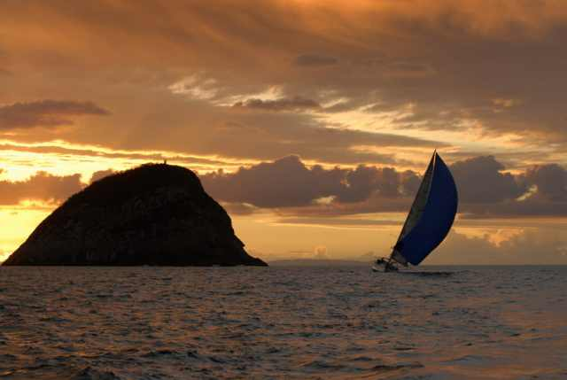
KISS …Keep It Simple:
.. and get accepted!
John Morris
KRIS, KMITL
previously
Engineering, Mahasarakham University
Electrical and Computer Engineering, The University of Auckland
Iolanthe II leaves the Hauraki Gulf under full sail –
Auckland-Tauranga Race, 2007

Slide 2
TABLES
☺ Stress relief
KISS: Ch 9, p 27-,

Slide 3

Tables
KISS: Edition 2 ☺
English Grammar!!
Not regular
Too many rules
Some help available
  …………….

Slide 4

Tables
KISS: Edition 2 ☺
Stress relief for non-English writers
Reducing need for (so much) English grammar
Technical papers must be clear and concise
  Relaxed grammar is allowed
  Your high school English teacher
  might be shocked
  but
  ………………………
You can’t write that!!

Slide 5
Tables
KISS: Edition 2 ☺
Many things can be put in tables
Introduction
Background
Previous work
Summarize in table(s)
  Columns
  Author(s)
  Year
  Name of method
  Short description
  Reference

Slide 6
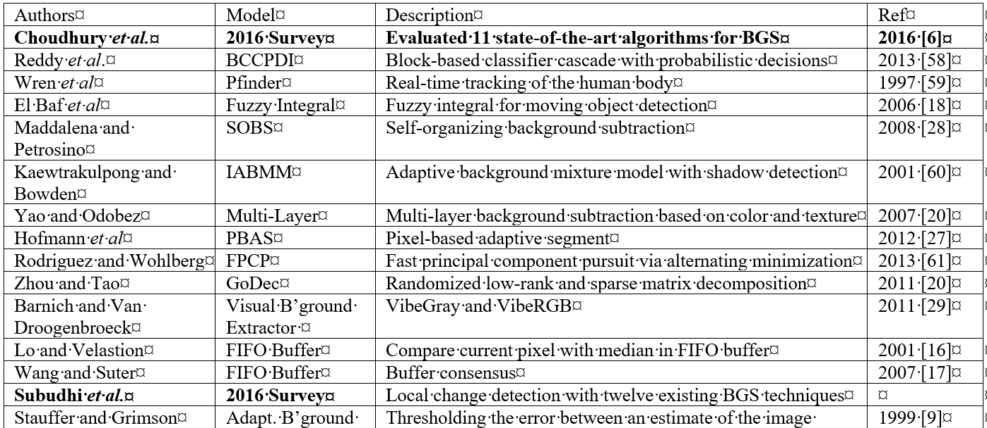

Introduction Table
Comment:
Phrases ONLY
No sentences!
No grammar!
English needed in the paper:
Methods used for background subtraction
are summarized in Table 1.

Slide 7
Tables
KISS: Edition 2 ☺
Many things can be put in tables
Methods
  Materials
  Equipment
  Steps in method
  Summarize in table(s)

Slide 8
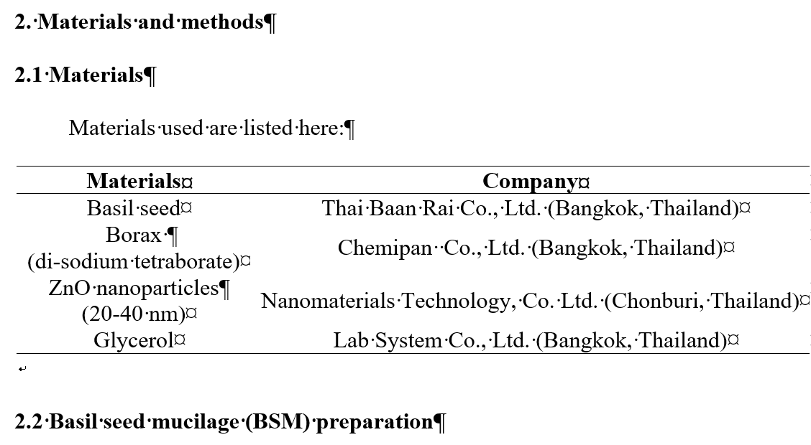
Materials Table
Materials section ..
One simple sentence in whole section!
Methods used
Purityor background subtraction
are summarized in Table 1.
Other columns could be added, eg
Purity
Table itself
Brief comments only
Full name of chemical
Particle size

Slide 9
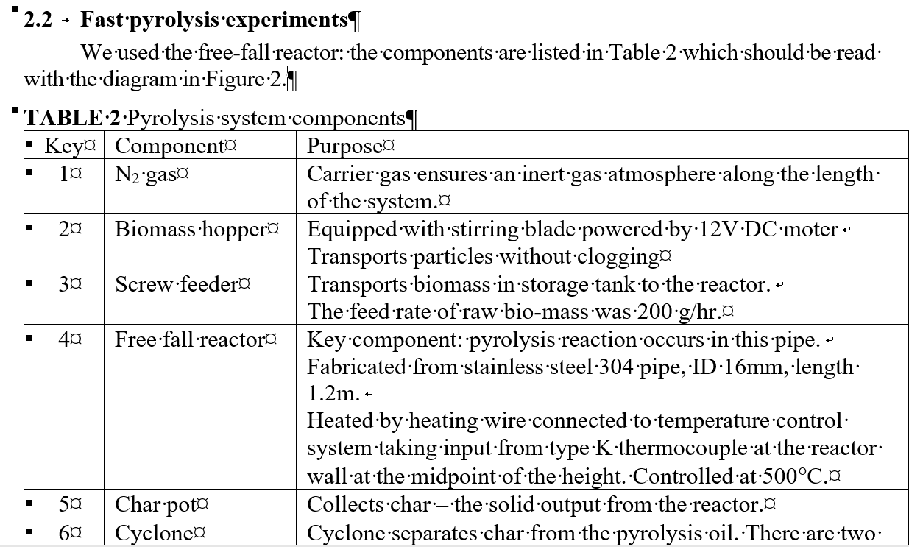
System Description
Methods section ..
Description of a system!
Table – most of details
Some simple comments
in English

Slide 10
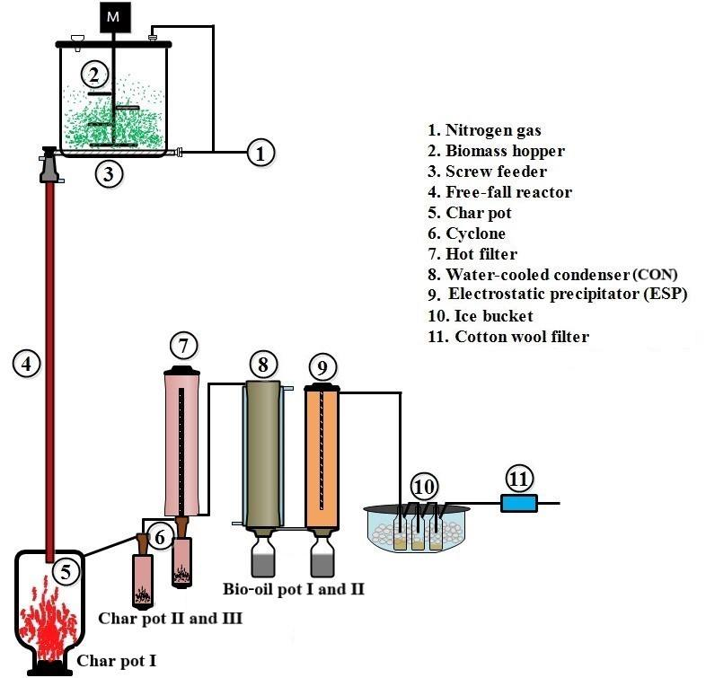
System Description
Methods section ..
Description of a system!
Figure –
read with descriptions
in table
Methods section for this paper
Table
Figure
Few English words

Slide 11
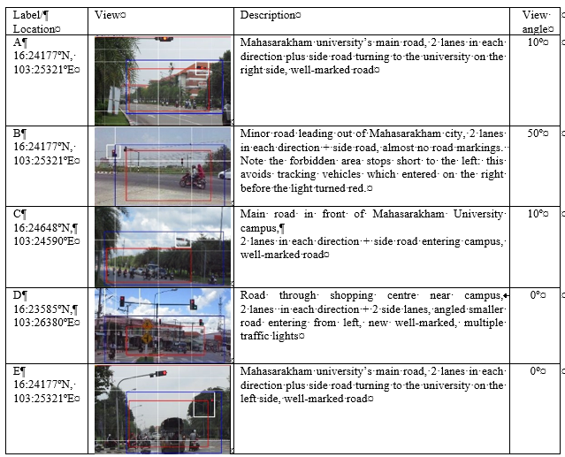
Experiment details
Everything
  Data
  Images
  Descriptions
  Experiment
  conditions
Descriptions
  Normal text
  Sentences
  or
  Notes
  Imperfect
  grammar

Slide 12
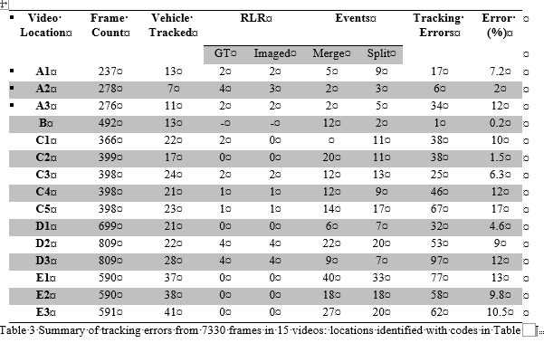
Results
Many people use tables here
  List experimental values
but
Add comments too!

Slide 13
Results
☺ You all know how to do this!
Many people use tables here
  List experimental values

Slide 14
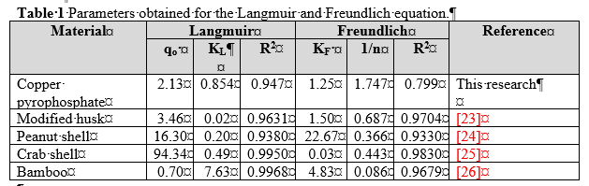
Results
Very simple here,
Just reference number
Add annotations to tables
Saves many words!
Extend this idea
Phrases
with no grammar

Slide 15
TABLES are YOUR FRIENDS
Very colloquial
Do NOT write in your paper
In presentation is OK
Do’s and Don’t s

Slide 16
DO NOT ….
Repeat results in your table in text
  Table saves text
  Reviewers do not want to read it
  Readers are bored by it
  Editors want you to save space!
Use excessive colours to highlight results
  Remember ..
  Paper may be printed in monochrome
  Colours emphasizing key conditions appear well on your screen
  but
  may be lost in the journal version in black and white

Slide 17

DO NOT ….
Excess digits are just noise!
Reviewers or editors can order
realism
Delay in your paper for corrections
Add excessive, unrealistic accuracy
  Same advice from presentations message
  Remember the half the least significant digit rule
  Writing 4.9654 mg/L implies 4.9654 ± 0.00005 mg/L
  or accuracy of ±0.001% !!
  Clearly unrealistic in your lab
  ±1% is more realistic
  Write 4.97 mg/L
Standard deviation and value don’t match
  4.9654 mg/L (σ = 0.04 mg/L)
  If σ = 0.04, reasonable value in table is 4.97 mg/L

Slide 18

DO NOT ….
Excess digits are just noise!
Reviewers or editors can order
realism
Delay in your paper for corrections
Add excessive digits to standard deviations
  σ is an estimate of the error
  Generally only 1 significant digit - σ = 0.06
  Writing σ = 0.06342 is just silly
  If σ is close to one, 2 digits are OK
    σ = 1. 2

Slide 19
DO ….
Highlight key results in text
  Table 4 shows that yield reached a maximum at 6m/s flow.
  Bold this value in text
Highlight poor results too
  There are always some bad conditions
  Maybe: Use one level of grey to highlight that
  Conditions in grey in Table 4 show that pressure below 2 Pa did not provide enough reagent to fill the sponge pores well.
Describe trends in text – not individual numbers
From Table 4, we see that yield increased until the methanol boiled (65°C).

Slide 20
DO ….
Add symbols to flag
  Good, weak, rising, decreasing, unbelievable, …
   or ☑ ☒ ⬆ ⬇ ??
  Table 4 shows that yield reached a maximum at 6m/s flow.
  Bold this value in text
Add comments
  Phrases only needed
  Avoid sentences and grammar stress

Slide 21
CONCLUSIONS, ABSTRACTS?
Table is …

Slide 22
Tables Everywhere
Conclusions
Scenario
  Your paper studied effectiveness of catalysts to remove dyes from wastewater
  Several experiments to measure
    % removal
    Recovery %
    Cost
    Ease of preparation
    Consistency of preparation
    ..
  Scattered in different sections throughout the paper
  Conclude in tradeoff table

Slide 23
Table in Conclusion
Conclusion
We assessed several catalysts for effectiveness in dye removal. The trade-offs are summarized in the table:
Overall, Zeolite AC45 appeared to present the best compromise over most factors, but the optimum will be affected by external factors.
Catalyst | Efficiency | Comment
Zeolite B6X | 99% | Expensive
Fly ash | 98% | Inconsistent quality
Calcined egg shell | 95% | Cheapest, supply irregular
Zeolite AC45 | 94% | Medium cost
…
…

Slide 24
Abstract too?
Possible
Key criteria
  Conciseness
  Efficient presentation
    You want high information density in abstract
    Increase usefulness
    Citation probability
    ..
but
Journals, editors, publishers, …
  Rules
  Aesthetics
  Custom
  Conservatism
  …
Factors not related
to efficient presentation!

Slide 25
Abstract too?
Possible
Key criteria
  Conciseness
  Efficient presentation
    You want high information density in abstract
    Increase usefulness
    Citation probability
    ..
but
Journals, editors, publishers, …
  Rules
  Aesthetics
  Custom
  Conservatism
  …
If you think it is appropriate,
TRY
Don’t be afraid!
Editor will NOT REJECT your paper ..
but you will be told to modify it!
If the data is all there,
Modifying format is quick
If necessary, bribe your nearest friendly
native speaker to help!!
Factors not related
to efficient presentation!

Slide 26
Abstract too?
Possible
Key criteria
  Conciseness
  Efficient presentation
    You want high information density in abstract
    Increase usefulness
    Citation probability
    ..
but
Journals, editors, publishers, …
  Rules
  Aesthetics
  Custom
  Conservatism
  …
If you think it is appropriate,
TRY
Don’t be afraid!
Editor will NOT REJECT your paper ..
but you will be told to modify it!
Note: Western customs
Suitable bribes
Wine, beer, ..
Chocolate, other addiction food
Small souvenirs from your home town
Almost anything edible
Money
  Schools have boring rules
  Western custom – don’t offer money
If the data is all there,
Modifying format is quick
If necessary, bribe your nearest friendly
native speaker to help!!
Factors not related
to efficient presentation!

Slide 27
100% TABLES?
How much can I put in tables?

Slide 28
My paper is just one large table?
Will the editor accept it?
100% ? Probably not
but
A lot ….
Example
  One of our KMITL colleagues wrote a significant paper
    More than 10 pages
  Most of the paper is one long table
  Referees added some comments ..
  but none about the tables!
  Paper under still under review
    Link will be added once the paper is accepted

Slide 29
Less Stress …… on your grammar
Consider putting
  Lists of
    Past work
    Materials
    Equipment
    Methods
    Steps in procedures
    Results
    Summaries
Tables
  Fewer English sentences
    Comments as simple phrases only
  Finish your paper faster

Slide 30
TABLES
Another use

Slide 31
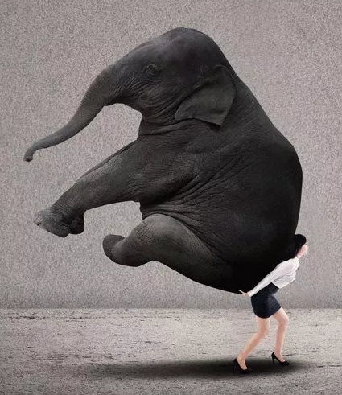
Another use for tables
Hint for Word users
LaTeX users also
Put LaTeX users will find this ‘normal’
Adding a set of images to your paper
You want to put 2 rows of 3 figures
Sub figure labels are (a), (b), (c), … , (f)
Caption for whole figure
Trying to line everything up with Word is like this ⇒
Use a table!
Columns: 3
Rows: 2 x 2 + 1 = 5
  2 rows – figures
  2 rows – captions (a), (b), …
  1 row – full caption:
  Figure 3: SEM images

Slide 32
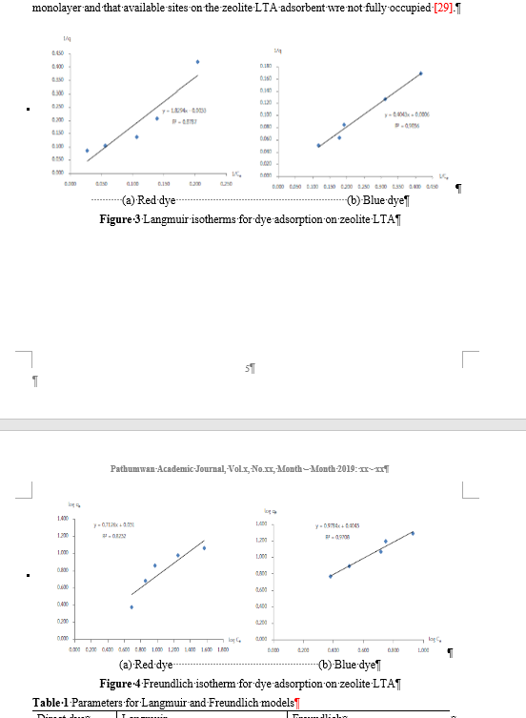
Another use for tables
First attempt with Word
4 figures over 2 columns
Overall caption
Sub figure labels are (a), (b), (c), … , (f)
Caption for whole figure
First problem
  Word split figures over 2 pages
Make a table
Columns: 2
Rows: 2 × 2 + 2 = 6
  2 rows – figures
  2 rows – captions (a), (b), …
  2 rows – group caption:
  Figure 3: SEM images
Page break here

Slide 33
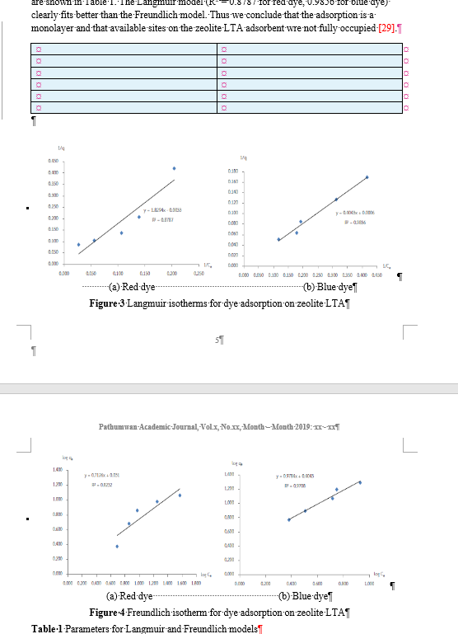
Another use for tables
Make a table
Columns: 2
Rows: 2 × 2 + 2 = 6
  2 rows – figures
  2 rows – captions (a), (b), …
  2 rows – group caption
Copy figures to rows 1 and 4
Empty 6 row x 2 col table

Slide 34
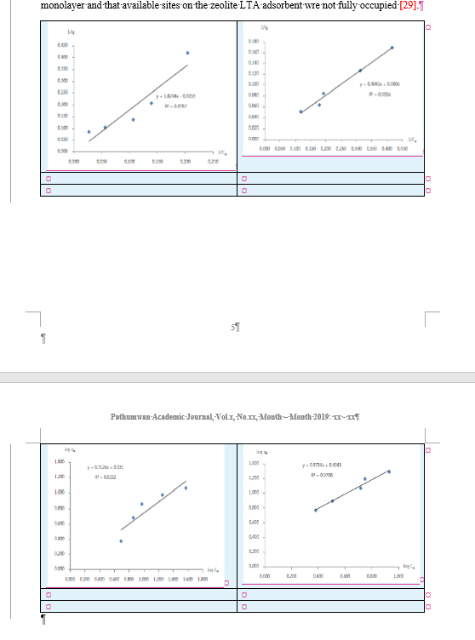
Another use for tables
Figures in rows 1 and 4
Make a table
Columns: 2
Rows: 2 × 2 + 2 = 6
  2 rows – figures
  2 rows – captions (a), (b), …
  2 rows – group caption
Copy figures to rows 1 and 4
Resize figures in table cells, if needed
Copy captions to cells
of rows 2 and 5
Row 1
Row 4

Slide 35
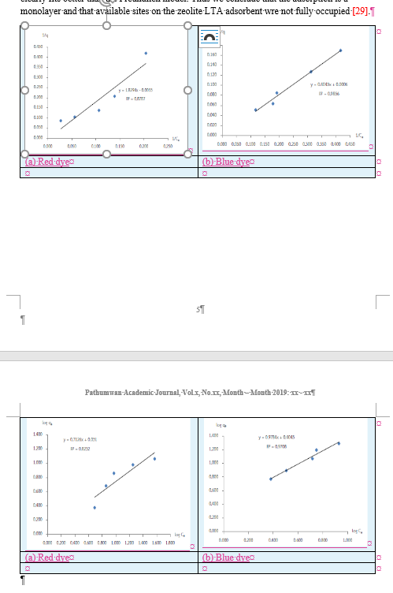
Another use for tables
Figures in rows 1 and 4
Make a table
Columns: 2
Rows: 2 × 2 + 2 = 6
  2 rows – figures
  2 rows – captions (a), (b), …
  2 rows – group caption
Copy figures to rows 1 and 4
Resize figures in table cells, if needed
Copy captions to cells
of rows 2 and 5
Merge cells in rows 3 and 6
Copy captions to merged cells
Row 2
Row 5

Slide 36
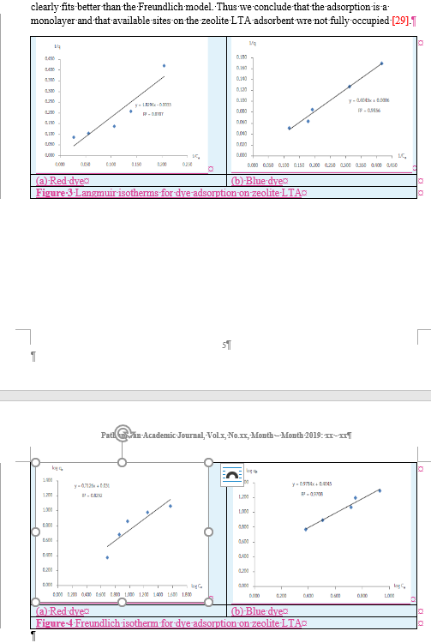
Another use for tables
Figures in rows 1 and 4
Make a table
Columns: 2
Rows: 2 × 2 + 2 = 6
  2 rows – figures
  2 rows – captions (a), (b), …
  2 rows – group caption
Copy figures to rows 1 and 4
Resize figures in table cells, if needed
Copy captions to cells
of rows 2 and 5
Merge cells in rows 3 and 6
Copy captions to merged cells
Centre everything ..
Select whole table and centre
Row 3
Row 6

Slide 37
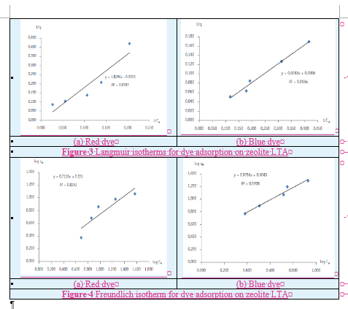
Another use for tables
This technique ⇒ better result
than adding spaces to center
captions
Make a table
Columns: 2
Rows: 2 × 2 + 2 = 6
  2 rows – figures
  2 rows – captions (a), (b), …
  2 rows – group caption
Copy figures to rows 1 and 4
Resize figures in table cells, if needed
Copy captions to cells
of rows 2 and 5
Merge cells in rows 3 and 6
Copy captions to merged cells
Centre everything ..
Select whole table and centre
Finally, use Paragraph,
Keep with next
Keeps everything together on one page

Slide 38
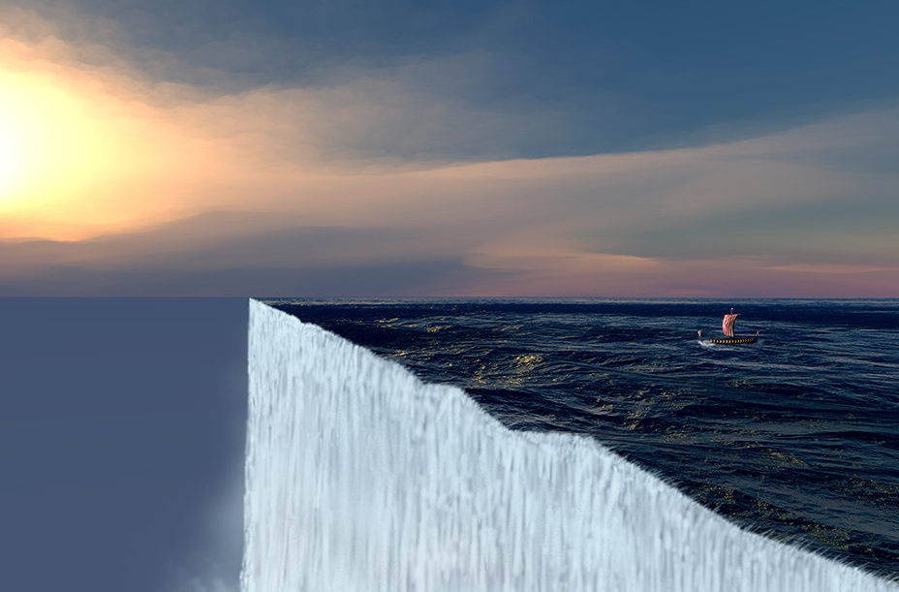
Popular
KISS: Ch 9.4, p 29
Popular is a bad word to support scientific work
History shows that many ‘popular’ theories were wrong
A popular idea until ~1500
  The world is flat,
  therefore you will fall off the edge
Although Pythagoras had good evidence
for a round earth in ~500BC
‘Popular’ in science is dangerous!!
Do not write
The popular approach is to …
You may regret this in 10 years
Safer ….
We followed the approach [ref] …
You understand that ‘popular’ may be wrong!
Popular
⇒ you believe it too!

